Slide 1
Microplastics in the Environment
Baoshan Xing
Stockbridge School of Agriculture
2023 SNEC WINTER CONFERENCE
March 30, 2023

Slide 2
Presentation Overview
I. Introduction
Occurrence of microplastics in the environment
Environmental behavior of microplastics
Toxicity of microplastics
V. Exposure and risk of microplastics to human health

Slide 3
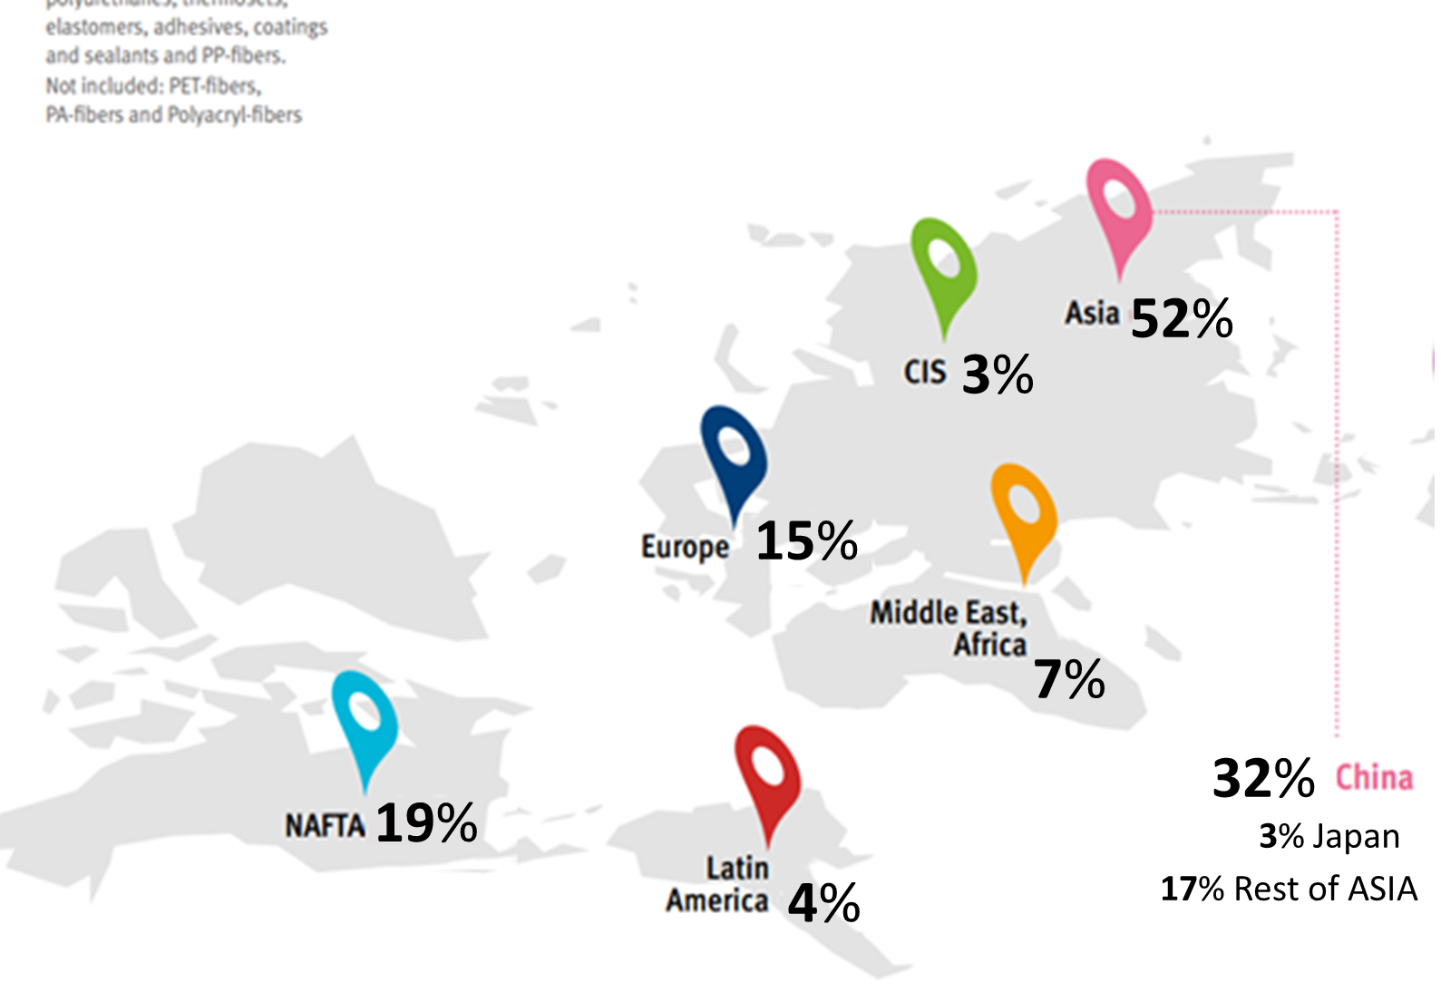
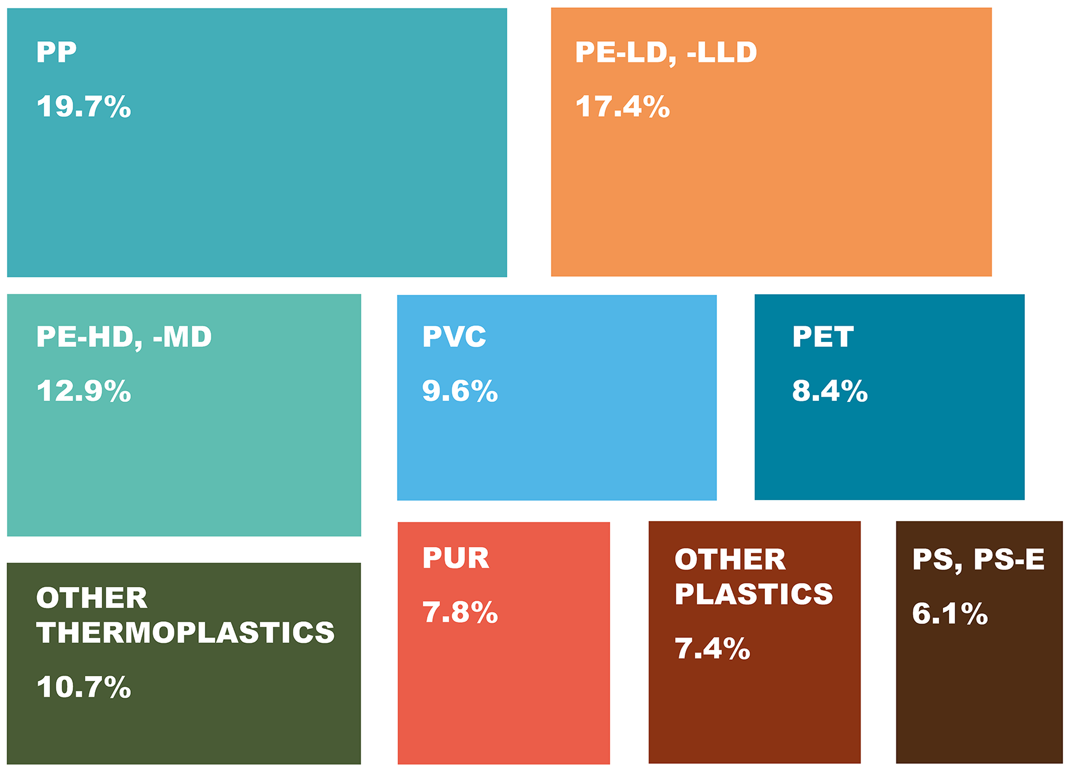
I. Introduction
Global plastics production
Distribution of global plastics production
Plastics demand distribution by type
2009 2020
227 MT/year 367 MT/year
MT (million tons)
Plastic Europe, 2021
Plastics annual production increases rapidly, and China has the highest production
The biggest plastics demand type is polyethylene (PE) in Europe
Notes:
Update：the data and images for distribution of global plastics production and plastics demand distribution by type
NAFTA: North American Free Trade Agreement，which was enacted in 1994 and created a free trade zone for Mexico, Canada, and the United States
CIS: Commonwealth of Independent States，which was a regional intergovernmental organization of nine members （Russian Federation，Belarus，Moldova，Armenia，Azerbaijan，Tajikistan，Kyrgyzstan，Kazakhstan，Uzbekistan）
update

Slide 4
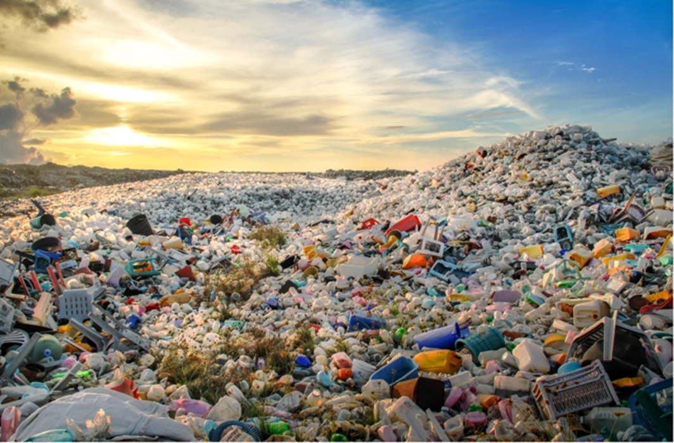
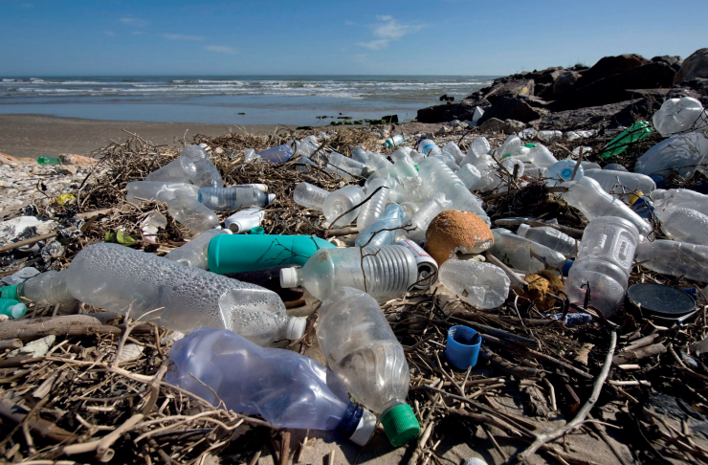
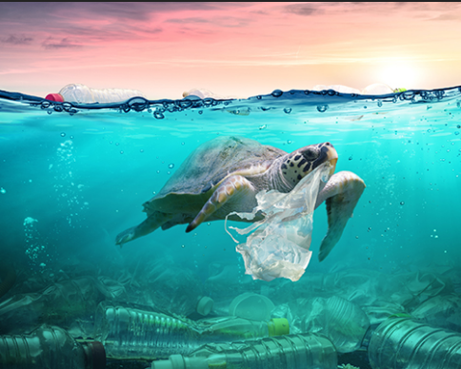
Plastics pollution: one of the world’s greatest environmental problems
Total plastics waste
Release into ocean
Pose threat to marine animals
Editors, Nat. Commun., 2018; Wang et al., Sci. Adv., 2018
Silva et al., Chem. Eng. J., 2021; Cressey, Nature, 2016
OceansAsia, 2020
8.37 billion tons of accumulated plastic waste in the world (1950-2019)
4-12 million tons/year in ocean
Killing 100,000/year marine mammals and turtles
Huge amounts of plastics waste enter oceans and pose serious threats to marine ecosystems
On March 2, 2022, a resolution was endorsed at the UN Environment Assembly (UNEA-5) to end plastic pollution and forge an international legally binding agreement by 2024
Notes:
Cressey, D. (2016). The Plastic Ocean. Scientists know that there is a colossal amount of plastics in the oceans. But they don’t know where it all is, what it looks like or what damage it does. Nature, 536, 263-265.
Cornwall, W. (2021). The plastic eaters.

Slide 5
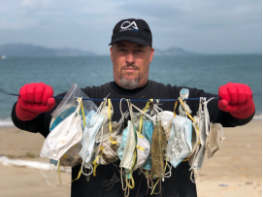
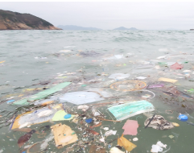
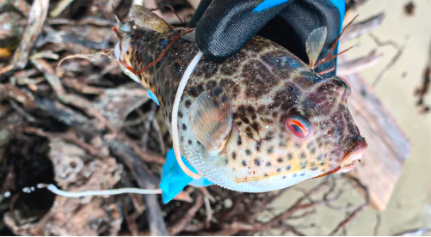
The impact of COVID-19 on marine plastics pollution
Masks on the beach
Masks could be released into oceans
Pose risk to marine animals
1.56 billion in 2020
OceansAsia, 2020
OceansAsia, 2020
Fadare et al., Sci. Total Environ., 2020
As a result of the COVID-19 pandemic, the number of masks (1.56 billion in 2020) entering the ocean is staggering; about 400-500 years are needed to degrade these masks in the environment
Disposable masks pose serious threat to marine organisms
Notes:
Newly added: pose risk to marine animals (the third picture)

Slide 6
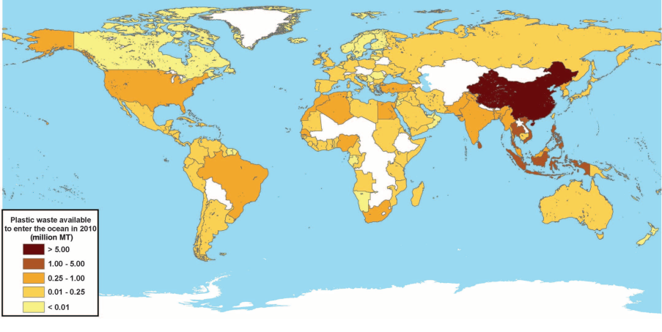
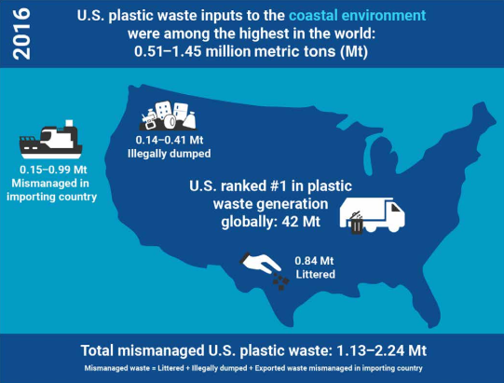
Plastics pollution is a global issue
Plastic waste inputs from land into the ocean
Contribution of plastic waste by U.S.
In 2010, global plastic waste in the ocean: 4.8-12.7 MT
Jambeck et al., Science, 2015
Law et al., Sci. Adv., 2020
Plastics waste input to the ocean, and China contributed the largest in the world in 2010 (one year)
The United States’ contribution was the highest in the world after accounting for illegally dumped and exported waste in 2016 (one year)
Notes:
Data in the right picture were U.S. plastic waste in 2016 (one year)
Jambeck, J. R., Geyer, R., Wilcox, C., Siegler, T. R., Perryman, M., Andrady, A., ... & Law, K. L. (2015). Plastic waste inputs from land into the ocean. Science, 347(6223), 768-771.
Law, K. L., Starr, N., Siegler, T. R., Jambeck, J. R., Mallos, N. J., & Leonard, G. H. (2020). The United States’ contribution of plastic waste to land and ocean. Science advances, 6(44), eabd0288.

Slide 7
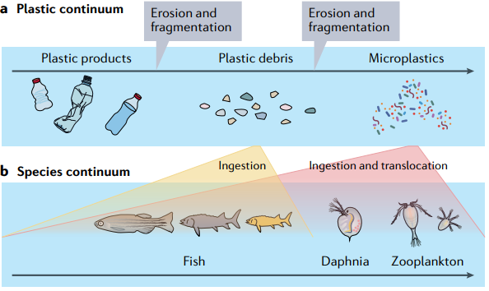
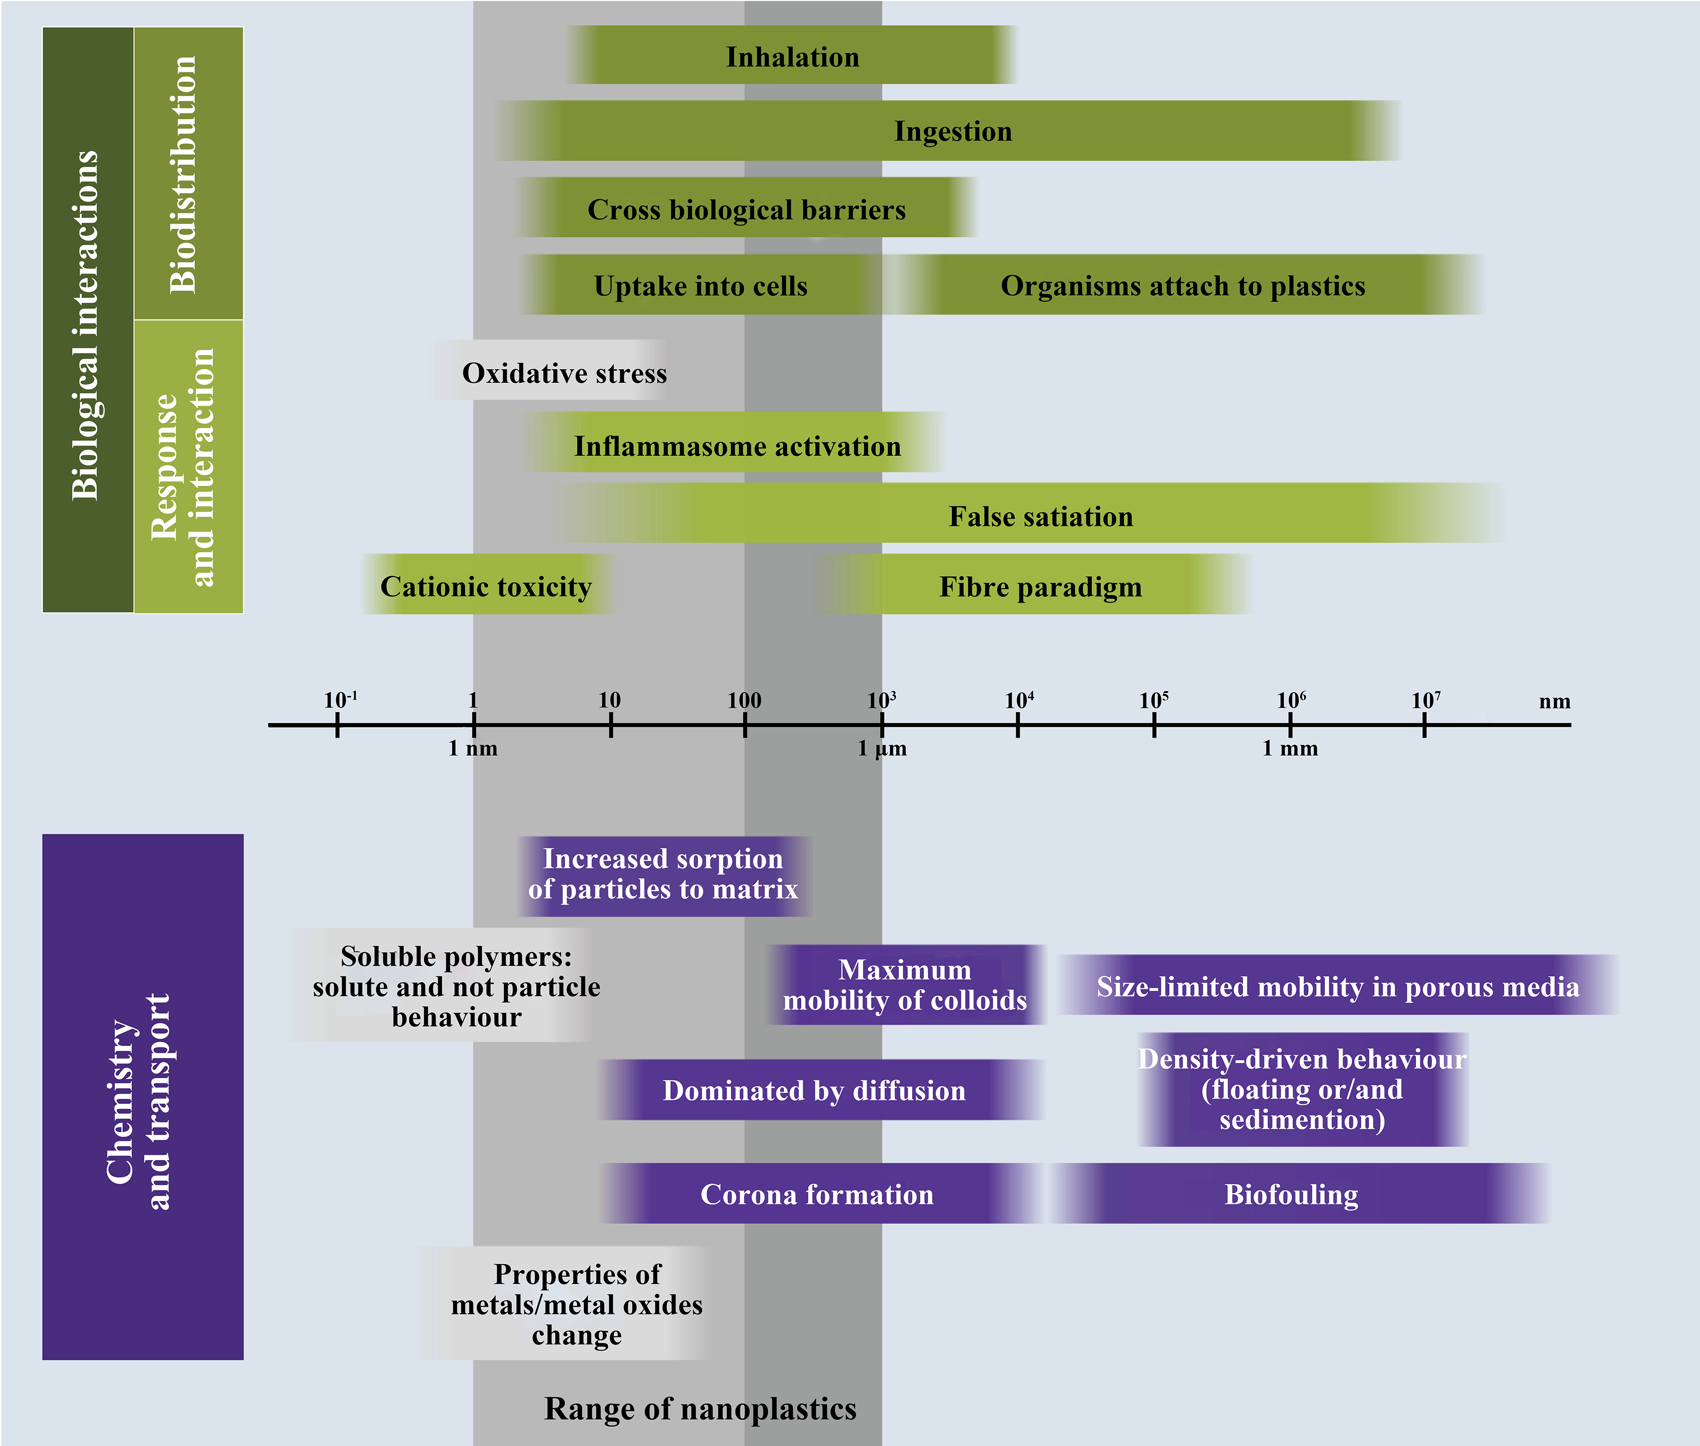
Small plastics should be better understood
Effect of particle size on the biological interactions and transport of plastic wastes
Interactions of plastics with organisms
Koelmans et al. , Nat. Rev. Mater., 2021
Mitrano et al., Nat. Nanotechnol., 2021
Small plastics are more bioavailable and may trigger interactions with a variety of species, leading to more ecological risk
Small plastics are highly polydisperse in physical properties and heterogeneous in composition, leading to longer transport distance in the environment
Notes:
Koelmans, A. A., Redondo-Hasselerharm, P. E., Nor, N. H. M., de Ruijter, V. N., Mintenig, S. M., & Kooi, M. (2022). Risk assessment of microplastic particles. Nature Reviews Materials, 1-15.
Mitrano, D. M., Wick, P., & Nowack, B. (2021). Placing nanoplastics in the context of global plastic pollution. Nature nanotechnology, 16(5), 491-500.

Slide 8
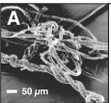
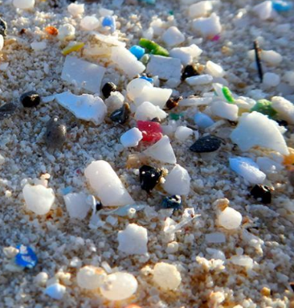
What are microplastics?
100 nm
Nanoplastics
(NPs)
1 μm
Microplastics
(MPs)
5 mm
Macroplastics
Macroplastics produce microplastics and nanoplastics
Wagner et al., Nat. Nanotechnol., 2019
Thompson et al., Science, 2004
In 2004, the term “microplastics” was first used
In 2008, microplastics were defined as particles less than 5 mm in size
Definition of nanoplastics is still under debate: 1-1000 nm vs. 1-100 nm

Slide 9
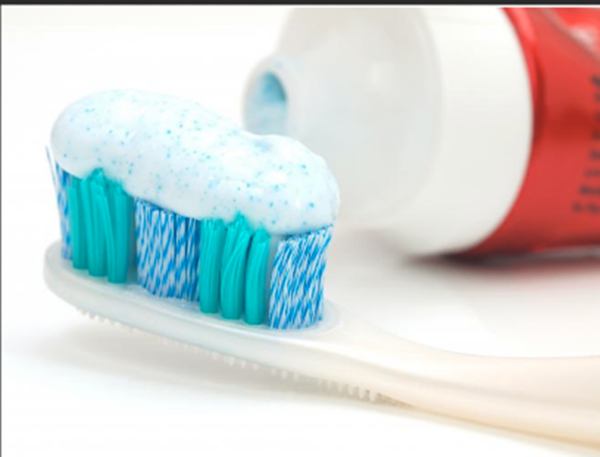
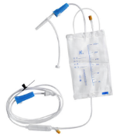
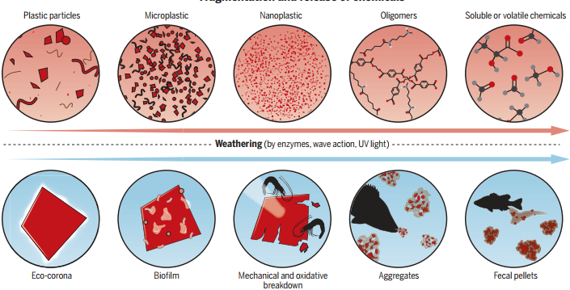
How are microplastics generated?
Primary microplastics
Facial-cleansers and cosmetics
Vectors for drugs
Virgin plastics production pellets
DeFrancesco et al., Nat. Biotechnol., 2020
Secondary microplastics
Physical (e.g., wind, wave)
Chemical (e.g., UV)
Biological (e.g., microorganisms)
MacLeod et al., Science, 2021
Notes:
DeFrancesco, L. (2020). Closing the recycling circle. Nature biotechnology, 38(6), 665-668.
MacLeod, M., Arp, H. P. H., Tekman, M. B., & Jahnke, A. (2021). The global threat from plastic pollution. Science, 373(6550), 61-65.

Slide 10
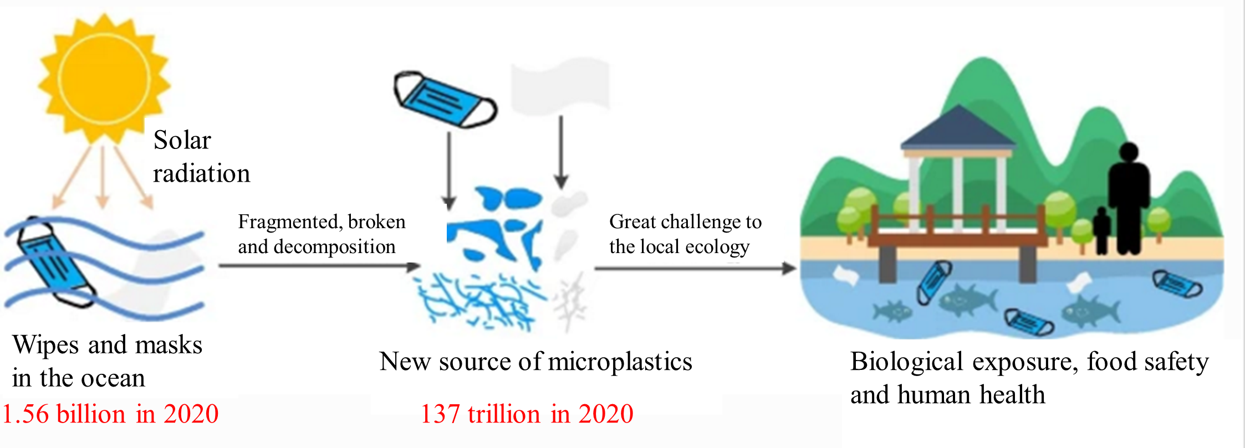
Surgical masks: a new source of microplastics
Fate and behaviors of discarded surgical masks in the environment
Hu et al., Environ. Sci. Pollut. Res., 2022; Sun et al., Environ. Sci. Technol. Lett., 2021
Disposable surgical masks lead to the increase of microplastics (137 trillion in 2020) in the marine environment through degradation and fragmentation
Disposable surgical masks are becoming a new source of microplastics in the marine environment
Notes:
Xu, E. G., & Ren, Z. J. (2021). Preventing masks from becoming the next plastic problem. Frontiers of environmental science & engineering, 15(6).

Slide 11
Concerns are raised about the microplastics in the environment
The following issues are addressed in this presentation:
What are the distribution and environmental behavior of microplastics in the environment?
What are the toxicological mechanisms of microplastics, and the role of eco-corona/biofilm?
How do microplastics pose risk to human health?

Slide 12
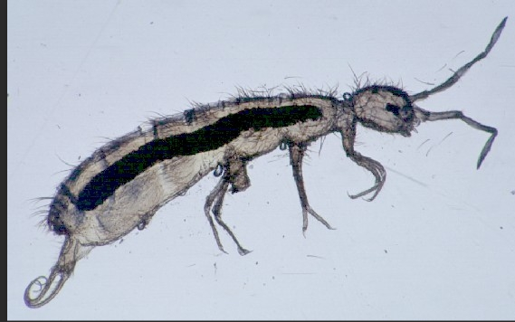
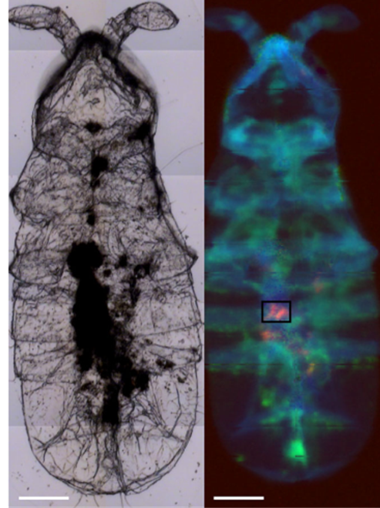
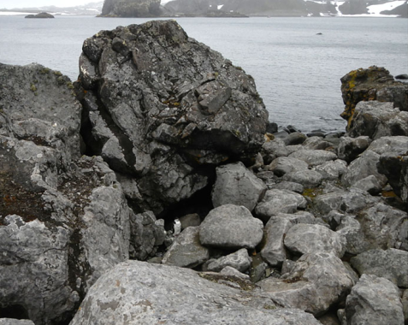
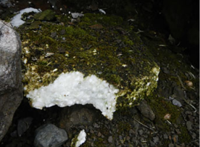
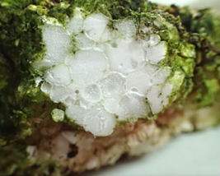
II. Distribution of microplastics
Microplastics contaminate the most remote regions
Microplastics in Antarctic Pole
Antarctic collembolans
Coastal fellfield at King George Island
PS foam
PS foam
PS
PS
Bergami et al., Biol. Lett., 2020
Microplastics were detected in the Antarctic terrestrial environment and Antarctic collembolans, and the detected type was polystyrene (PS) foam
Notes:
In the right figure, the insect is Antarctic collembolans (Cryptopygus antarcticus).
Bergami, E., Rota, E., Caruso, T., Birarda, G., Vaccari, L., & Corsi, I. (2020). Plastics everywhere: first evidence of polystyrene fragments inside the common Antarctic collembolan Cryptopygus antarcticus. Biology letters, 16(6), 20200093.

Slide 13
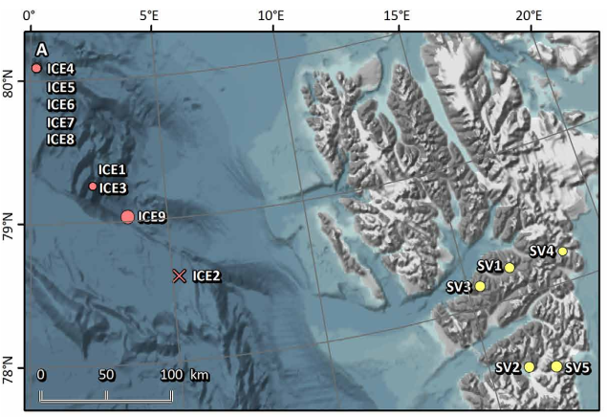
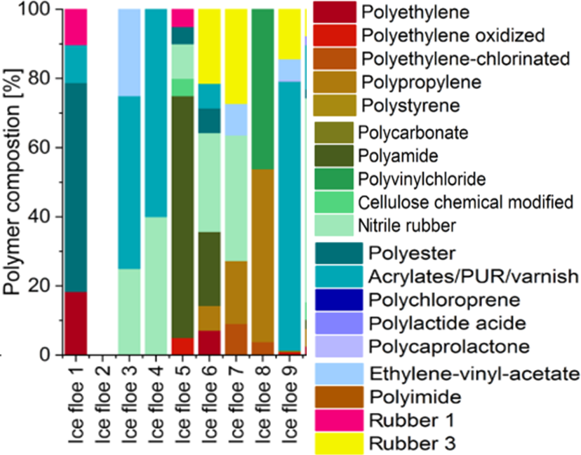
Microplastics in the Arctic Pole
Map of sampling locations for snow
Relative composition of microplastics
Arctic snow
0 - 14.4 × 10³ particles/L
Bergmann et al., Sci. Adv., 2019
The size of microplastics detected in Arctic ranged 11-475 μm, and the highest concentration in snow was 14.4 × 10³ particles/L
PS, polyvinyl chloride (PVC), polycarbonate (PC), polylactic acid (PLA), and polyimide (PI) occurred exclusively in Arctic snow
Notes:
Bergmann, M., Mützel, S., Primpke, S., Tekman, M. B., Trachsel, J., & Gerdts, G. (2019). White and wonderful? Microplastics prevail in snow from the Alps to the Arctic. Science Advances, 5(8), eaax1157.
(80% of microplastics ≤ 25 μm; 98% < 100 μm)

Slide 14
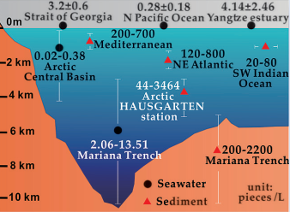
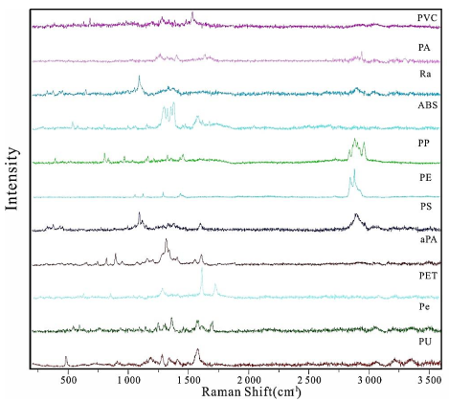
Microplastics in the deepest part of the world’s ocean
Microplastics in Mariana Trench
Raman spectra analysis
Polyamide
Rayon
Acrylonitrile butadiene styrene
Aromatic polyamide
Polyester
Polyurethane
Depth: 6,000-11,000 m
Peng et al., Geochem. Persp. Let., 2018
Microplastics abundances in hadal sediments (200-2,200 particles/L) were higher than those in hadal bottom seawaters (2.06-13.51 particles/L)
Eleven different microplastic types were identified from the Mariana, and the length of microplastics in seawater (1-3 mm) was longer than those in sediment (0.1-0.5 mm)
Notes:
Peng, X., Chen, M., Chen, S., Dasgupta, S., Xu, H., Ta, K., ... & Bai, S. (2018). Microplastics contaminate the deepest part of the world’s ocean. Geochemical Perspectives Letters, 9(1), 1-5.

Slide 15
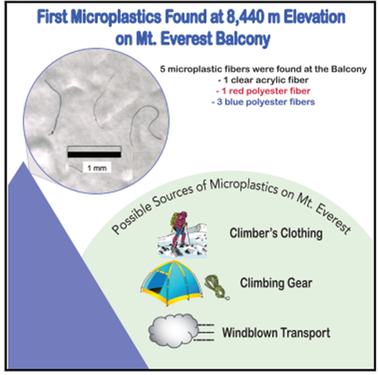
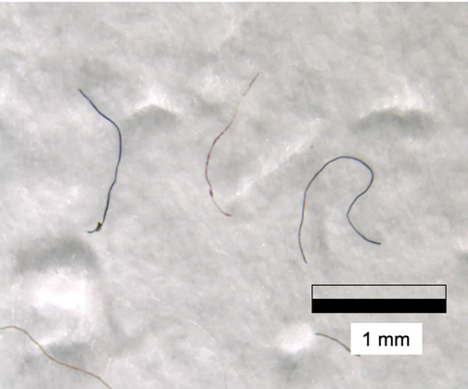
Microplastics on Mount Everest
Mt. Everest microplastics fibers
Napper et al., One Earth, 2020
Five microplastics fibers were found at the Balcony (8,440 m), including 1 clear acrylic fiber, 1 red polyester fiber and 3 blue polyester fibers, probably released from climber’s clothing and climbing gear
Notes:
Napper, I. E., Davies, B. F., Clifford, H., Elvin, S., Koldewey, H. J., Mayewski, P. A., ... & Thompson, R. C. (2020). Reaching new heights in plastic pollution—preliminary findings of microplastics on Mount Everest. One Earth, 3(5), 621-630.

Slide 16
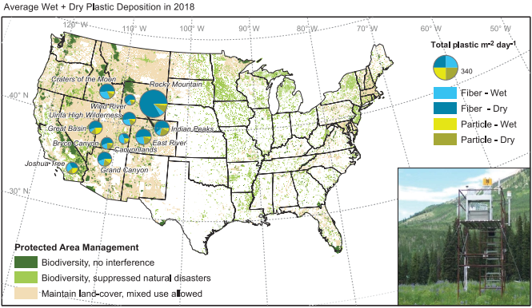
Microplastics deposition in remote U.S. conservation areas
Microplastics deposition in 11 National parks and wilderness areas in U.S.
Microplastics were distributed in U.S. protected areas (98% of atmospheric samples)
Microfibers (20 μm-3 mm) made up most of the synthetic material
Urban centers and resuspension from soils or water are principal sources for wet-deposited microplastics
Long-range or global transport leads to the smaller size of microplastics under dry conditions
Deposition rate:
132 particles/m²/day
Brahney et al., Science, 2020
Notes:
Protected areas base map is from the United States Geological Survey (USGS) Protected Areas Database (PAD)
Biodiversity orders: dark green > light green > brown.
Brahney, J., Hallerud, M., Heim, E., Hahnenberger, M., & Sukumaran, S. (2020). Plastic rain in protected areas of the United States. Science, 368(6496), 1257-1260.
Microfibers made up most of the synthetic material found in both wet (66%) and dry (70%) deposition, and fiber sizes were about 20 um-3 mm, with average widths and depths of 18 and 6 mm, respectively
https://www.usgs.gov/core-science-systems/science-analytics-and-synthesis/gap/science/introduction-pad-us-viewer?qt-science_center_objects=0#qt-science_center_objects

Slide 17
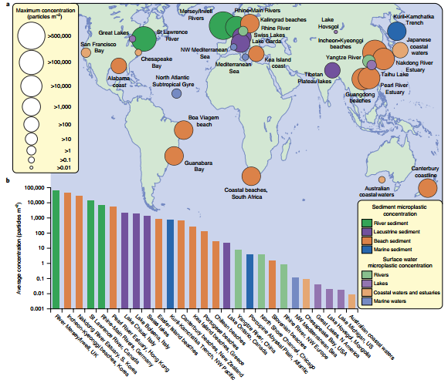
Distribution of microplastics in the environment
Microplastics in the surface water and sediments of the world
River Tame
The highest concentration (~517,000 particles/m²) was in the sediments of River Tame, UK
The top 9 ranked hotspots were located within the world’s most populous urban environments, such as Seoul, Hong Kong, and Guangdong
Hurley et al., Nat. Geosci., 2019
2015
The first global microplastics map
Notes:
Hurley, R., Woodward, J., & Rothwell, J. J. (2018). Microplastic contamination of river beds significantly reduced by catchment-wide flooding. Nature Geoscience, 11(4), 251-257.

Slide 18
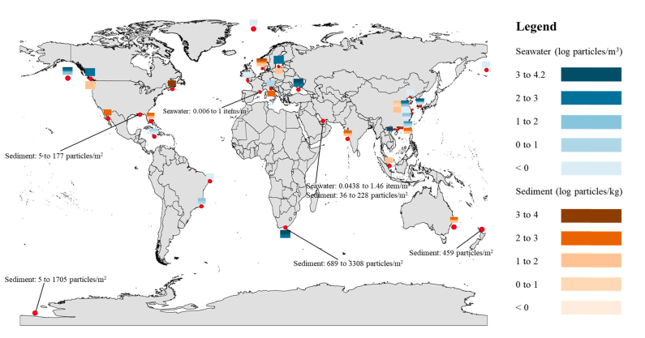
Microplastics in marine environments (seawater and sediment)
Highest concertation
Seawater: 15,560 particles/m³ in Korea
Sediments: 2,000–8,000 particles/kg in Canada;
689-3,308 particles/m² in South Africa
Korea
15,560 particles/m³
South Africa
Wang et al., J. Hazard. Mater., 2021
Microplastics are found in oceans all over the world, and the concentrations in seawater and sediments could vary by 4 orders of magnitude
Microplastics pollution in seawater or sediment is very severe in some areas (e.g., China, Canada, Korea)
Notes:
Wang, C., Zhao, J., & Xing, B. (2020). Environmental Source, Fate, and Toxicity of Microplastics. Journal of Hazardous Materials, 124357.
对于沉积物中塑料的最高浓度,由于单位不统一，其中一个是2000-8000 particles/kg in Canada，the other was 689-3308 particles/m2

Slide 19
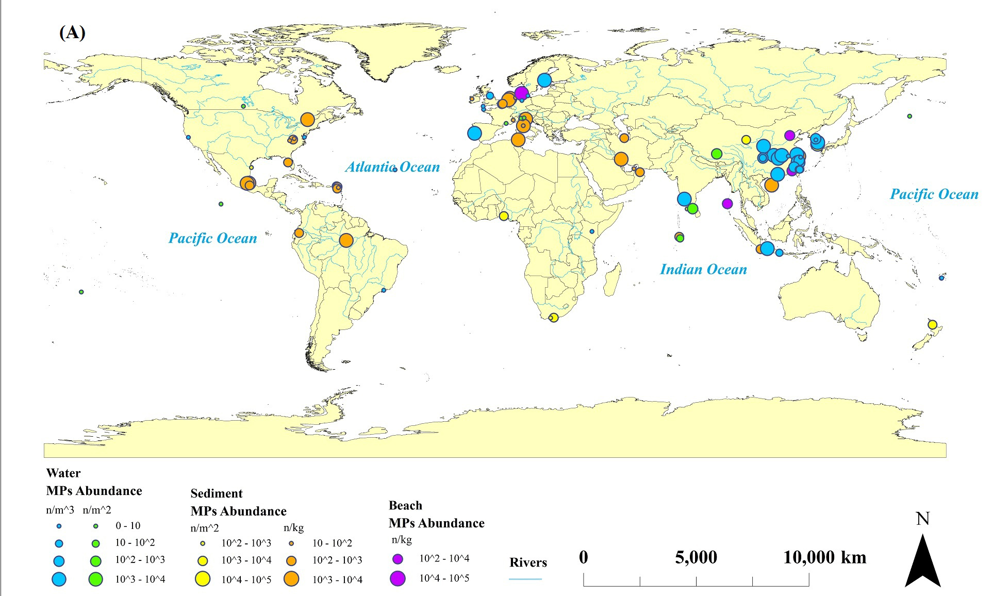
Microplastics in inland water, sediments, and beaches
Highest concertation
Inland water: Yangtze River basin
500 to 3,100 particles/m³ (middle-lower )
1,597 to 12,611 particles/m³ (Three Gorges Reservoir)
7,960±6,840 particles/kg
Tunisia
Beach: 285,673 particles/m² in South Korea
Inland sediments: 7,960±6,840 particles/kg in Tunisia
Wang et al., Environ. Sci. Technol., 2021
The highest microplastics concentration in lake sediments and inland waters located in Tunisia and Yangtze River, respectively
Microplastics concentration in inland water, sediments and beaches could vary by 4, 4, 5 orders of magnitude, respectively

Slide 20
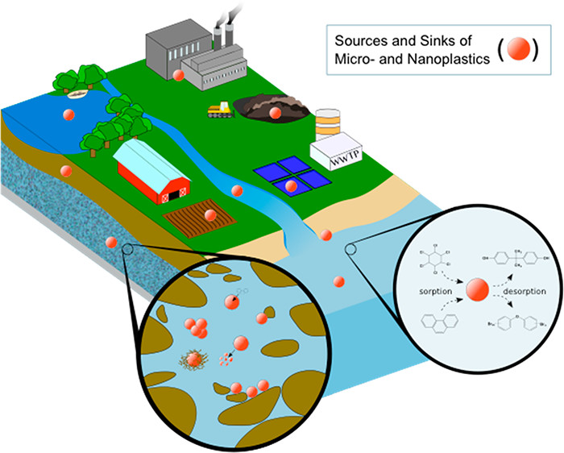
III. Environmental behavior of microplastics
Environmental processes in aquatic environment
Adsorption/desorption
?
Aggregation/dispersion
Degradation/aging
Olubukola et al., Environ. Sci. Technol., 2018
Adsorption/desorption, aggregation/dispersion and transformation (degradation/aging) are the most important environmental processes of microplastics
Aggregation behavior would greatly change the transport of microplastics
Degradation affects aggregation and adsorption ability of microplastics
Notes:
Alimi, O. S., Farner Budarz, J., Hernandez, L. M., & Tufenkji, N. (2018). Microplastics and nanoplastics in aquatic environments: aggregation, deposition, and enhanced contaminant transport. Environmental science & technology, 52(4), 1704-1724.

Slide 21
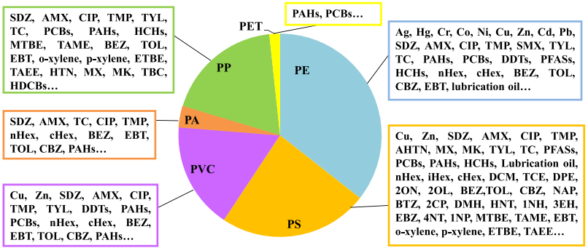
Adsorption behavior of microplastic in the environment
Current research on adsorption of pollutants by microplastics
Types of pollutants
Organic pollutants
Heavy metals
Guo and Wang,
Mar. Pollut. Bull., 2019
The most frequently-studied microplastics are PE, PS, PVC, and PP
At room temperature, PE being vert rubbery showed higher adsorption capacities for organic pollutants than PS and PVC (glassy state), due to the contribution of partitioning
Microplastics properties (e.g., molecular structure, specific surface areas, crystallinity, and polarity) could influence the adsorption
Notes:
Polymers whose Tg is below ambient temperature are called rubbery polymers (e.g., PE), while those with Tg above ambient temperature are called glassy polymers (e.g.,poly(vinylchloride) (PVC) and polystyrene (PS)).Tg for PE, PS and PVC are (-120, 100, 81 ⁰C). Polymer molecules in a rubbery state are capable of segmental chain movements, whereas those in a glassy state are restricted to vibrational and short-range rotational motions
Guo, X., & Wang, J. (2019). The chemical behaviors of microplastics in marine environment: A review. Marine pollution bulletin, 142, 1-14.
PE exhibited the highest affinity for pyrene, followed by PS and PVC.

Slide 22
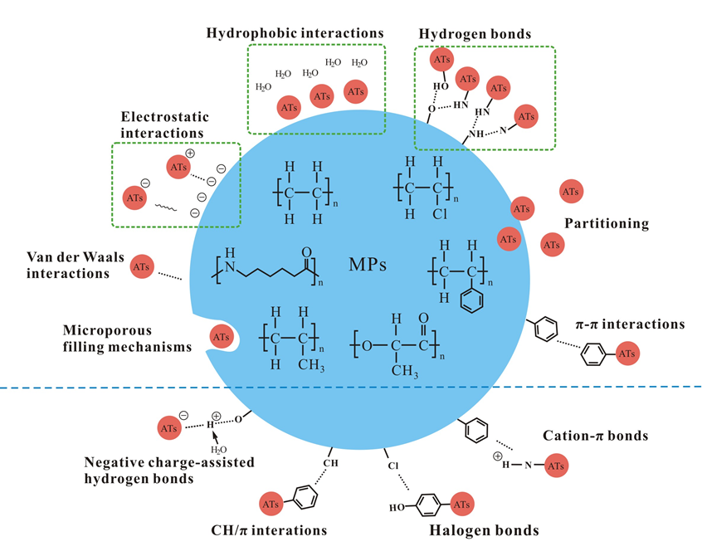
Adsorption mechanisms
Adsorption mechanisms of antibiotics on microplastics
Adsorption mechanisms
Hydrophobic interactions
Hydrogen-bonding interactions
Electrostatic interaction
Van der Waals
Partitioning
π-π interactions
Halogen bonds
Cation-π bonds
CH/π interactions
Negative charged-assisted hydrogen bonds
Main forces
Future studies can focus on these mechanisms
Wang et al., Environ. Sci. Technol., 2021
Hydrophobic interactions, hydrogen-bonding interactions and electrostatic interaction were confirmed as the important forces during microplastics adsorption antibiotics
Future studies can focus on the relative contributions of individual mechanisms during adsorption
Notes:
Wang, Y., Yang, Y., Liu, X., Zhao, J., Liu, R., & Xing, B. (2021). Interaction of Microplastics with Antibiotics in Aquatic Environment: Distribution, Adsorption, and Toxicity. Environmental Science & Technology, 55(23), 15579-15595.

Slide 23
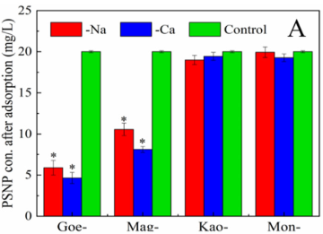
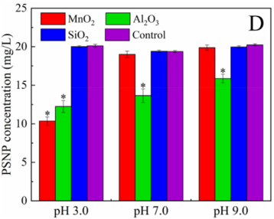
Aggregation of microplastic in the environment
Microplastics-mineral heteroaggregation
Interactions of PS nanoplastics with different kinds of minerals
pH 7.0
Zhang et al., Water Res., 2020
Positive charge (+): Goethite, magnetite, Al₂O₃; Negative charge (-): Kaolinite, montmorillonite, SiO₂, MnO₂
Heteroaggregates could form between microplastics and positively charged minerals due to electrostatic interaction
Goethite showed higher heteroaggregation with PS than magnetite, due to the formation of hydrogen bonding
Notes:
Zhang, Y., Luo, Y., Guo, X., Xia, T., Wang, T., Jia, H., & Zhu, L. (2020). Charge mediated interaction of polystyrene nanoplastic (PSNP) with minerals in aqueous phase. Water research, 178, 115861.

Slide 24
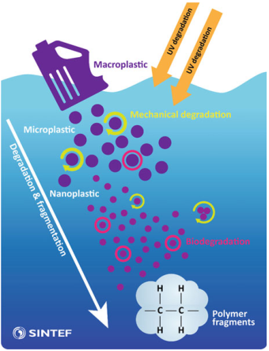
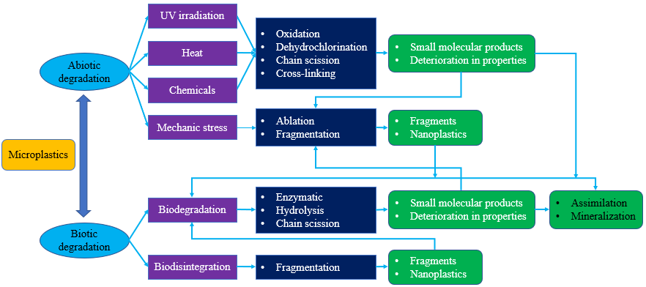
Aging/degradation of microplastics in the environment
Degradation processes and pathways of microplastics
Degradation processes
General processes involved in the degradation of microplastics
Mechanical degradation
Biodegradation
Modified from Zhang et al., Environ. Pollut., 2021
UV degradation is the most important process for microplastics transformation
Hydrolysable polymers (e.g., polyethylene terephthalate, PET) are more susceptible to biodegradation due to the presence of extracellular hydrolases in the organisms
Booth et al., Norwegian Environment Agency, 2018
Notes:
Barboza, L. G. A., Cózar, A., Gimenez, B. C., Barros, T. L., Kershaw, P. J., & Guilhermino, L. (2019). Macroplastics pollution in the marine environment. In World seas: An environmental evaluation (pp. 305-328). Academic Press.
Zhang, K., Hamidian, A. H., Tubić, A., Zhang, Y., Fang, J. K., Wu, C., & Lam, P. K. (2021). Understanding plastic degradation and microplastic formation in the environment: A review. Environmental Pollution, 116554.

Slide 25
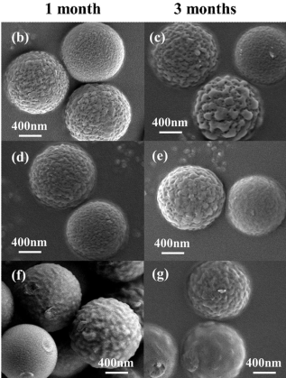
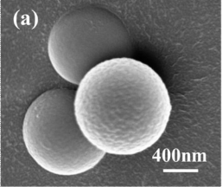
UV-induced microplastics degradation
PS microplastics under UV irradiation in air, pure water and seawater
Change on physicochemical properties of typical microplastics after aging
Surface becomes rough
Generates pores and debris
Crystallinity increases (PS, PE), decreases (PP)
Oxygen-containing functional groups (O/C, carbonyl index) increase
Hydrophilicity increases
Pristine PS
UV Air
UV Pure water
irregular
UV Seawater
debris
Degradation: air > seawater > pure water
Mao et al., J. Hazar. Mater., 2020
Microplastics degradation in air was much stronger than waters due to the higher utilization rate of UV light
The aging degree in seawater is higher than that pure water, but the specific mechanism was not investigated
Notes:
Mao, R., Lang, M., Yu, X., Wu, R., Yang, X., & Guo, X. (2020). Aging mechanism of microplastics with UV irradiation and its effects on the adsorption of heavy metals. Journal of hazardous materials, 393, 122515.

Slide 26
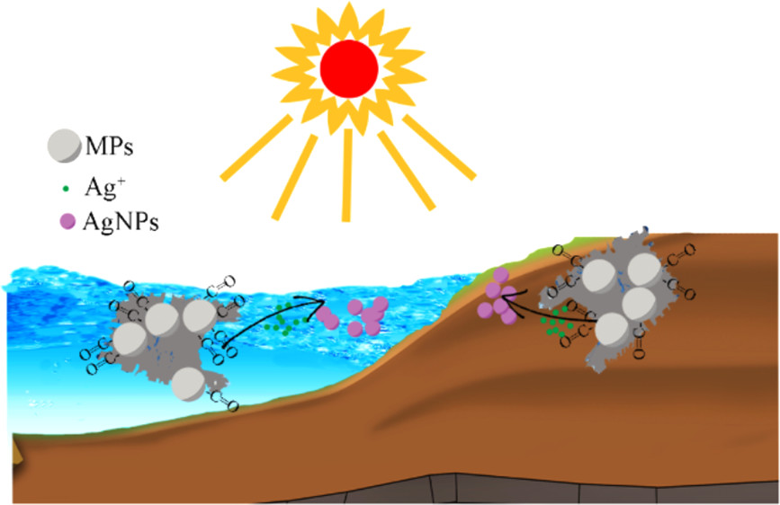
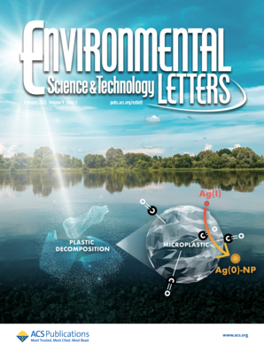
Weathered microplastics induce silver nanoparticle formation from Ag⁺
MPs
Ag⁺
AgNPs
Huang et al., Environ. Sci. Technol. Lett. 2022
Carbonyl groups including aldehydes on weathered PS act as a key determinant for Ag(I) reduction
This study points out a previously unrecognized pathway of natural Ag(0) nanoparticles formation
Notes:
Newly added

Slide 27
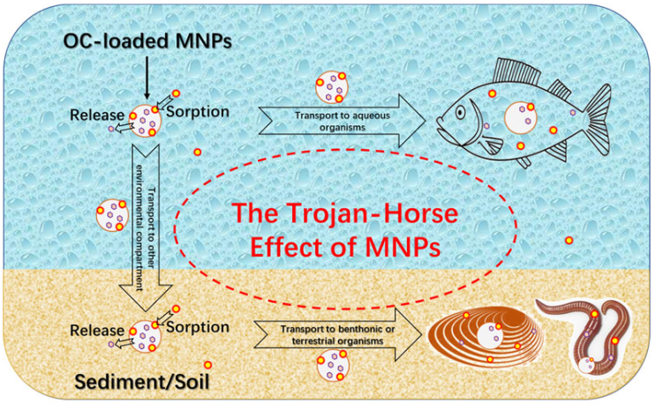
IV. Toxicity of microplastics
Uptake and toxicity of microplastics in organisms
Uptake？
Bioaccumulation
Microplastics
Toxicity？
Freshwater
Seawater
Bioaccumulation
Zhang et al., Crit. Rev. Environ. Sci. Technol., 2020
Microplastics could be taken up by terrestrial, freshwater and marine organisms, and exhibited toxicity
Notes:
Zhang, M., & Xu, L. (2020). Transport of micro-and nanoplastics in the environment: Trojan-Horse effect for organic contaminants. Critical Reviews in Environmental Science and Technology, 1-37.

Slide 28
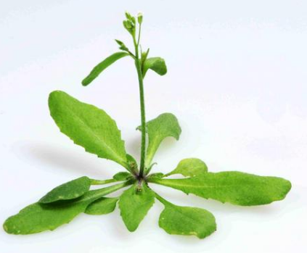
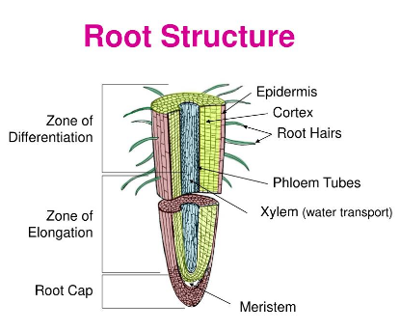
Uptake of microplastics in the terrestrial plants
PS nanoplastics accumulated in Arabidopsis thaliana
Maturation zone
Nanoplastics
Merged
Root tip
Nanoplastics
Merged
PS-COOH (red)
Arabidopsis thaliana
PS-NH₂-F (green)
Control
Sun et al., Nat. Nanotechnol., 2020
Both positively and negatively charged nanoplastics can accumulate in Arabidopsis thaliana
PS-COOH could be transported to the apoplast and xylem via the apoplastic pathway
PS-NH₂ mainly accumulated on the root epidermis and root hairs, due to the aggregation induced by the medium and root exudates
Notes:
PS-COOH 200 nm
PS-NH2 200 nm
7 days
Sun, X. D., Yuan, X. Z., Jia, Y., Feng, L. J., Zhu, F. P., Dong, S. S., ... & Xing, B. (2020). Differentially charged nanoplastics demonstrate distinct accumulation in Arabidopsis thaliana. Nature nanotechnology, 15(9), 755-760.

Slide 29
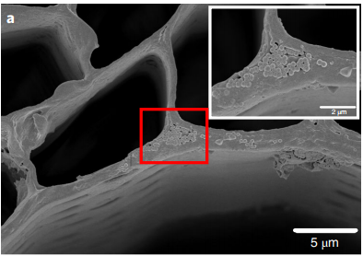
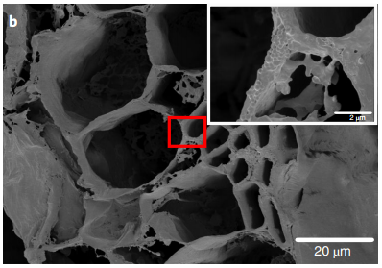
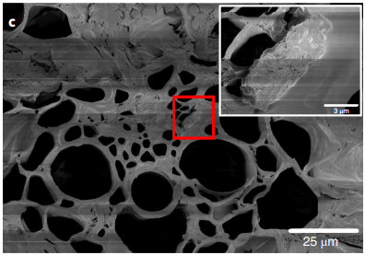
Uptake of microplastics in the terrestrial plants
Uptake of microplastics by crop plants
Root
Stem
Leaf
Triticum aestivum
SEM images of PS localization in the root, stem and leaf of a wheat plant
Root
Root
Leaf
Lactuca sativa
grape/string-like
Li et al., Nat. Sustain., 2020
SEM images of PS localization in the root and leaf of a lettuce plant
PS microplastics were observed in the roots, shoots and leaves of wheat and lettuce
PS microplastics passed through the intercellular space via the apoplastic transport system
Notes:
Two-week-old plants were exposed to 50 mg/L^{–1} suspensions of 0.2 um PS beads for 10 d.
Li, L., Luo, Y., Li, R., Zhou, Q., Peijnenburg, W. J., Yin, N., ... & Zhang, Y. (2020). Effective uptake of submicrometre plastics by crop plants via a crack-entry mode. Nature Sustainability, 3(11), 929-937.

Slide 30
Uptake of microplastics in the freshwater organisms
Transgenerational effects of PS nanoplastics on D. magna
Daphnia magna
PS (20 nm) with green fluorescence
Xu et al., Environ. Sci. Technol., 2020
PS nanoplastics were distributed in the intestine and brood chamber, and transferred from parent to neonates in the second and third generation
There are two possible routes (not confirmed): Permeate into yolk granules/lipid droplets, and/or uptake via brood-chamber
Notes:
50 mg/l
Xu, E. G., Cheong, R. S., Liu, L., Hernandez, L. M., Azimzada, A., Bayen, S., & Tufenkji, N. (2020). Primary and secondary plastic particles exhibit limited acute toxicity but chronic effects on Daphnia magna. Environmental Science & Technology, 54(11), 6859-6868.

Slide 31
Toxicity of microplastics to the terrestrial organisms
Toxicity of PS nanoplastics to Arabidopsis thaliana
Fresh weight of aerial parts
10-day exposure
Plants in pots
Plant length
Chlorophyll content
Root length
7-week exposure
Sun et al., Nat. Nanotechnol., 2020
Toxicity of PS-NH₂ was stronger than PS-SO₃H, because PS-NH₂ induced stronger reactive oxygen species accumulation
Notes:
Sun, X. D., Yuan, X. Z., Jia, Y., Feng, L. J., Zhu, F. P., Dong, S. S., ... & Xing, B. (2020). Differentially charged nanoplastics demonstrate distinct accumulation in Arabidopsis thaliana. Nature nanotechnology, 15(9), 755-760.

Slide 32
Toxicity of microplastics to the terrestrial organisms
Toxicity of PS microplastics to earthworm
Contents of PS in earthworm intestines
Superoxide dismutase
Glutathione
Eisenia fetida
Enzymatic activities
DNA damage
Jiang et al., Environ. Pollut., 2020
PS microplastics could accumulate in the earthworm intestines
Oxidative stress and DNA damage were induced after PS microplastics exposure
PS (1300 nm) showed stronger toxicity to earthworms than PS (100 nm) , but the mechanism was unknown
Notes:
Jiang, X., Chang, Y., Zhang, T., Qiao, Y., Klobučar, G., & Li, M. (2020). Toxicological effects of polystyrene microplastics on earthworm (Eisenia fetida). Environmental Pollution, 259, 113896.

Slide 33
Toxicity of microplastics to marine organisms
Toxicity of microplastics to Grouper (Epinephelus moara)
Epinephelus moara
Eosinophil infiltration
focal necrosis
hydropic degeneration
PD-PS (photodegraded PS)
> P-PS (pristine PS)
> C-PS (commercial PS)
Wang et al., Environ. Sci. Technol., 2020
Microplastics induced growth inhibition and hepatic/pathological damage of grouper
The enhanced lipid deposition was one of the reasons for the aggravated hepatic lesion upon PD-PS exposure
Notes:
Wang, X., Zheng, H., Zhao, J., Luo, X., Wang, Z., & Xing, B. (2020). Photodegradation elevated the toxicity of polystyrene microplastics to grouper (Epinephelus moara) through disrupting hepatic lipid homeostasis. Environmental science & technology, 54(10), 6202-6212. grouper (Epinephelus moara), a primary mariculture specie with high economic and ecological values for human consumption,

Slide 34
Effect of eco-corona on PS nanoplastics toxicity towards marine microalgae
PS size after incubation for EPS (extract from algae)
Cell viability
α = p < 0.001
δ = p > 0.05
α = p < 0.001
β= p < 0.01
Chlorella sp
Cell permeability
Quantum yield of plasma sheath II
α = p < 0.001
δ = p < 0.05
γ = p> 0.05
Dong et al., Water Res., 2020
Note: ‘*’ indicates the difference in percentage noted with respect to control
Natarajan et al., Environ. Res., 2020
Eco-corona formed on PS lessened the toxicity of PS nanoplastics towards algae by preventing direct contact between PS and algae
Negatively charged PS lessened the toxicity more obviously, due to the higher binding affinity for EPS
Notes:
Natarajan, L., Omer, S., Jetly, N., Jenifer, M. A., Chandrasekaran, N., Suraishkumar, G. K., & Mukherjee, A. (2020). Eco-corona formation lessens the toxic effects of polystyrene nanoplastics towards marine microalgae Chlorella sp. Environmental Research, 188, 109842.

Slide 35
V. Potential risk of microplastics to human health
Microplastics in seafood (0-10.5 particles/g)
Danopoulos et al., Environ. Health. Persp., 2020
200 particles/g stool
9 plastics types (PP 63%, PET 17%)
WWF, 2019
CNN, 2018; Schwabl et al., Ann Intern Med. 2019
Microplastics could enter the human body
Notes:
Danopoulos, E., Jenner, L. C., Twiddy, M., & Rotchell, J. M. (2020). Microplastic Contamination of Seafood Intended for Human Consumption: A Systematic Review and Meta-Analysis. Environmental health perspectives, 128(12), 126002.
Schwabl, P., Köppel, S., Königshofer, P., Bucsics, T., Trauner, M., Reiberger, T., & Liebmann, B. (2019). Detection of various microplastics in human stool: a prospective case series. Annals of internal medicine, 171(7), 453-457.

Slide 36
Major pathways of human exposure to microplastics
I
I
Dormitory
II
II
II
0-3.0×10⁷ particles/L
9.9×10³ particles/m²/d
1.62×10⁷ particles/L
(102±21.1)×10⁶ particles/L
11.6 billion microplastics
3.1 billion nanoplastics
II
II
III
PS
Lehner et al., Environ. Sci. Technol., 2019
Zhang et al., Environ. Sci. Technol., 2020
Danopoulos et al., Environ. Health. Persp., 2020
Schymanski et al., Water Res., 2018
Hernandez et al., Environ. Sci. Technol., 2019
Li et al., Nature Food, 2020
Zhang et al., Environ. Sci. Technol., 2020
Vogt et al., J. Invest. Dermatol., 2006
Ranjan et al., J. Hazar. Mater., 2021
PS
118±88 particles/L
0-10.5 particles/g
Nanoplastics in human skin epidermal cells (LSCM image)
I: Lung; II: Gastrointestinal; III: Skin
Microplastics can enter the human body through ingestion and inhalation easily in daily life
Notes:
Vogt et al. identified PS (40 nm, red fluorescence) in the perifollicular tissue could enter epidermal cells after transcutaneous application on human skin (retroauricular region)
Vogt, A., Combadiere, B., Hadam, S., Stieler, K. M., Lademann, J., Schaefer, H., ... & Blume-Peytavi, U. (2006). 40 nm, but not 750 or 1,500 nm, nanoparticles enter epidermal CD1a+ cells after transcutaneous application on human skin. Journal of investigative dermatology, 126(6), 1316-1322.

Slide 37
Release of micro(nano)plastics from plastic infant feeding bottles
Polydimethylsiloxane (PDMS)
Sterilizing
Micro(nano)plastics?
PP
Plastic feeding bottles
Li et al., Nature Food, 2020
Su et al., Nat. Nanotechnol., 2022
World Health Organization, 2007
Can micro(nano)plastics be released from plastic infant feeding bottles?
Notes:
Newly added
Li, D., Shi, Y., Yang, L., Xiao, L., Kehoe, D. K., Gun’ko, Y. K., ... & Wang, J. J. (2020). Microplastic release from the degradation of polypropylene feeding bottles during infant formula preparation. Nature Food, 1(11), 746-754.
Su, Y., Hu, X., Tang, H., Lu, K., Li, H., Liu, S., ... & Ji, R. (2021). Steam disinfection releases micro (nano) plastics from silicone-rubber baby teats as examined by optical photothermal infrared microspectroscopy. Nature nanotechnology, 1-10.
Newly added

Slide 38
Micro(nano)plastics release from silicone-rubber baby teats
Silicone baby bottle teats
Steaming at 100 ℃
Washing three times
60 cycles
Steaming again
Sample preparation and air drying
O-PTIR imaging
Wash
water
Filtration
Deposition
Su et al., Nat. Nanotechnol., 2022
Teat and micro(nano)plastic sample preparation
Notes:
Newly added
Su, Y., Hu, X., Tang, H., Lu, K., Li, H., Liu, S., ... & Ji, R. (2022). Steam disinfection releases micro (nano) plastics from silicone-rubber baby teats as examined by optical photothermal infrared microspectroscopy. Nature nanotechnology, 17(1), 76-85.

Slide 39
Micro(nano)plastics release from silicone-rubber baby teats
Flake- or oil-film-shaped micro(nano)plastics (0.6–332 μm) were generated by the steam-induced degradation of baby teats
By the age of one year, a baby could ingest >0.66 million elastomer-derived microplastics
Global microplastics emission from teats sterilization may be as high as 5.2×10¹³ particles/year
The health and environmental risks of the particles are yet unknown
Su et al., Nat. Nanotechnol., 2022
Notes:
Su, Y., Hu, X., Tang, H., Lu, K., Li, H., Liu, S., ... & Ji, R. (2021). Steam disinfection releases micro (nano) plastics from silicone-rubber baby teats as examined by optical photothermal infrared microspectroscopy. Nature nanotechnology, 1-10.
Newly added

Slide 40
Microplastics and inflammatory bowel disease
Microplastics in human stools
Yan et al., Environ. Sci. Technol. 2022
In both healthy and inflammatory bowel disease (IBD) human stools, most microplastics were < 300 μm with the shape of sheets and fibers
There was a correlation between fecal microplastics and inflammatory bowel disease status
Notes:
Newly added
Yan, Z., Liu, Y., Zhang, T., Zhang, F., Ren, H., & Zhang, Y. (2021). Analysis of Microplastics in Human Feces Reveals a Correlation between Fecal Microplastics and Inflammatory Bowel Disease Status. Environmental science & technology.
Fecal microplastics concentration in IBD patients was significantly higher than that in healthy people
The positive correlation between fecal microplastics and IBD status suggests that microplastics exposure may be related to the disease process or that IBD exacerbates the retention of microplastics
Plastic packaging of drinking water and food, and dust are important sources of human exposure to microplastics

Slide 41
Microplastics detected in nasal mucus after wearing a mask
Microplastics in human nasal mucus
Number of microplastics detected in nasal mucus
Ma et al., Environ. Pollut.,2021
Fiber-like and spherical microplastics in the masks could be inhaled by human when wearing a mask, while the exact size and quantity are unknown
A higher breathing frequency resulted in a larger number of microplastics detected in the nasal mucus
Notes:
Newly added
The nasal cavity of a male adult (62 kg and age 34) was first cleaned three times using saline water. After 12 h, the adult wore a mask in each of the following three scenarios: 1) breathing without talking, 2) breathing and talking, 3) treadmill jogging at a pace of 10 km per hour.
Ma, J., Chen, F., Xu, H., Jiang, H., Liu, J., Li, P., ... & Pan, K. (2021). Face masks as a source of nanoplastics and microplastics in the environment: quantification, characterization, and potential for bioaccumulation. Environmental Pollution, 288, 117748.

Slide 42
Microplastics reduce lipid digestion
Effect of microplastics on lipid digestion
Different types
Different sizes
Different concentrations
Tan et al., Environ. Sci. Technol., 2020
PS, PE, and PET had the strongest inhibition, much higher than PVC and poly(lactic-co-glycolic acid) (PLGA)
Lipid digestion was highly PS concentration-dependent, while size-independent
Notes:
Tan, H., Yue, T., Xu, Y., Zhao, J., & Xing, B. (2020). Microplastics Reduce Lipid Digestion in Simulated Human Gastrointestinal System. Environmental Science & Technology, 54(19), 12285-12294.

Slide 43
Concluding remarks:
Microplastics are widely distributed in seawater, soils, sediments and freshwater, even reach the most remote regions. Atmospheric transport is an important pathway for microplastics transport to remote regions.
Adsorption, aggregation and degradation are the most important environmental processes of microplastics; degradation could regulate adsorption and aggregation behavior.
Microplastics can be ingested by terrestrial, marine and freshwater organisms, and could become toxic by inducing oxidative stress and DNA damage; microplastics additives also increase toxicity while eco-corona/biofilm could mitigate their toxicity.
Microplastics can enter the human body through ingestion and inhalation, possibly leading to health risks (e.g., inflammation, reduced digestion health & nutrient assimilation).

Slide 44
Knowledge gaps needs to be addressed in the future
Nanoplastics should be further studied (e.g., collection, detection, environmental concentration, distribution and fate) in addition to microplastics.
In-situ detection and characterization of microplastics in the environment and organisms need to be developed.
The standard approaches on microplastics research (e.g., detection, characterization, toxicity) should be established for comparisons.
The role of eco-corona/biofilm should be better understood, including formation mechanism, and its effect on the behavior, toxicity, internalization of microplastics
“Trojan horse” effect need to be considered on the toxicity of microplastics and co-existing contaminants to organisms and humans.
Transport of microplastics through important tissue barriers, including skin, intestine epithelium, placenta, and blood-to-brain barriers should be better examined and understood.

Slide 45
Acknowledgments
My research group:
Students
Postdocs
Visiting scientists
Collaborators:
Dr. Jian Zhao
Dr. Hao Zheng
Dr. Zhenyu Wang
USDA-NIFA: MAS 00549

