Slide 1
Through the River and Over the Woods – Global PFAS Exposure and Implications for Ecosystem Health
Lisa McIntosh, MS, DABT
Woodard & Curran, Inc.
Soil and Water Conservation Society
Southern New England Chapter
March 30, 2023

Slide 2
What are PFAS?
Per- and Polyfluoroalkyl Substances
Large class of man-made compounds
Very stable, carbon-fluorine bonds
High thermal, chemical stability
Water soluble
Used as surfactants, water/stain repellents, etc.
C – F
4-eva

Slide 3
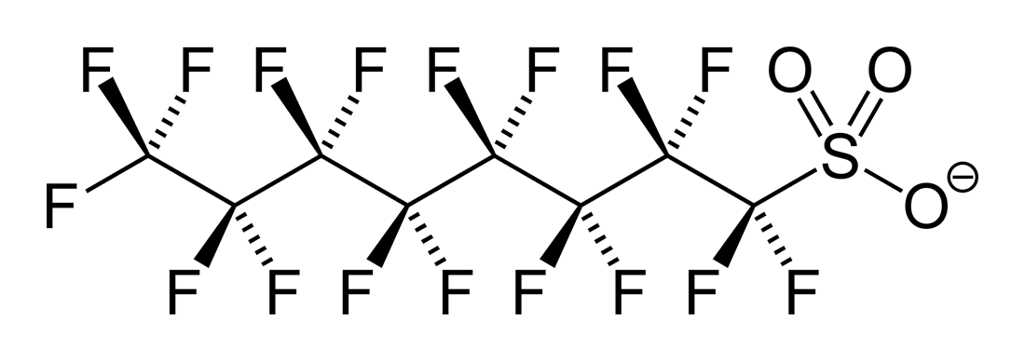
Environmental focus on perfluoroalkyl group
Nonpolymers
C_{n} F_{2n+1} – R
Perfluoroalkyl carboxylic acids (PFCAs) - PFOA
Perfluoroalkyl sulfonic acids (PFSA) – PFOS
Long vs. short chain
Some polyfluoroalkyl substances also important
Precursors to PFCAs
fluorotelomers
Persistent, Bioaccumulative, Toxic
PFOA: Perfluorooctanoic acid (C8)
PFOS: Perfluorooctane sulfonic acid
Notes:
Focus is on PFAAs because most commonly detected in environment, in most PFAS analyte lists currently; have tox data for humans/ecological receptors, federal guidance values/criteria
PFOA has carboxyl functional group, PFOS has sulfonic acid
Polyfluoroalkyl substances – in particular, fluoroteomers, may degrade into PFCAs and so may be significant source in the environment.

Slide 4
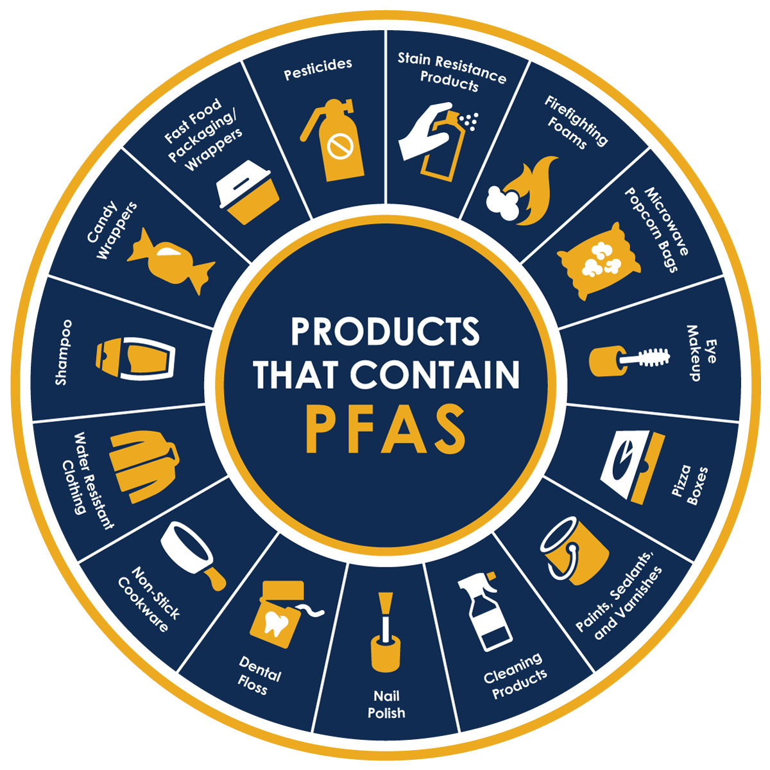
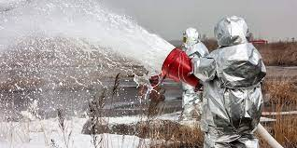
PFAS Sources/Uses
Fire-fighting foams (e.g., AFFF)
Consumer products
Industrial use
Aerospace, metal plating, automotive, electronics, construction, etc.
Source: Riverside Public Utilities
https://riversideca.gov/press/understanding-pfas
Notes:
AFFF – aqueous film forming foam
Graphic from California’s Riverside Public Utilities

Slide 5
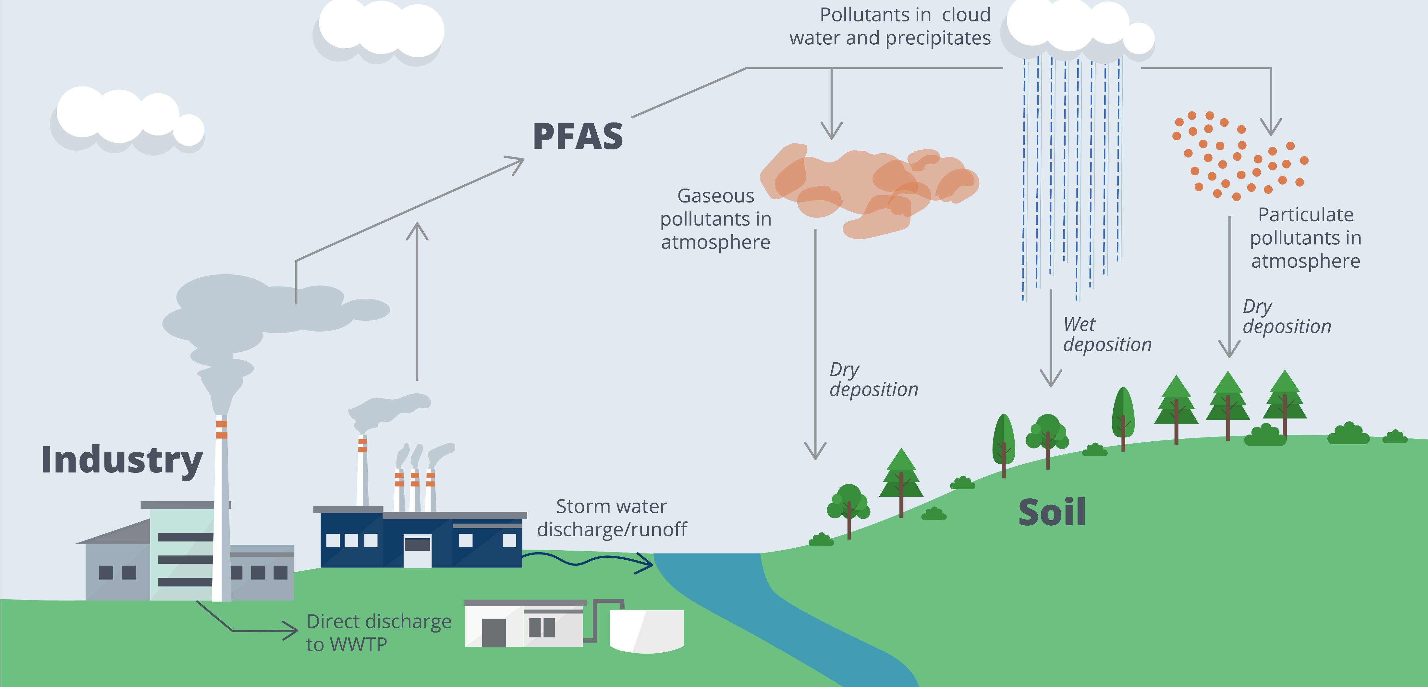
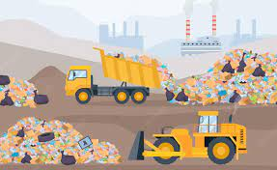
How do PFAS move through the environment?
Bioaccumulation
Landfilling
Leaching to groundwater
Migration to surface water

Slide 6
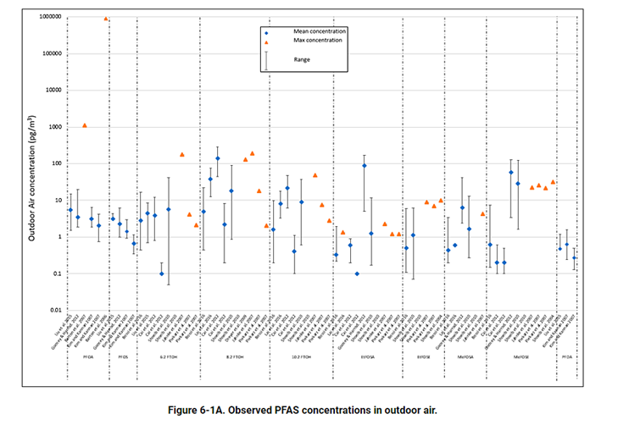
PFAS in the air
Important transport system
Local and global
Gas, aerosol, particulates
Volatile precursors can be prevalent
Removal via deposition
Dry particulates
Precipitation
Source: ITRC PFAS Technical and Regulatory Document
https://pfas-1.itrcweb.org/6-media-specific-occurrence/#figure_6_1a
Notes:
So – talking about exposure in the environment
Picograms per cubic meter

Slide 7
Raining down
Woodard & Curran PFAS in Rain Study (unpublished data)
% Detected
6%
13%
2%
2%
6%
Minimum Detected
1.82
2.3
1.94
2.86
2.08
Maximum Detected
3.48
3.36
1.94
2.86
2.35
1H,1H,2H,2H-Perfluorooctanesulfonic Acid (6:2FTS)
Perfluorobutanoic Acid (PFBA)
Perfluorohexanoic Acid (PFHxA)
Perfluorononanoic Acid (PFNA)
Perfluoropentanoic Acid (PFPeA)
Fluorotelomer precursor
Short chain
Results in ng/l
Notes:
Highest total PFAS 8.78 ng/l
6:2 FTS – PFOS alternative -mist suppressant in chromate plating process

Slide 8
PFAS on the ground
Unpublished data
PFOS Background Concentrations in New England Soils
Notes:
Part per billion levels

Slide 9
…and in the ground(water)
Source: Environmental Working Group
https://www.ewg.org/interactive-maps/pfas_contamination/map/
Notes:
Soil leaching to groundwater
Variable concentrations, depends on source areas (like military installations or firefighting training areas)
Map: environmental working group

Slide 10
…and waterways
Direct inputs from atmosphere, wastewater, releases etc.
Indirect input via groundwater, stormwater runoff
Remote areas: pg/L to ng/L

Slide 11
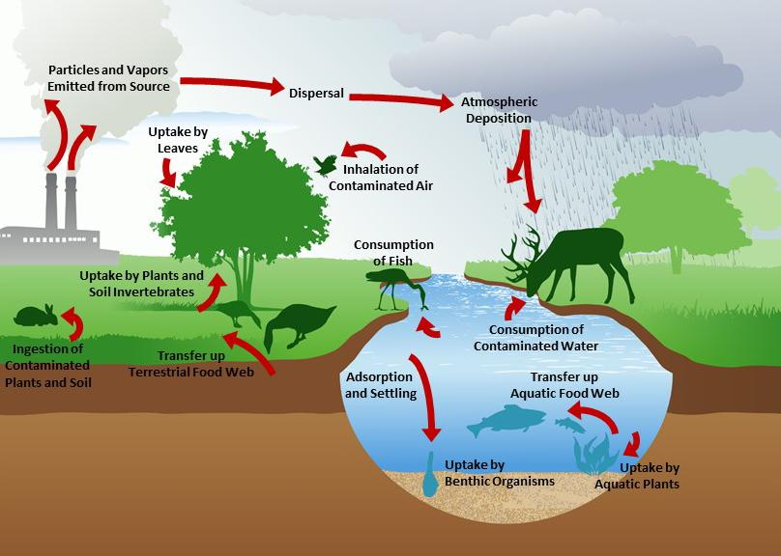
PFAS transport through the food web
Bioconcentration:
Uptake from water
Bioaccumulation:
Uptake from all surrounding sources
Biomagnification:
Increasing concentrations with increasing trophic levels
Source: EPA EcoBox: https://www.epa.gov/ecobox/epa-ecobox-tools-exposure-pathways-exposure-pathways-era

Slide 12
PFAS accumulate in biota
Binds to proteins, phospholipids
PFOS predominant
Global exposure documented
Notes:
Part per billion levels

Slide 13
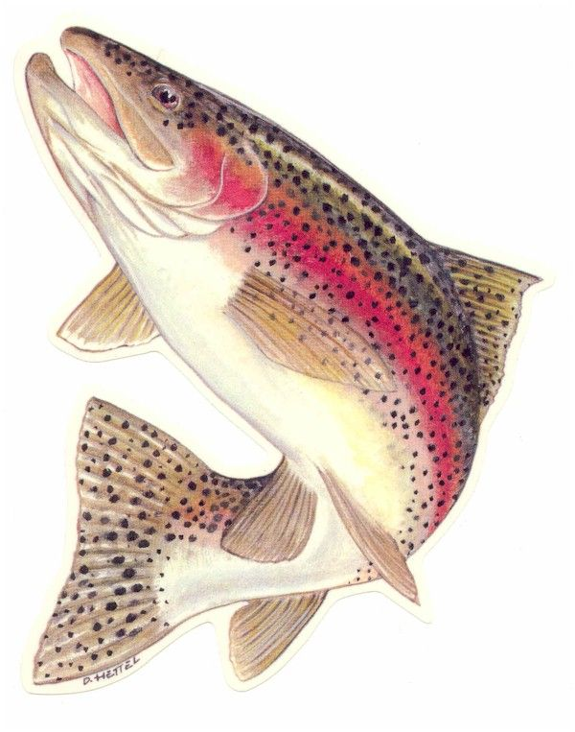
Bioaccumulation is highly variable
C3
PFBA
C8
PFOS
Structure
Media chemistry
Organism
More bioaccumulative
More bioaccumulative
C10
PFDS
Notes:
‘sweet spot’ of ~C7-C13 for animals
Shorter chain for plants
Highly variable, though

Slide 14
The Big Question: does exposure translate into effect?
Decades and multitude of laboratory data
Mostly on PFOS and PFOA
Mostly laboratory studies
Toxicity is highly variable among organisms
Notes:
EPA Ecotox database

Slide 15
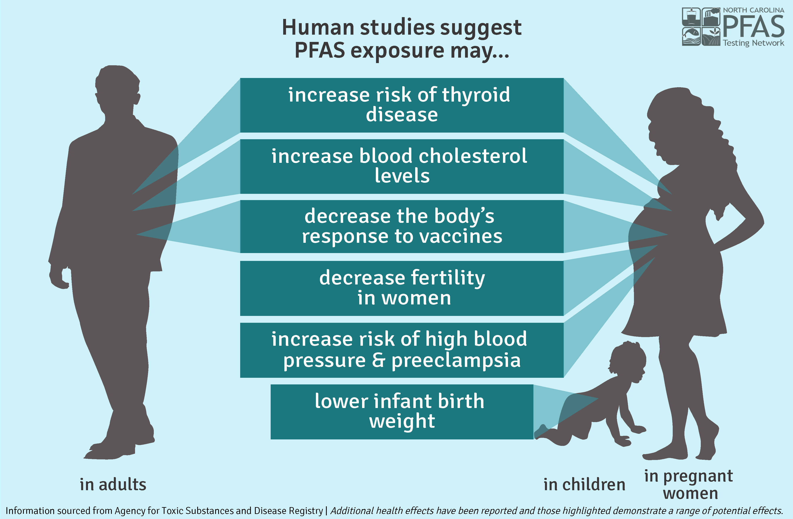
Health effects in mammals
Cancer
PFOA: liver, testicular, pancreatic, kidney
PFOS: bladder, prostate, kidney, breast
Graphics reproduced from
North Carolina NC PFAST Network:
https://ncpfastnetwork.com/printed-materials/

Slide 16
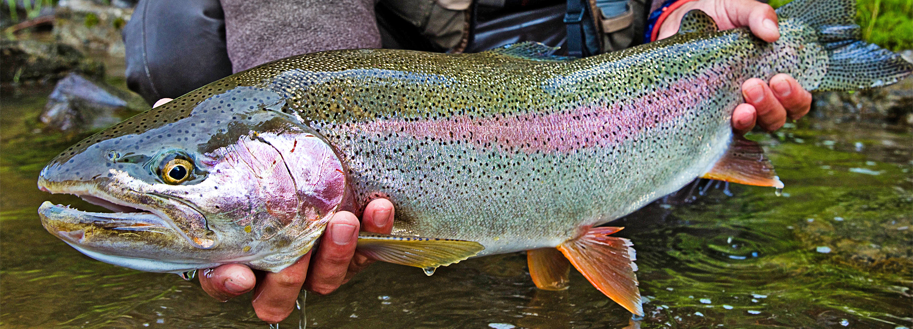
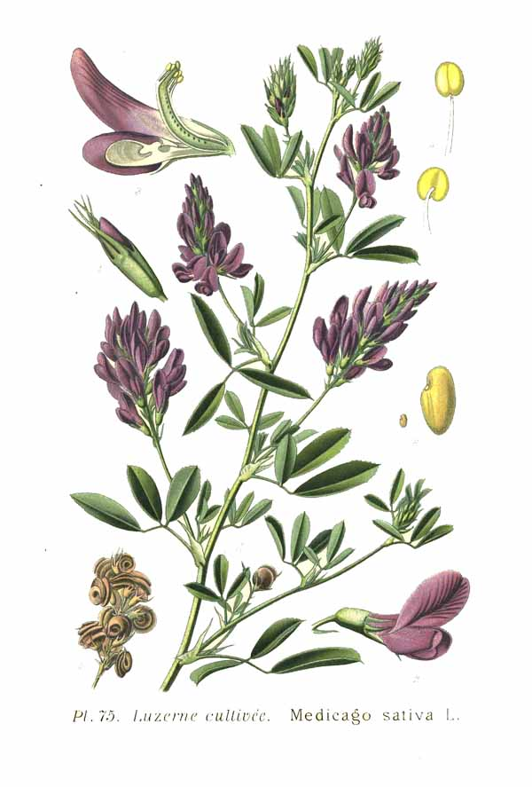
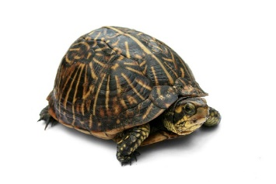
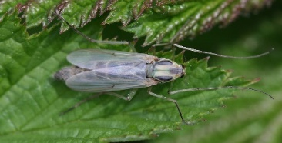
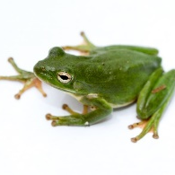
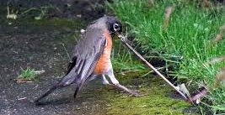
Effects on non-mammals
Studies mainly focus on survival, growth, and reproduction
ppb to ppm levels
immune, developmental
transgenerational
Highly variable
Moderation by TOC and other factors

Slide 17
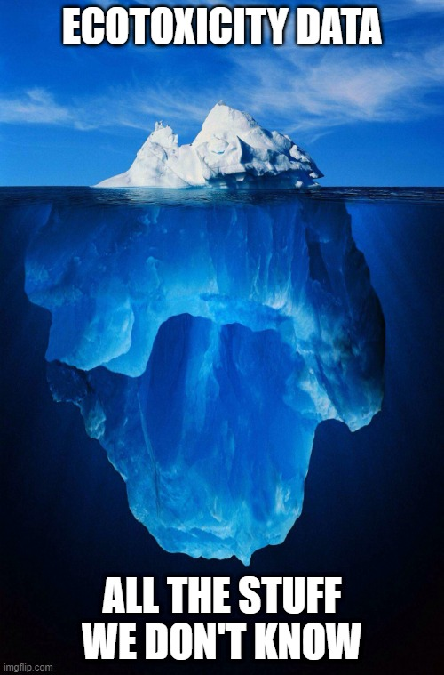
What don’t we know?
Toxicity of most PFAS
Toxicity in most species
Toxicity of PFAS mixtures
Modulation by environmental factors
Population-level impacts

Slide 18
Ecological risk assessment of PFAS
Stressors
Migration pathways
Exposure routes
Exposure potential
Toxicity
Risk
Uncertainty

Slide 19
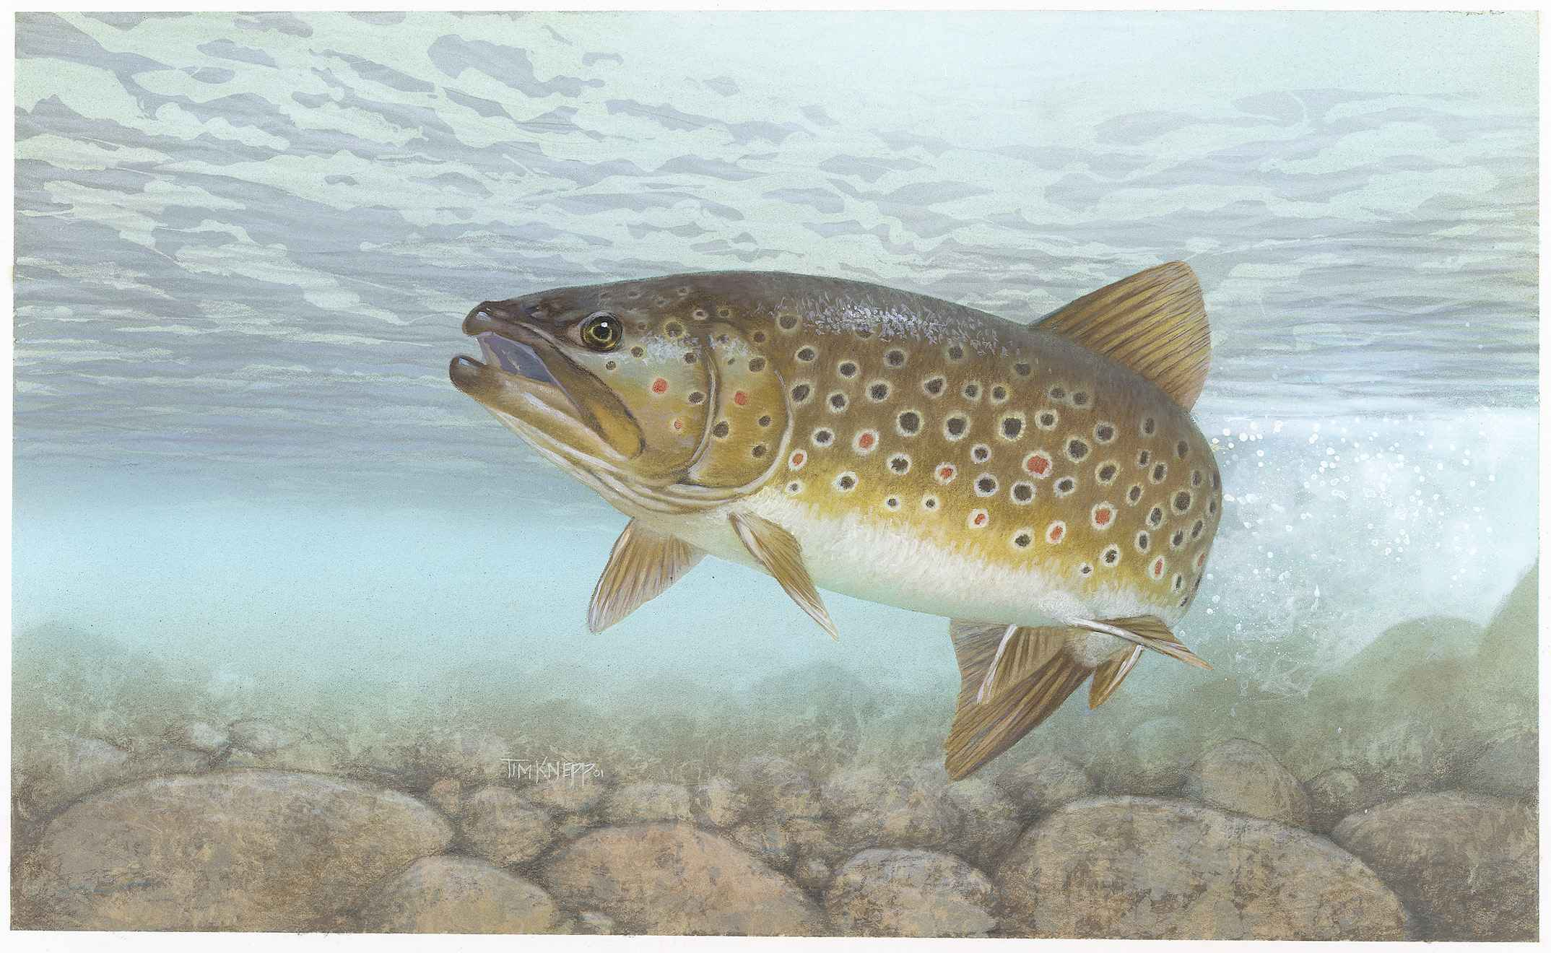
PFAS ecological benchmarks for surface water
Ecological Screening Value | Concentration ug/L
 | PFOS | PFOA
USEPA NRWQC-chronic (draft) | 8.4 | 94
Ecological Screening Value¹ | 22.6 | 307
Many states promulgated or are in process of developing WQC
USEPA proposed invertebrate/fish tissue-based NRWQC
1. Grippo, M., Hayse, J. , Hlohowskyj, I. and Picel, K. September 2021. Derivation of PFAS Ecological Screening Values. Argonne National Laboratory
Notes:
Argonne National Laboratory, in support of Air Force, developed screening levels for water – part per billion
States: Michigan, Minnesota . Massachusetts has target surface water level to develop groundwater gw-3 criteria.

Slide 20
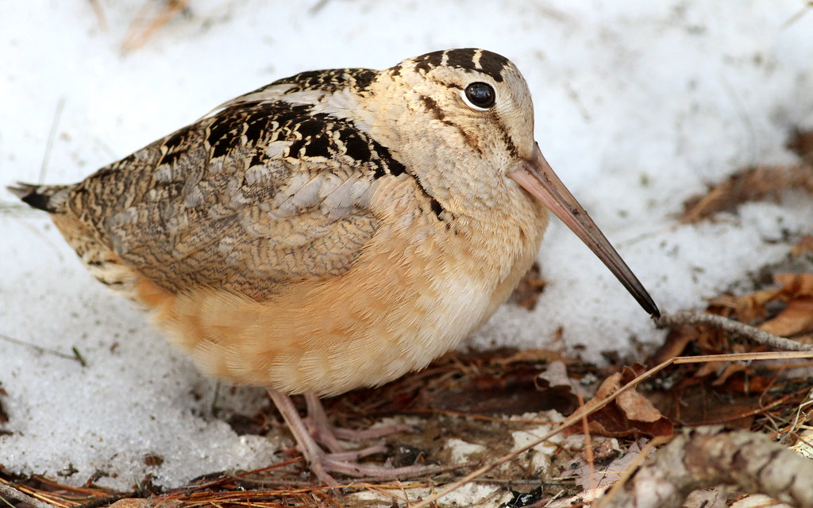
PFAS ecological benchmarks for soil
Receptor | Ecological Screening Value (ug/kg)¹
 | PFOS | PFOA
Plants | 40,200 | 79,500
Invertebrates | 48,100 | 22,400
Mammals | 8.7 | 3,840
Birds | 38.6 | --
Grippo, M., Hayse, J. , Hlohowskyj, I. and Picel, K. September 2021. Derivation of PFAS Ecological Screening Values. Argonne National Laboratory

Slide 21
Use multiple lines of evidence to assess risk
Chemistry
Toxicology
Ecology
Risk Characterization
??
Abiotic concentrations
Reference levels
Tissue samples
Literature tox values
Lab toxicity studies
Bioaccumulation testing
??
??
Population surveys
Condition indices
Weight of Evidence is Critical

Slide 22
Understand limitations and uncertainties
Line of Evidence | Uncertainties
Benchmarks | Few currently available; not site-specific
Toxicity Testing | Which species is most sensitive?
Bioaccumulation Testing / Tissue Sampling | Standardized analytical methods lacking
Food Chain Models | How to best predict uptake?
Field Surveys | Chemical, physical and biological confounders

Slide 23
So what does all this mean?
PFAS are prevalent in our environment.
Organisms are exposed to PFAS on a global scale.
Exposure associated with adverse effects at environmental levels
Considerable uncertainty/variability

Slide 25
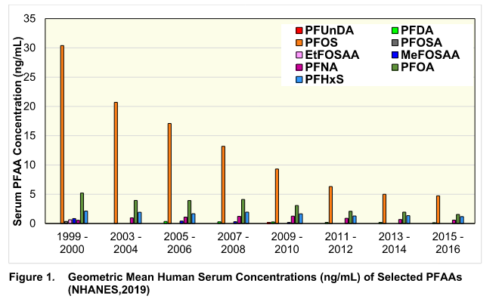
Have any good news?
EPA’s PFAS Action Plan, 2019:
“Ecological toxicity information is also needed by stakeholders to inform risk assessment and management to protect ecosystems, animals, and plant resources they support ….”
PFAS is a priority
Regulatory impetus
Phase out of PFOS/PFOA
Human PFOS and PFOA serum levels have decreased
Push for:
Research & Development
Analysis
Remediation

Slide 26
PFAS resources
USEPA PFAS Website: https://www.epa.gov/pfas
Interstate Technology and Regulatory Council (ITRC): PFAS Technical and Regulatory Document: https://pfas-1.itrcweb.org/
Argonne National Laboratories, Grippo, M., Hayse, J. , Hlohowskyj, I. and Picel, K. September 2021. Derivation of PFAS Ecological Screening Values. https://www.denix.osd.mil/dodepa/
National Groundwater Association
Groundwater and PFAS: State of Knowledge and Practice. https://my.ngwa.org/NC__Product?id=a183800000kbKF9AAM
Vermont Soil Study: https://anrweb.vt.gov/PubDocs/DEC/PFOA/Soil-Background/PFAS-Background-Vermont-Shallow-Soils-03-24-19.pdf
Maine Soil Study: https://www.maine.gov/dep/spills/topics/pfas/Maine_Background_PFAS_Study_Report.pdf
New Hampshire Soil Study (data): https://www.usgs.gov/data/statewide-survey-shallow-soil-concentrations-and-polyfluoroalkyl-substances-pfas-and-related

Slide 27
Thank You!
Questions?
Lisa McIntosh
Woodard & Curran
lmcintosh@woodardcurran.com

