Slide 1
Growing Together
A Balanced Approach to Solar Siting
Emily J Cole, PhD
Climate and Agriculture Program Manager ecole@farmland.org

Slide 2
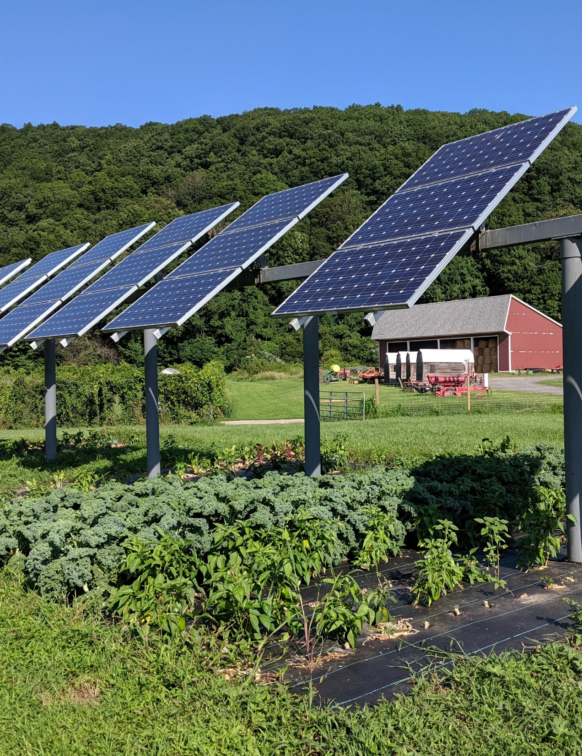
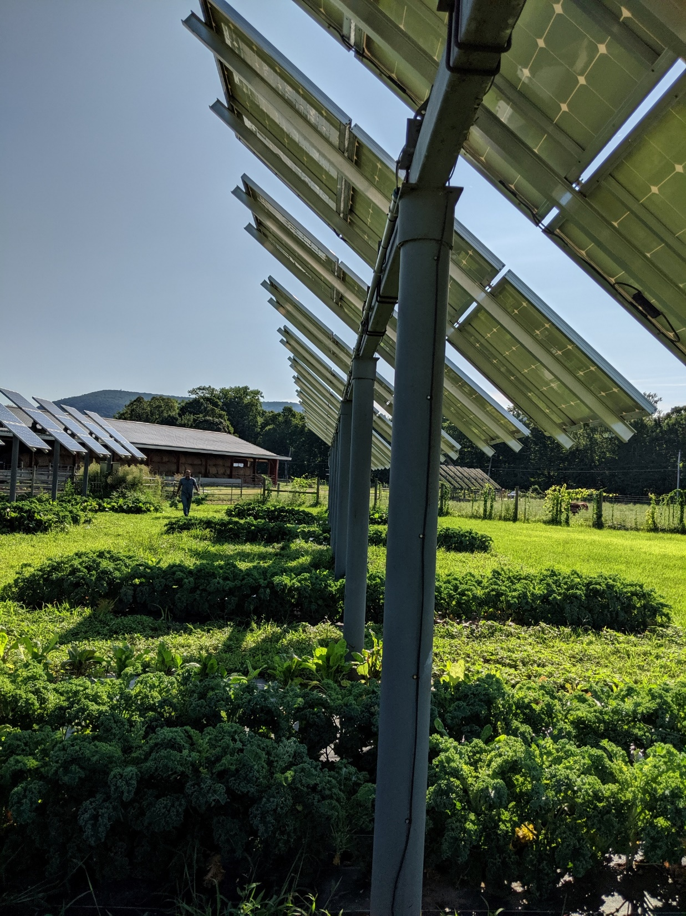
The Balanced Approach
We cannot move forward towards a climate stable future without renewable energy.
Smart solar siting is an opportunity to improve overall farm viability and keep farmland from further sale or development.
We cannot feed ourselves in the future without sufficient productive farmland.
As the climate worsens, we will continue to lose significant acreage and productivity of our farmland.
The path forward together takes careful consideration, compromise, and cooperation.
It starts with communication.

Slide 3
Smart Solar Siting It’s a process
Smart solar siting removes unnecessary barriers to solar projects that are in the public interest while providing oversight for projects that will have community or natural resource impacts.
It is built upon data driven analyses that consider the inherent trade-offs associated with ground mounted solar and the differing values of stakeholders in order to reduce conflict and achieve greater public support of renewable energy siting.
There is no single solution to the solar siting challenge. Smart solar siting requires a range of policy approaches at the legislative, regulatory, and community level.

Slide 4
Smart Solar Siting for New England
There is no single solution to the solar siting challenge. Smart solar siting requires a range of policy approaches at the legislative, regulatory, and community level. With smart solar siting we can accelerate the expansion of renewable energy generation and cut greenhouse gas emissions while maintaining our natural and working lands.
Support solar growth & protect natural and working lands with
SMART SOLAR SITING
Status quo *
0% solar
100% ag
Farmland loss
100% solar
0% ag
Notes:
-

Slide 5
High-Level Guiding Principles for Solar Energy Development
PROCESS
Establishing high level principles is useful for working within a state or community to build consensus.
Convene stakeholders early
Draft a problem statement
Know the policy context
Adopt shared principles
Collect data
Consider a range of policy approaches
SUBSTANCE
Meet state climate change and clean energy goals
Design a smart planning process
Educate local governments
Seek opportunities for shared benefits
Engage and empower communities
Promote equity
Balance important land uses
Site on preferred sites whenever possible
Protect vulnerable habitat
Support design innovation and research alternative siting methods
Notes:
Based upon more than 40 interviews with stakeholders across all sectors – we worked to find where stakeholder values lied – and where in the solar energy development process was there an opportunity for those values to be voiced. We also reviewed their concerns about the overall process and worked to make these high level guiding principles.
Working to assess each New England State’s potential to meet climate and solar generation goals while protecting the region’s best farm and forest land and provide resources that generate better understanding among policy makers, influencers, and advocates, of the benefits of smart solar siting and the potential to meet solar energy goals while still protecting farm and forest land.

Slide 6
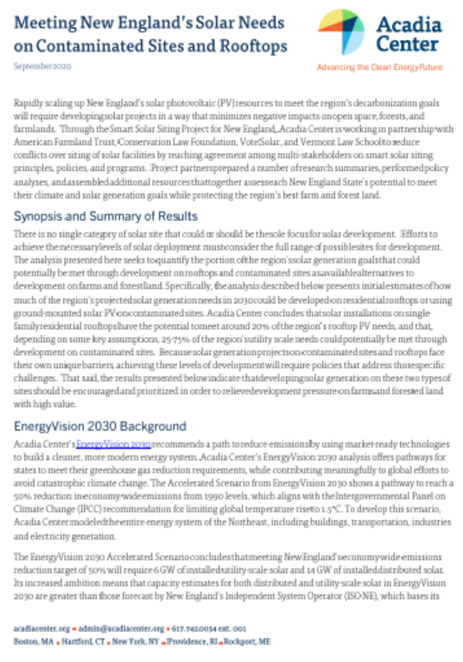
Meeting New England’s Solar Needs on Contaminated Sites and Rooftops
Acadia Center examined how much of the region’s solar needs could potentially be met on:
Contaminated sites
Residential rooftops

Slide 7
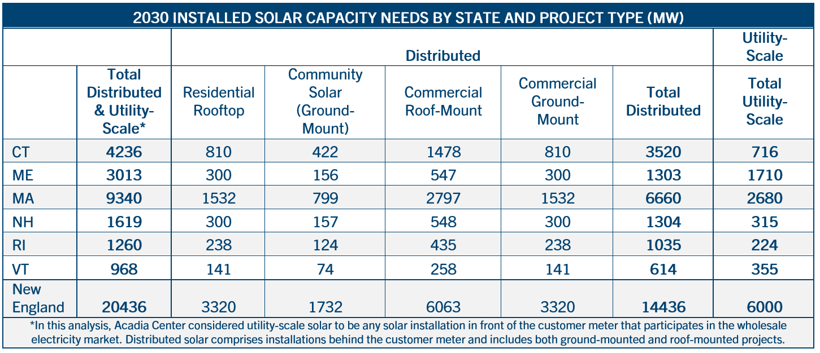
EnergyVision 2030: Solar Breakout
Notes:
Allocated among states by population as a proxy for load (rough approximation, conditions in each state vary)
Drew from EV2030 assumptions, further allocated across these categories of project type and size
Relied on US EIA, NREL for utility scale solar estimates

Slide 8
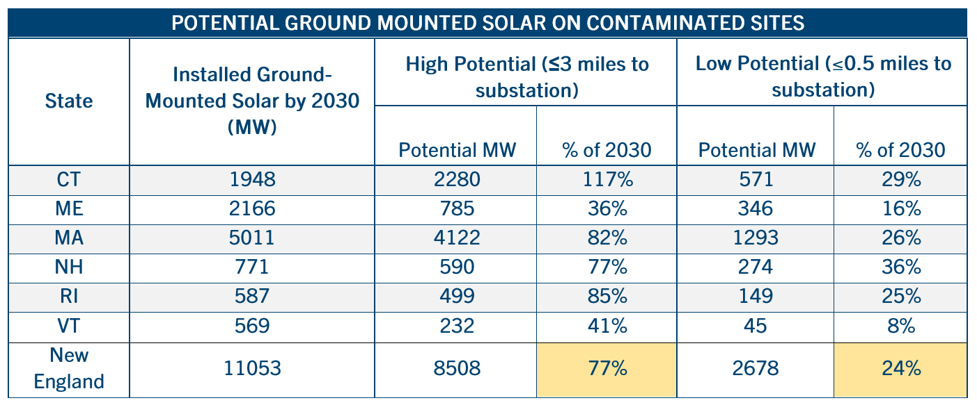
Ground-Mounted Solar Potential on Contaminated Sites
Notes:
Results: GM needs in 2030 covers community solar, commercial ground-mount and utility-scale
Bounded across a range - used distance from substation as a proxy
Low potential - limiting the interconnection to within ½ mile of a substation
High potential - if it was feasible to interconnect projects within 3 miles of a substation, yields a higher potential (for illustration, not industry practice)
Inputs:
Contaminated sites come from Re-Powering America’s dataset of brownfields, Superfund sites, landfills; Excluded RCRA
Screened out certain sites over 500 acres (e.g., still in use, waterbodies, etc)
Other Assumptions and Constraints
• Each MW requires 5 acres
• Projects >= 5 MW, <=150 MW
Implications:
o closer review of site-specific data will be necessary to understand how on-the-ground conditions at these sites would ultimately lead to solar development
o states and stakeholders can evaluate crucial factors such as topography and ease of access that significantly affect a given site’s developable potential

Slide 9
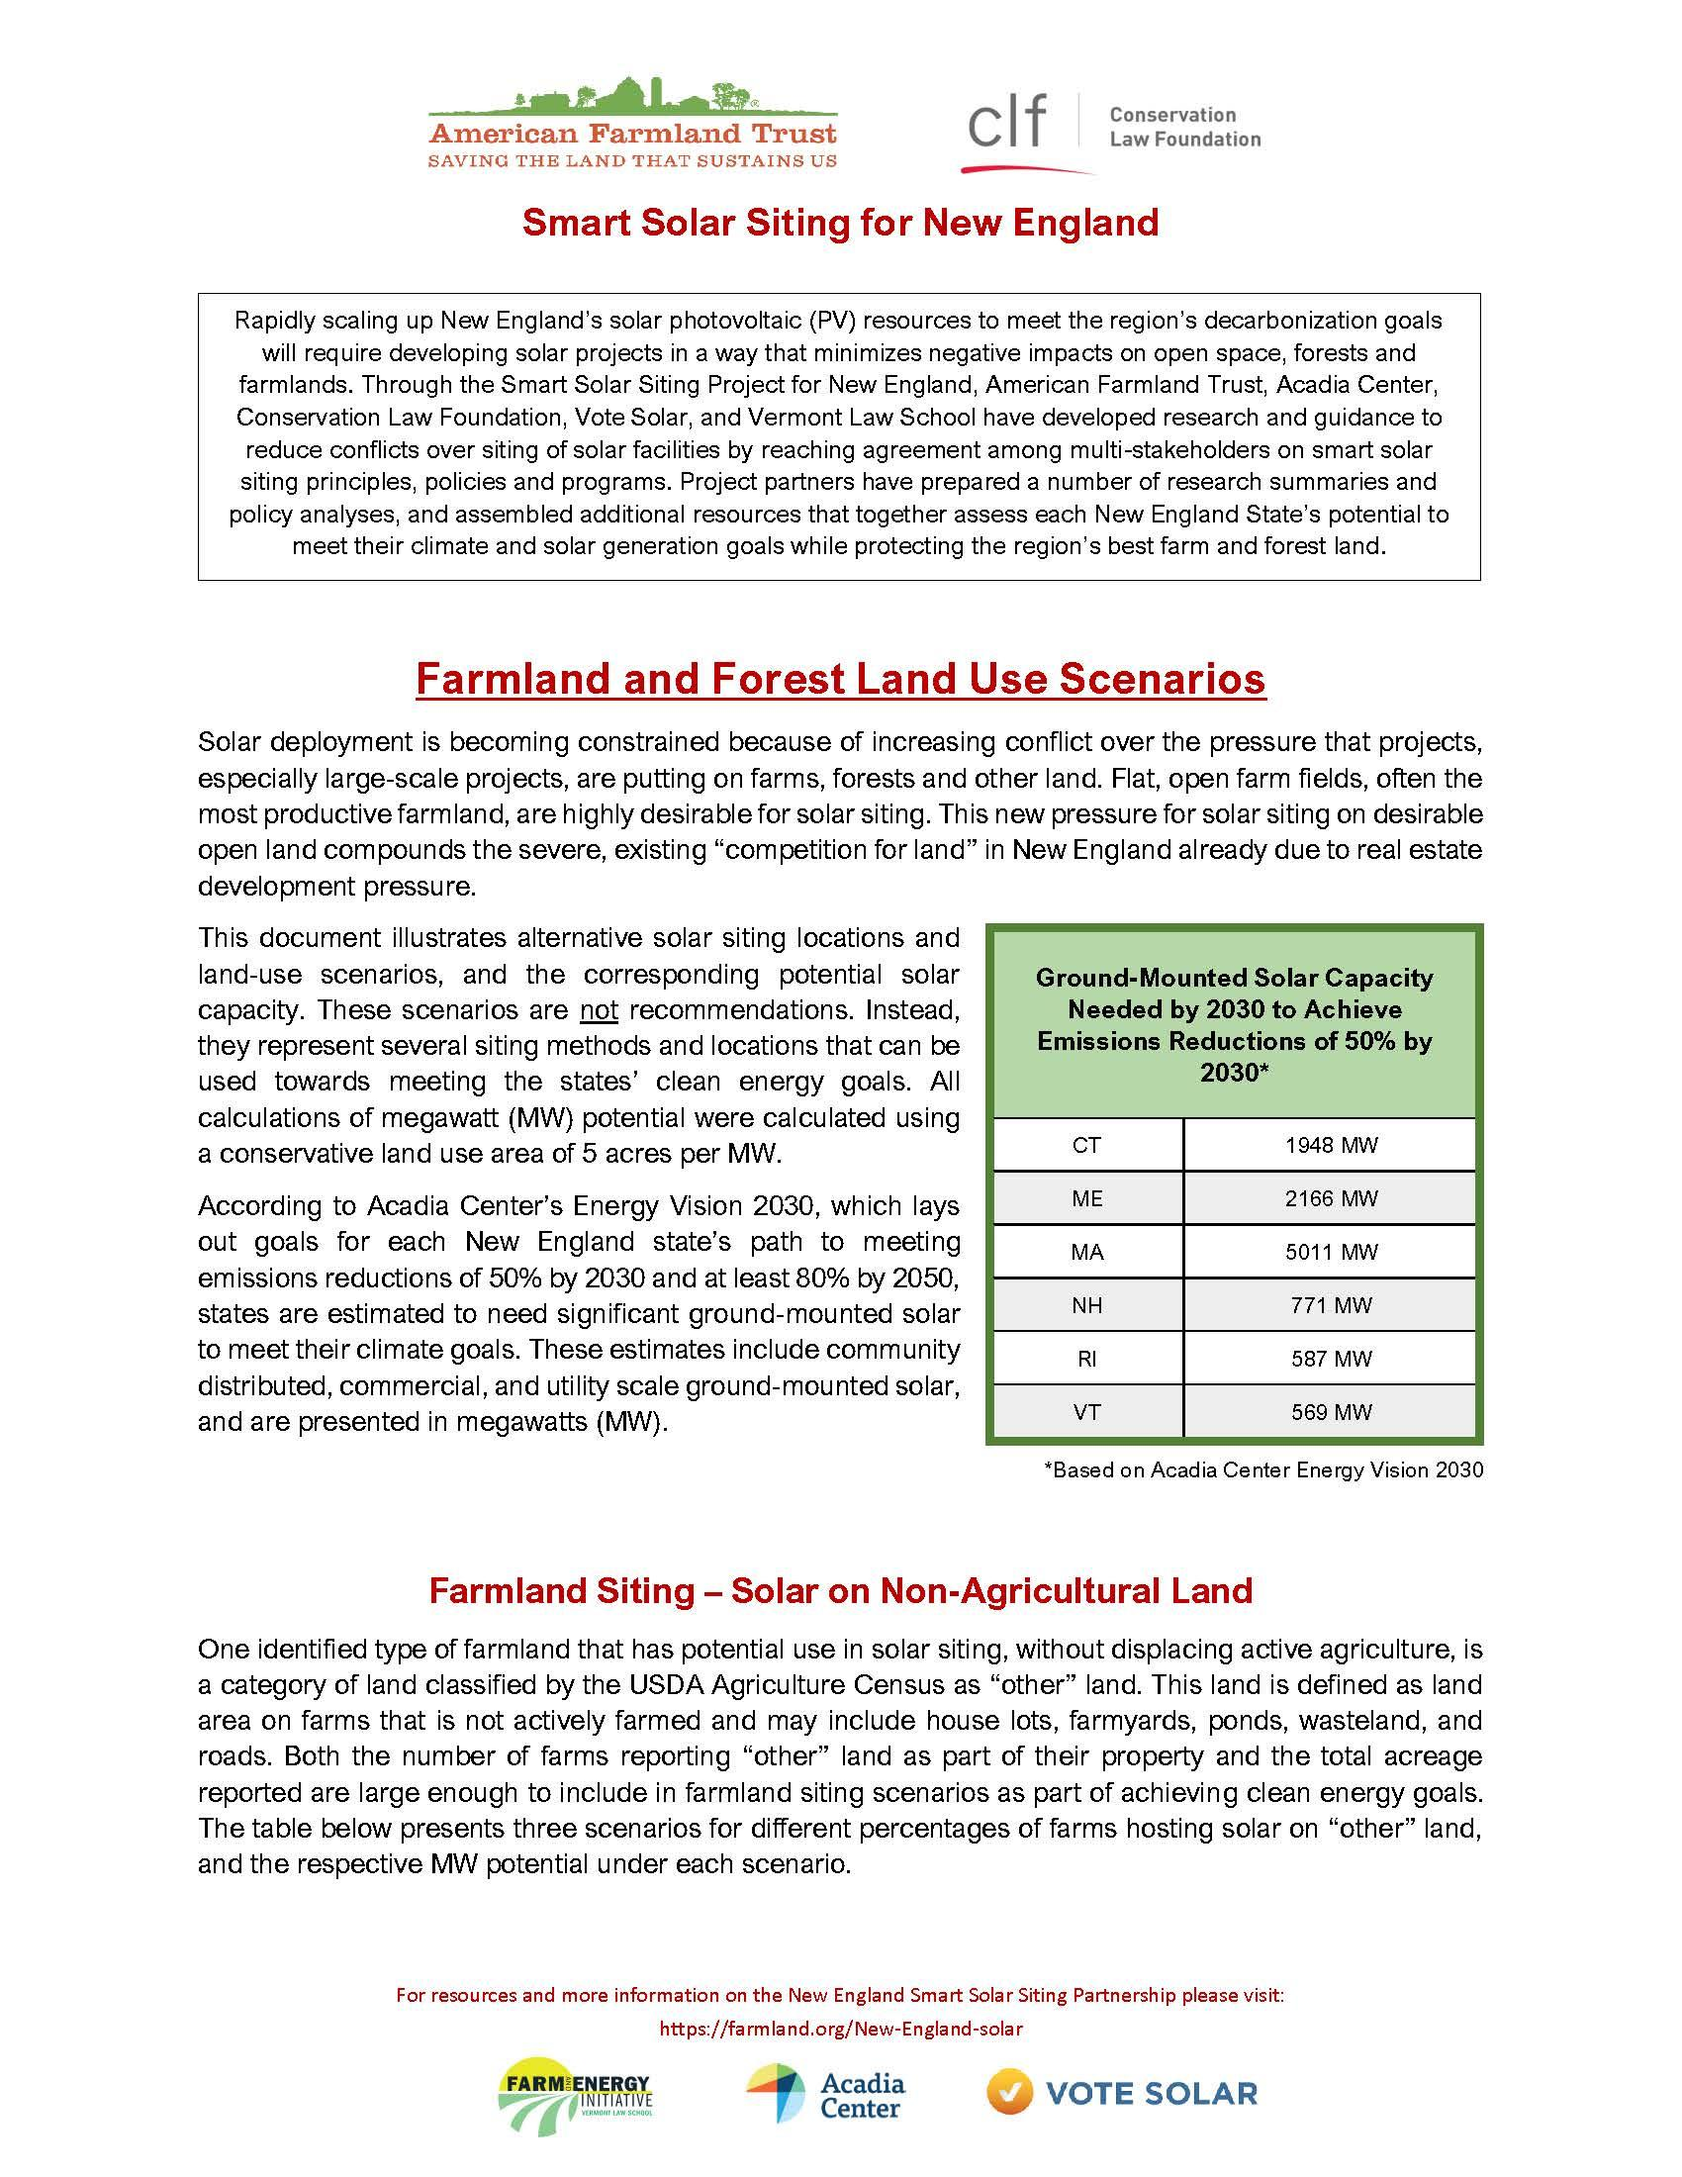
Farmland and Forest Land Use Scenarios
Scenarios represent siting methods/locations that could be used towards meeting states’ clean energy goals.
All calculations of megawatt (MW) potential calculated using conservative land use area of 5 acres per MW.

Slide 10
Farmland and Forest Land Use Scenarios
Farmland Siting – Solar on Non-Agricultural Land

Slide 11
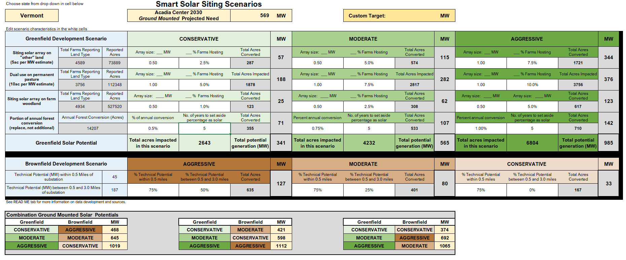
Balance Important Land Uses

Slide 12
Balance Important Land Uses

Slide 13
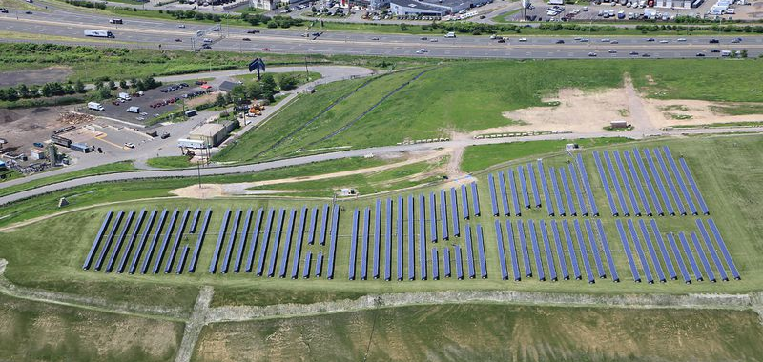
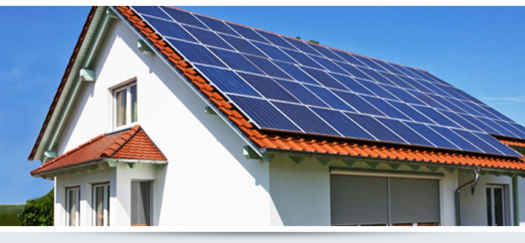
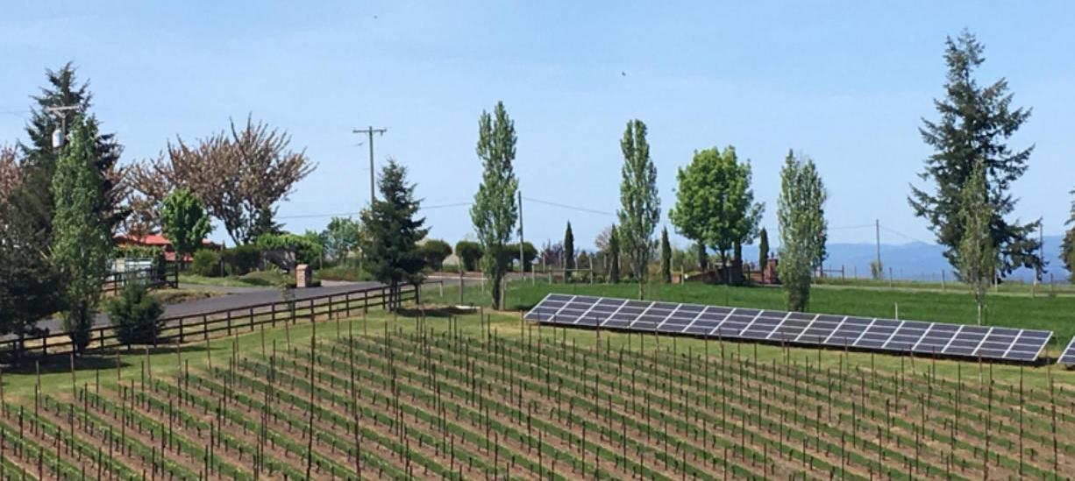
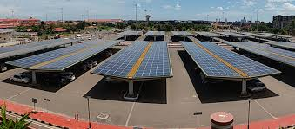
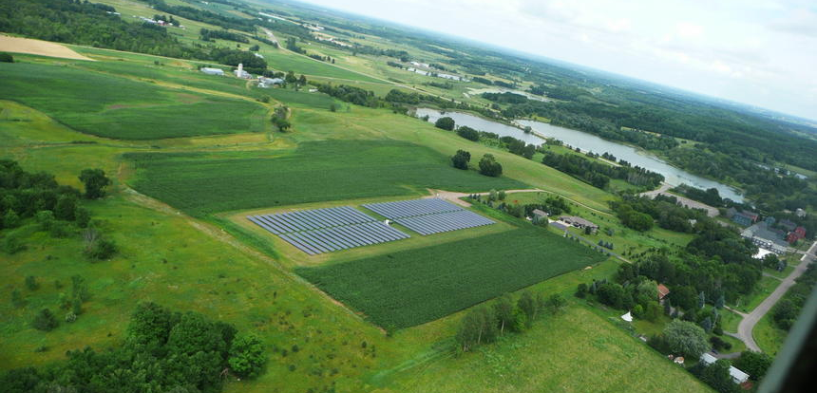
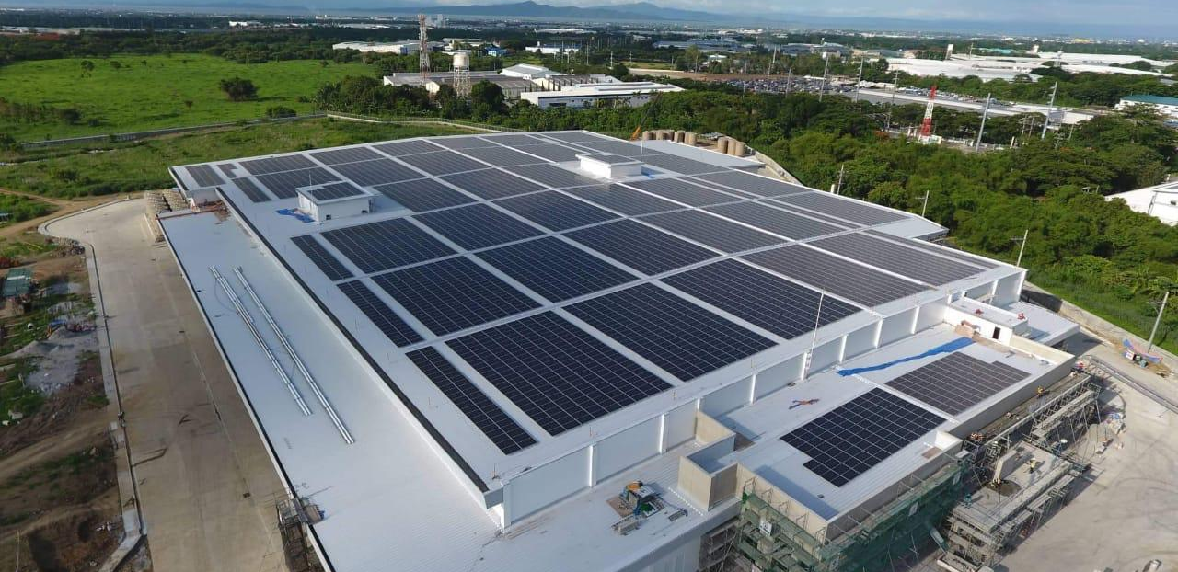
AFT & Solar Why are we in this conversation?

Slide 14
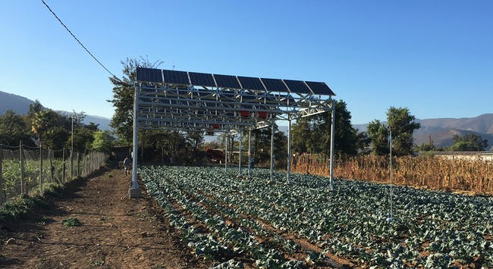
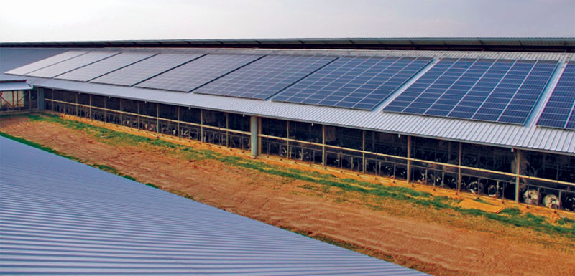
To combat climate change - encourage solar energy that doesn’t sacrifice agricultural land
States have set ambitious goals for reducing greenhouse gas emissions will require dramatic increases in solar and wind energy.
These efforts create opportunities for farmers and landowners to reduce their energy expenses and earn new income, but also pose threats to farmland.
The solution is smart solar siting that guides solar development onto land where it has the least impact on agriculture and the environment.
Notes:
AFT supports accelerated solar development and believes that, with proper planning and siting, our agricultural lands can also play a meaningful role in hosting solar energy while maintaining active and productive agriculture.
We understand that if all we do is protect farmland, we will still lose acres and inches of topsoil, handicapping our potential for food production and food security due to climate change.
To protect our best farmland for the future, we must work to develop smart solar siting policies and guidelines today, to help our farmers keep their land and keep it in agriculture.

Slide 15
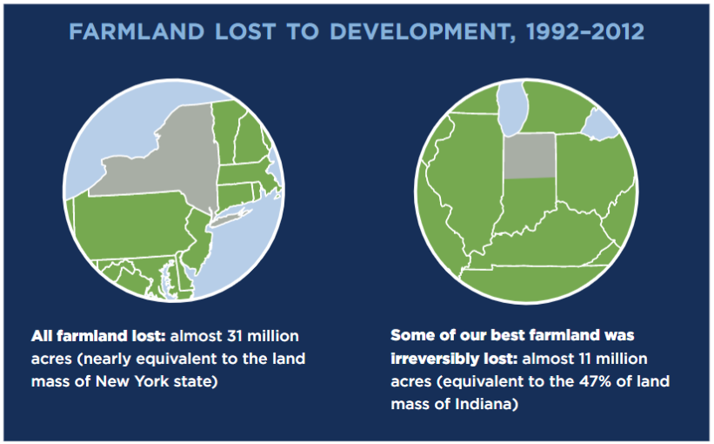
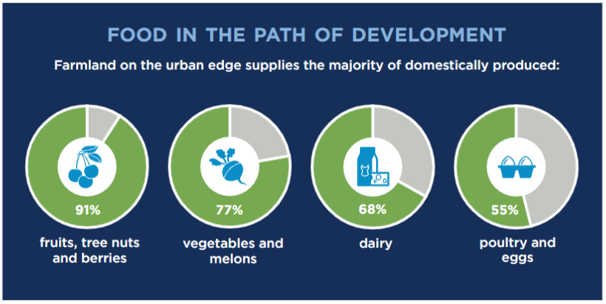
Farms Under Threat
AFT is working on critical issues in the face of significant threats to farmers, to farmland, and to the environment.
Notes:
Presenter: AFT

Slide 16
AFT & Solar Siting
We support accelerated solar development that doesn’t convert farmland or displace agriculture
Our agricultural lands can also play a meaningful role in hosting solar energy
There is so much more we can harvest – not just clean energy
Maximize potential renewable energy while minimizing impact on the nation’s most productive farmland and other resources.
Notes:
AFT supports accelerated solar development and believes that, with proper planning and siting, our agricultural lands can also play a meaningful role in hosting solar energy while maintaining active, productive agriculture.

Slide 17
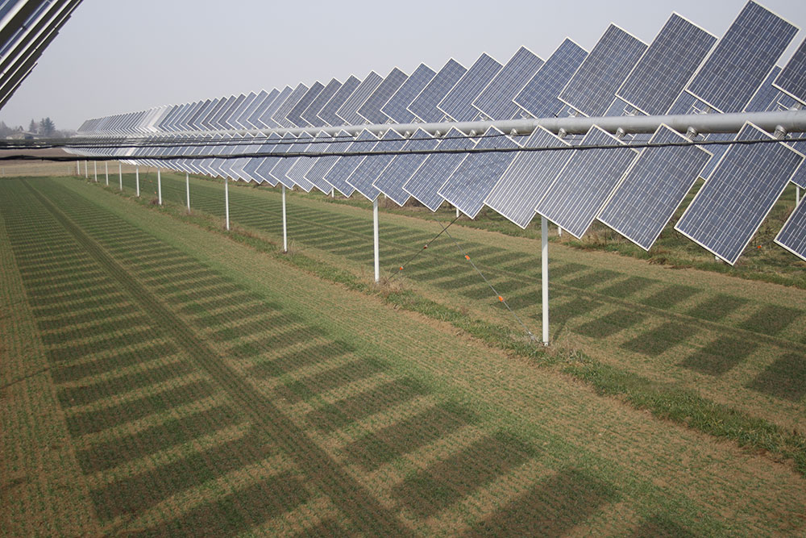
Prioritize land - guide siting to disturbed
or marginal farmland
Prioritize agriculture - protect farmland for the future
Prioritize farmers – insist they are part of development and design
AFT Solar Siting Guidelines for Farmland
https://remtec.energy/en/agrovoltaico/installations/29-borgo-virgilio
Notes:
https://remtec.energy/en/agrovoltaico/installations/29-borgo-virgilio
Maximize the benefits of solar on farmland:
Farmland conservation and expansion
Farmer viability and improved tenure
Regenerative practices implementation
Ecological and Landscape-level Land-use planning
Integration, not domination

Slide 18
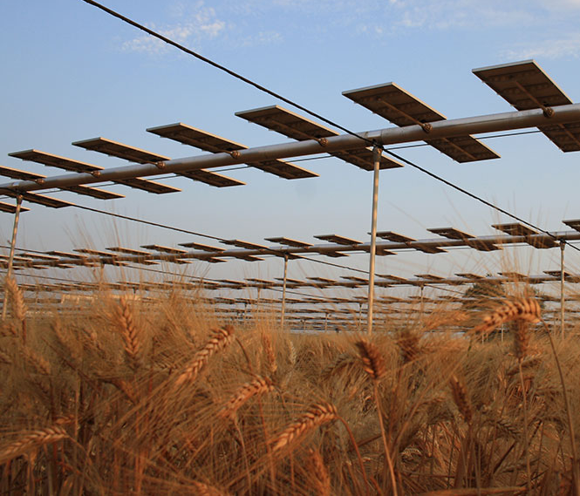
Explore and Support Research on Dual-Use Solar
Protect farmland from permanent development
Protect farmland access for farmers leasing land as well as for new farmers
Provide income diversification and improved income stability
Improve moisture retention in soil and plants in times of high heat and low precipitation
Reduce heat-stress in livestock by providing added shade in summer
Protect the land’s potential for increased carbon sequestration & other best practices that generate co-benefits
https://remtec.energy/en/agrovoltaico/installations/30-monticelli-dongina
Notes:
This
,* leading to:
Reports of increased yields for some vegetables under dual-use arrays (including potatoes, celery, kale, and others)**
Increases in pasture grass biomass under arrays during summer months as compared to areas in full-sun*
http://farmlandinfo.org/publications/what-is-dual-use-solar/

Slide 19
The Balanced Approach
We cannot move forward towards a climate stable future without renewable energy.
Smart solar siting is an opportunity to improve overall farm viability and keep farmland from further sale or development.
We cannot feed ourselves in the future without sufficient productive farmland.
As the climate worsens, we will continue to lose significant acreage and productivity of our farmland.
The path forward together takes careful consideration, compromise, and cooperation.
It starts with communication.

Slide 20
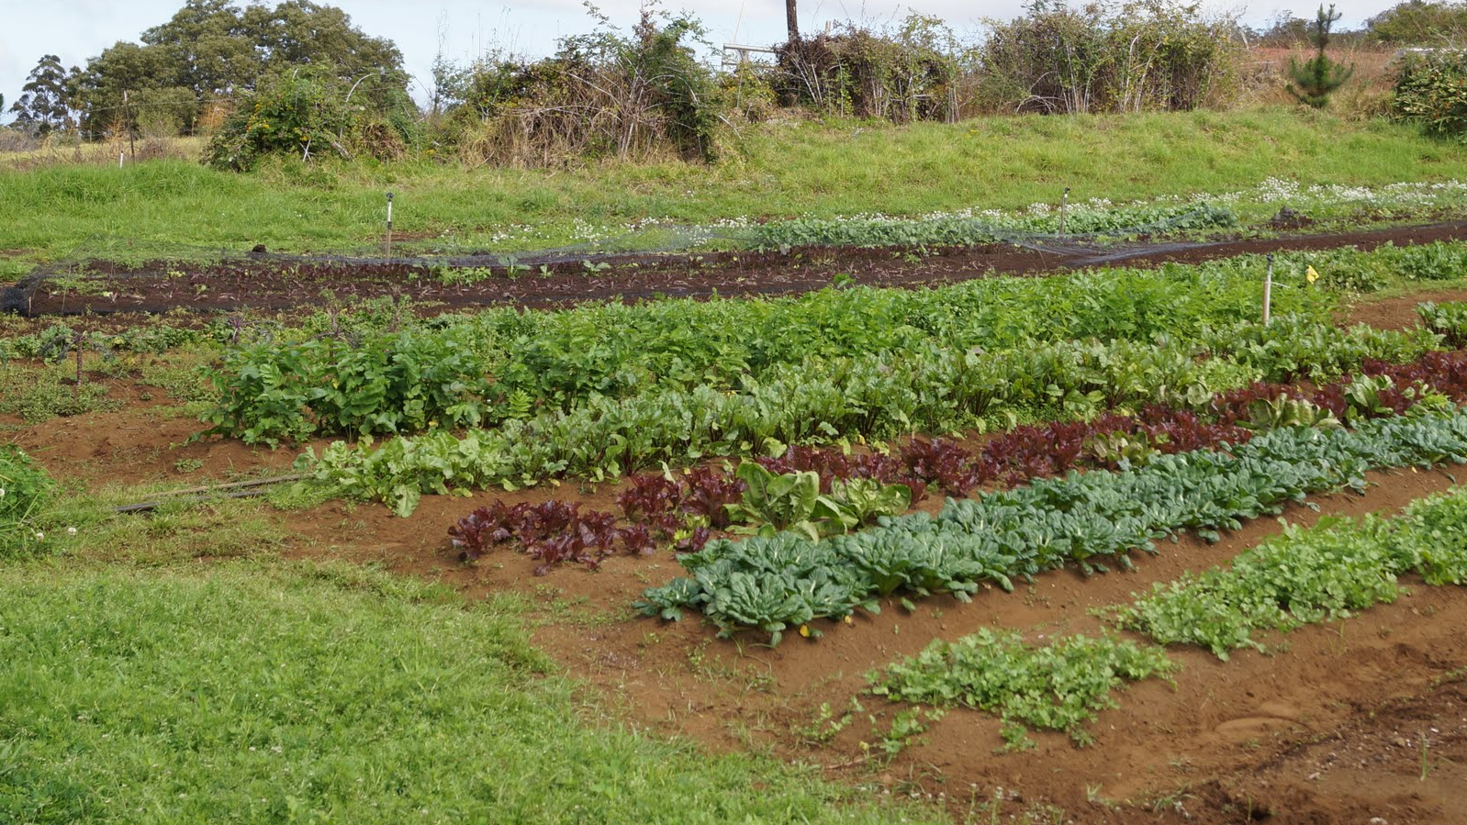
Thank you!
Emily J. Cole, PhD
ecole@farmland.org

