Slide 1
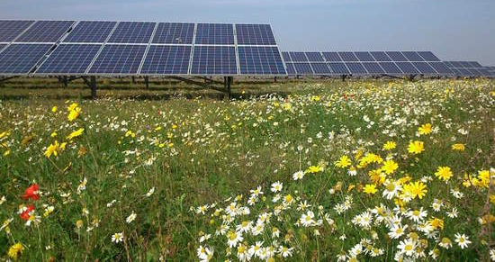
SNEC Meeting; December 4, 2020 Zara Dowling
UMass Clean Energy Extension Pollinator-Friendly Certification Program for Solar PV Arrays

Slide 2
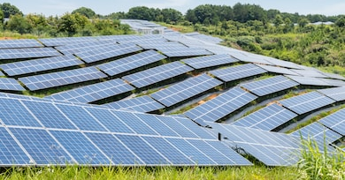
Why Pollinator-Friendly Solar?
2,100 MW pre-SMART
Under SREC II:
1001,600 under SMART
1000 projects greater than 200 kW (~1 acre) in size
500 of these projects NOT on brownfields, landfills, parking lots, buildings = ROUGHLY 3,500 acres
Under SMART: TBD, Up to 1,280 MW “large” projects = ROUGHLY 9,000 acres
Good time
g
Notes:
2,100 MW pre-SMART
Under SREC II:
1001,600 under SMART
1000 projects greater than 200 kW (~1 acre) in size
500 of these projects NOT on brownfields, landfills, parking lots, buildings = ROUGHLY 3,500 acres
Under SMART: TBD, Up to 1,280 MW “large” projects = ROUGHLY 9,000 acres

Slide 3
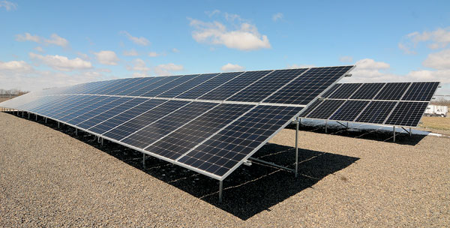
Why Pollinator-Friendly?

Slide 4
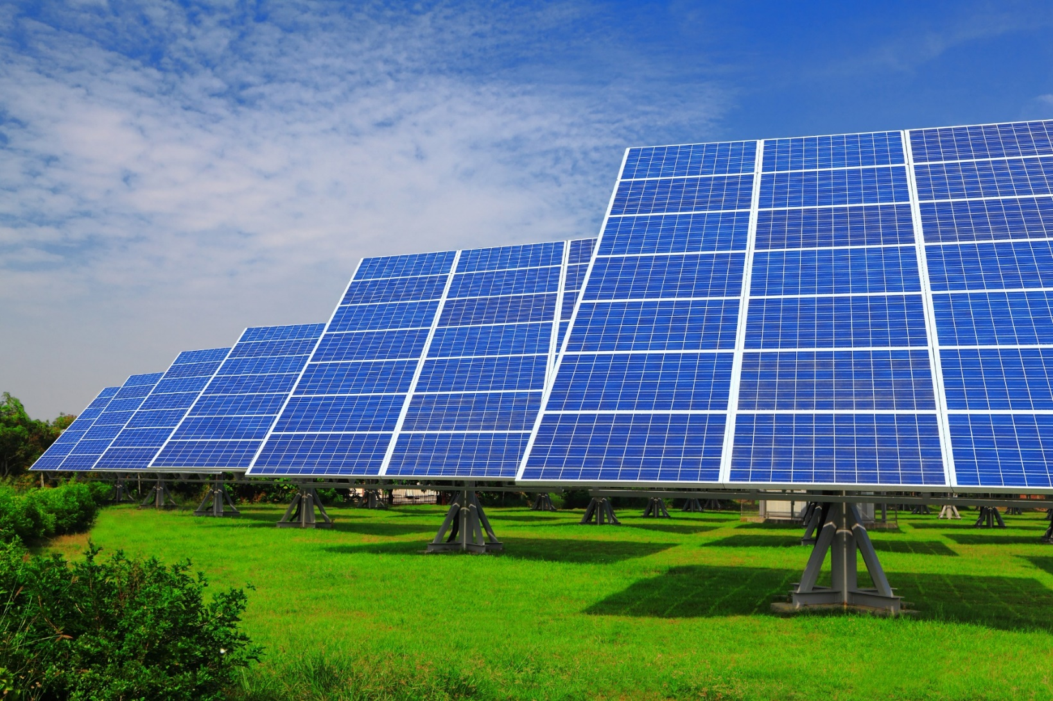
Why Pollinator-Friendly?

Slide 5
“Pollinator-Friendly” Solar in Other States
Minnesota
Michigan
Vermont
North Carolina
Virginia
Illinois
Good time
g

Slide 6
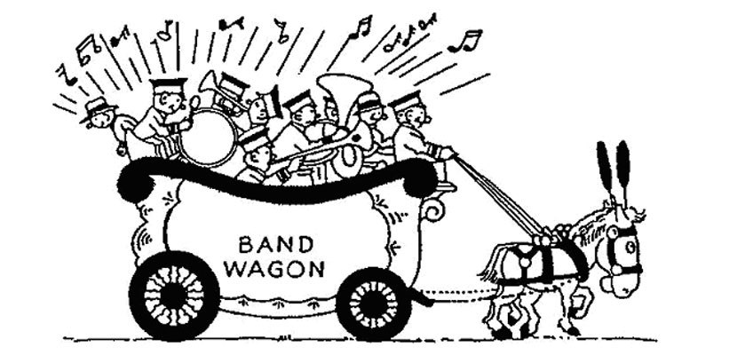
“Pollinator-Friendly” Solar

Slide 7
Criteria used in other states
Detailed establishment and monitoring plans
NO INSECTICIDES on seeds, seedlings, or to be used on-site
Species requirements – flowering, appropriate for habitat, “good” for pollinators
Appropriate seeding density
Plant diversity (# of flowering species)
Seasonal diversity of blooms
Vegetation screen with native and/or flowering plants
Creation of nesting habitat
Signage/education
Mowing requirements – only once per year, or outside of certain seasons
Good time
g

Slide 8
Additional Ideas
Checklist format (like LEED certification)
Clear distinctions between criteria for establishment and maintenance/monitoring
No fungicides
Plants that support specialist species
Perennial water source
Limiting nocturnal lighting
Wildlife considerations

Slide 9
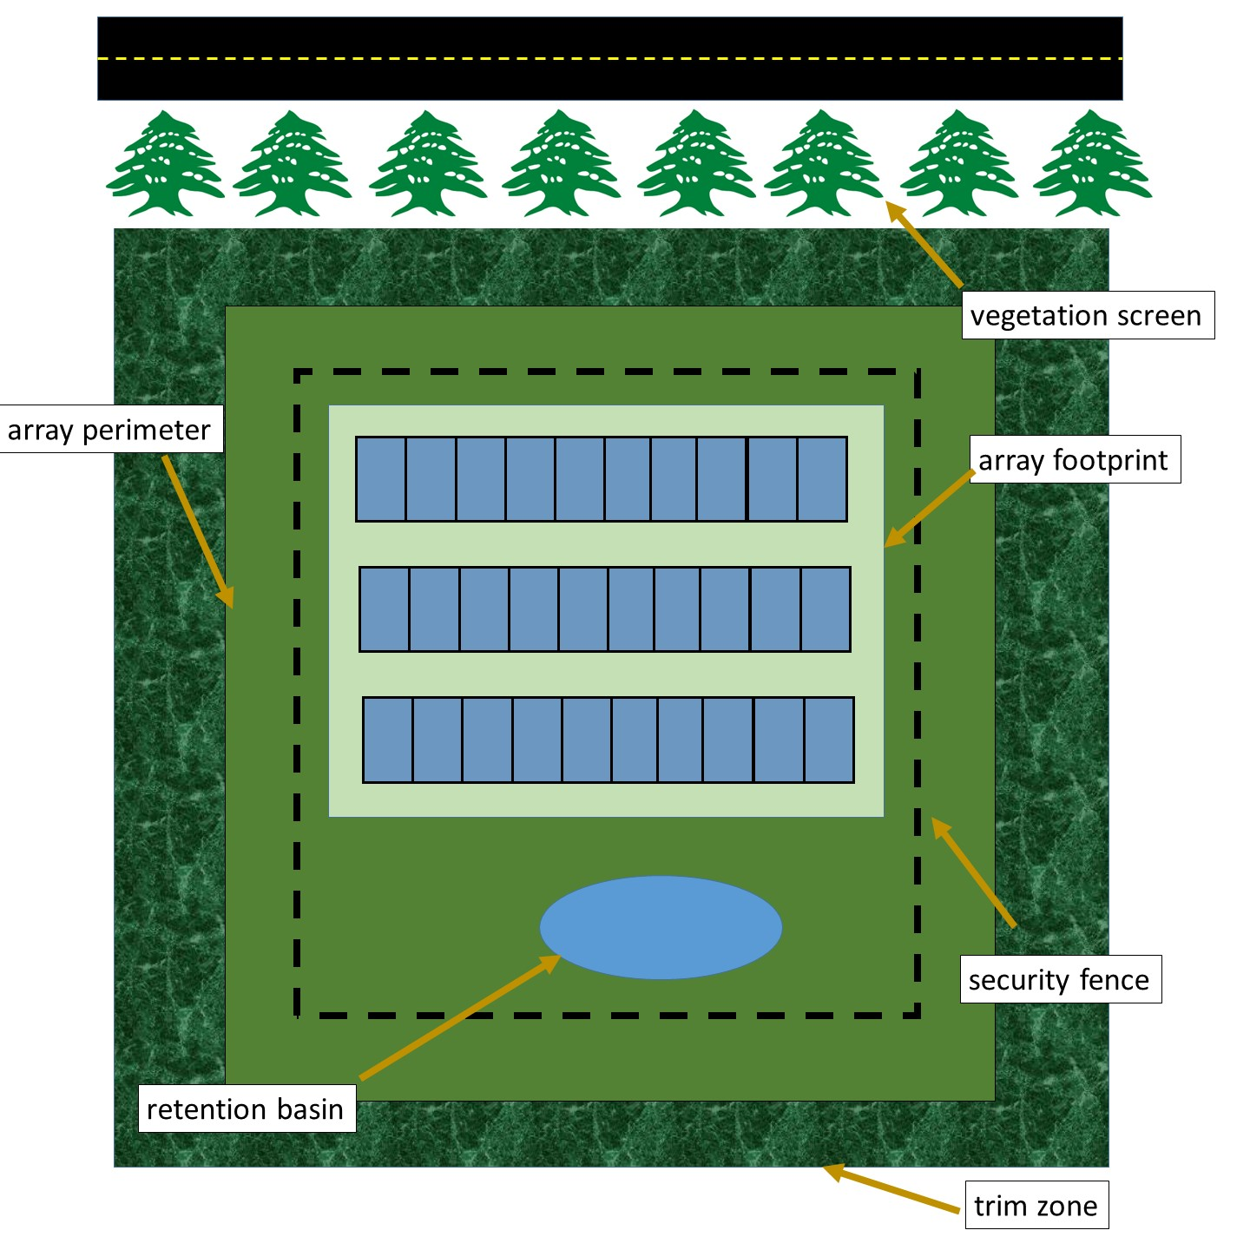
Pollinator-Friendly Solar Array

Slide 10
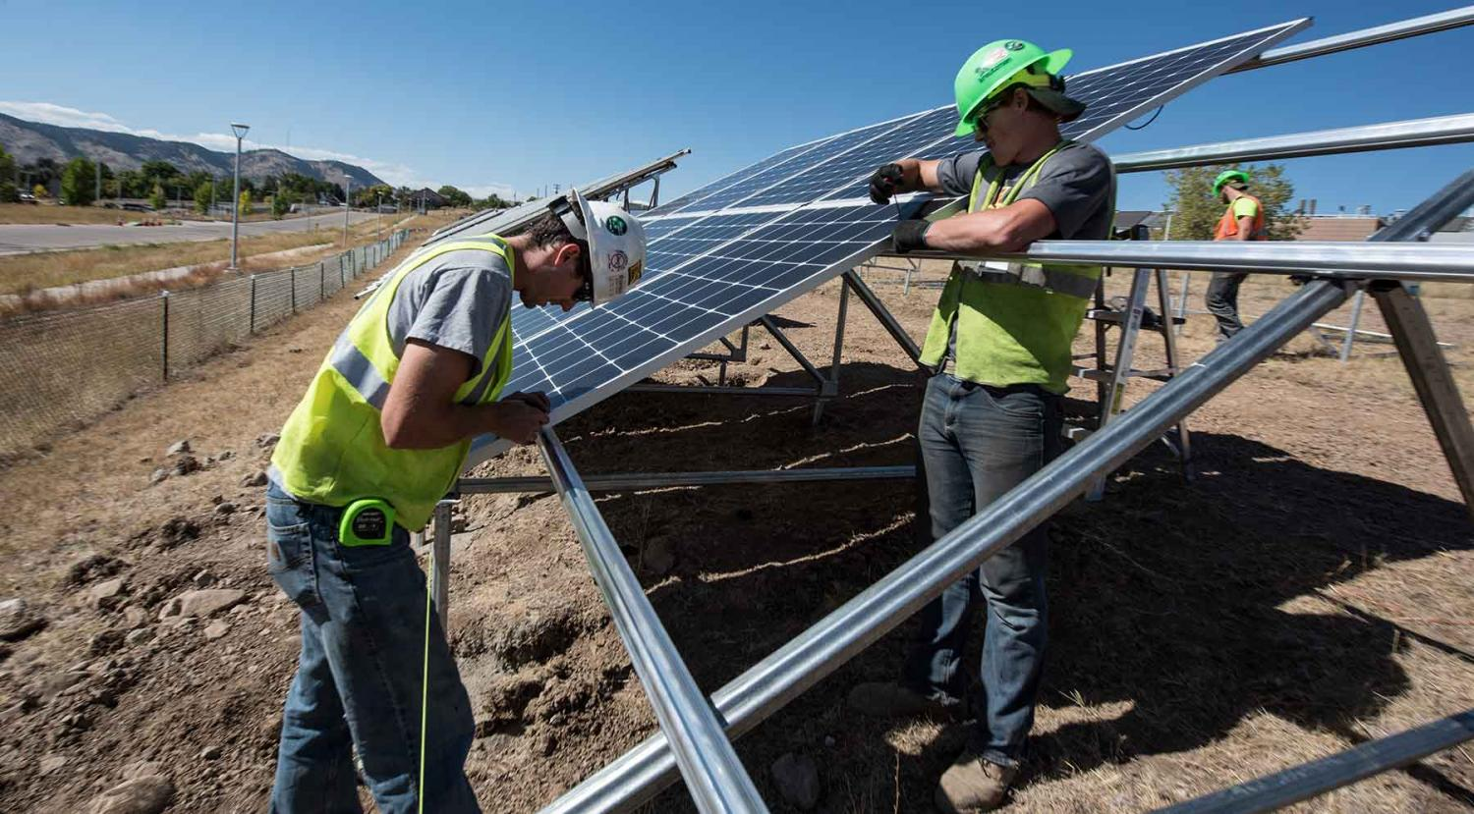
Array Footprint and Perimeter

Slide 11
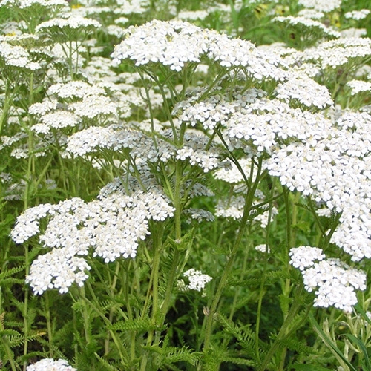
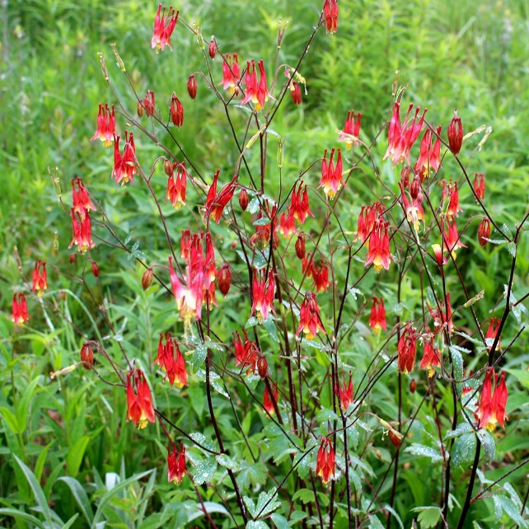
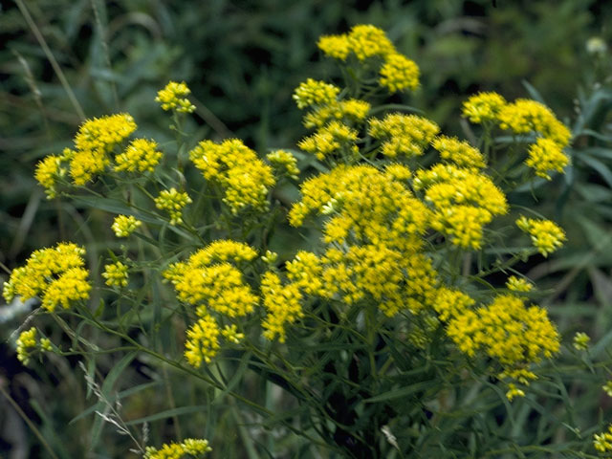
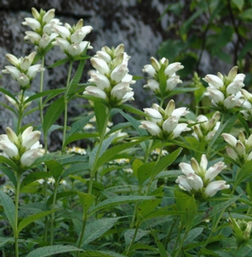
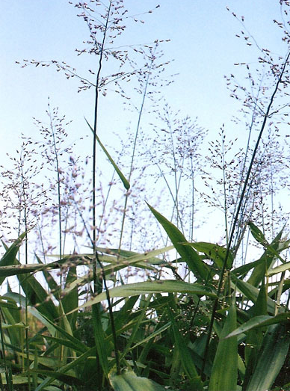
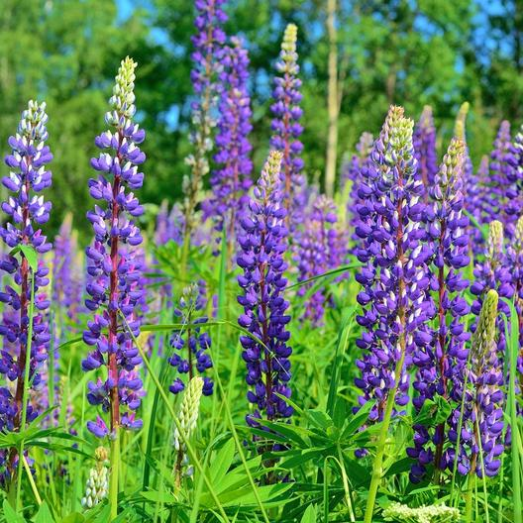
Array Footprint

Slide 12
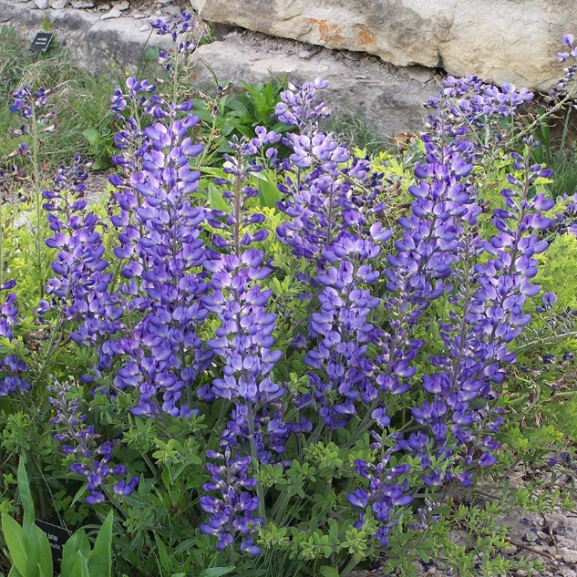
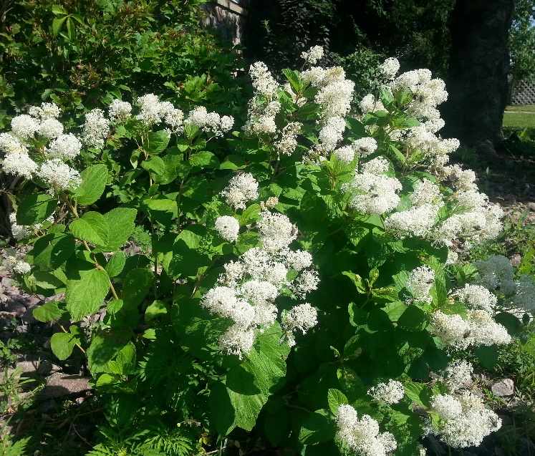
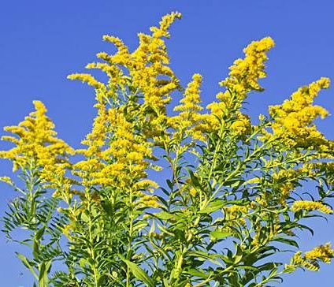
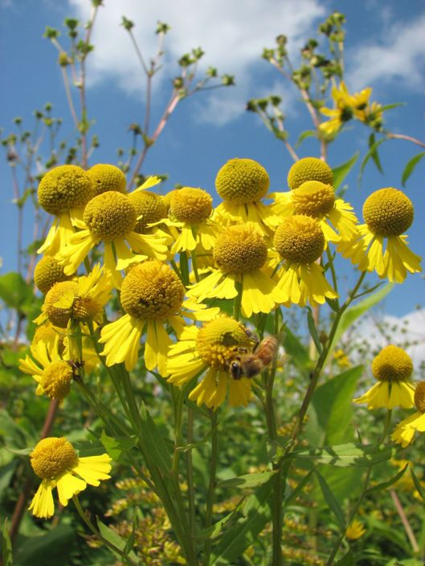
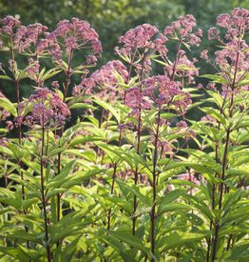
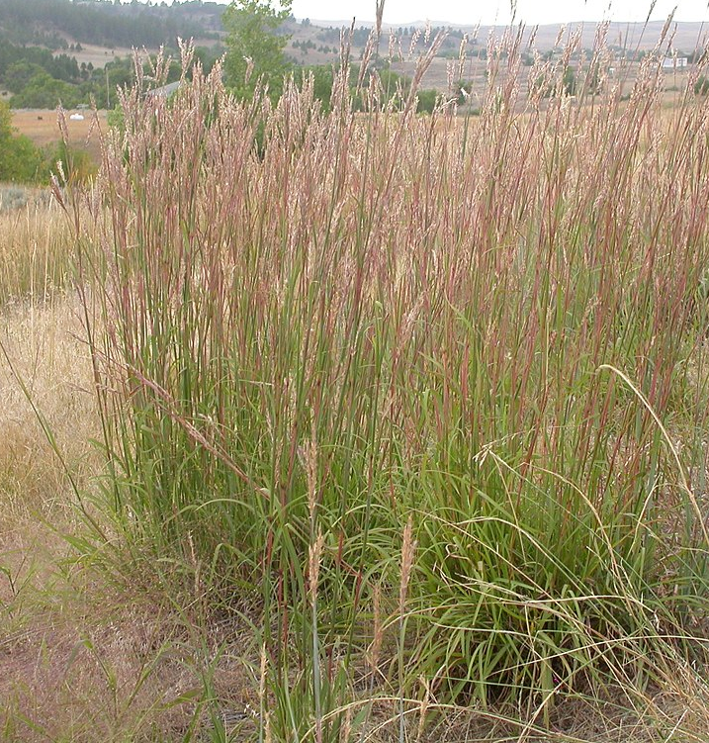
Array Perimeter

Slide 13
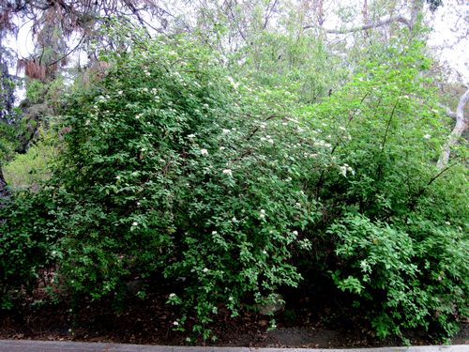
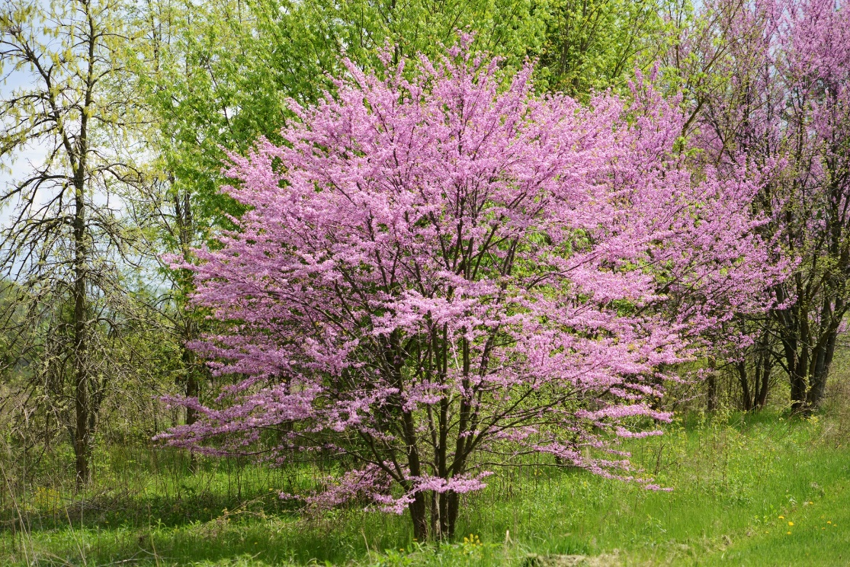
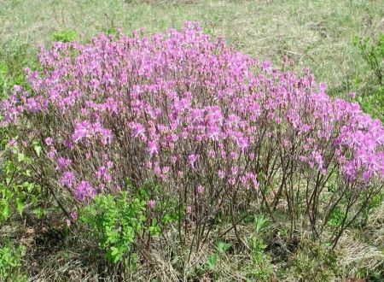
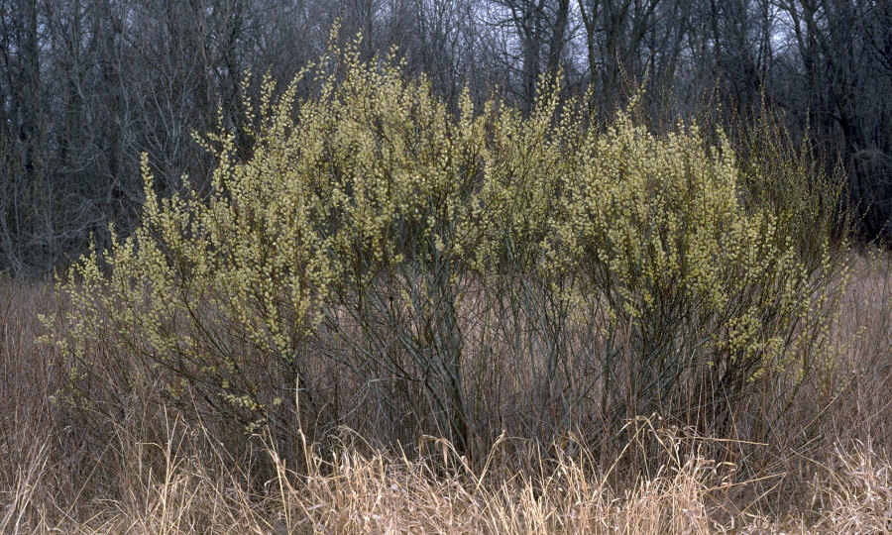
Trim Zone

Slide 14
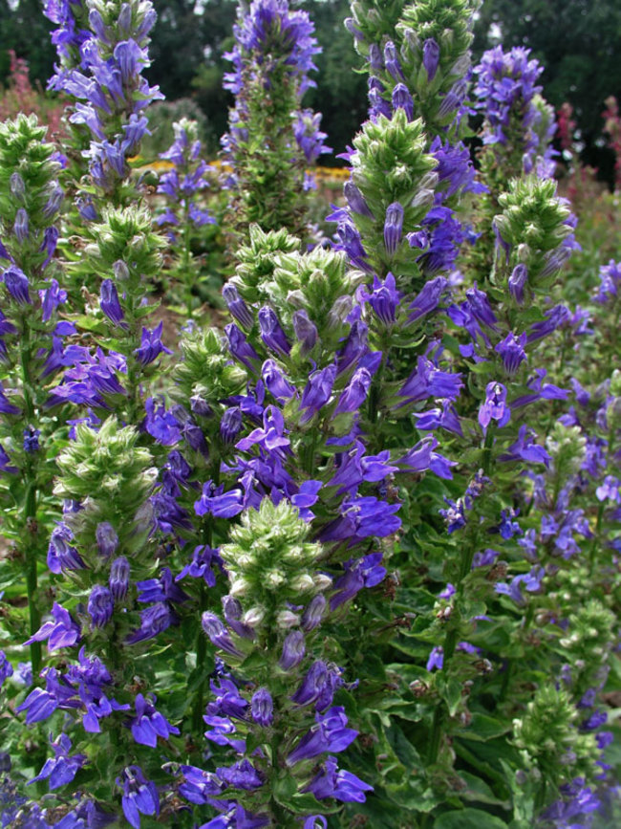
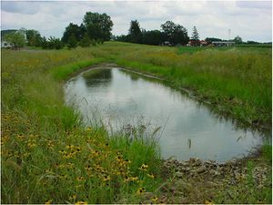
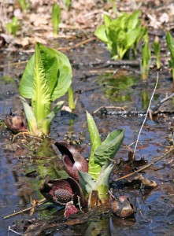
Stormwater Retention Basin

Slide 15
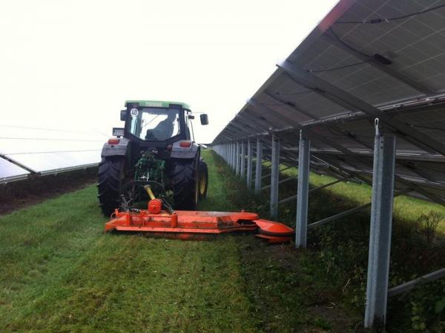
Mowing

Slide 16
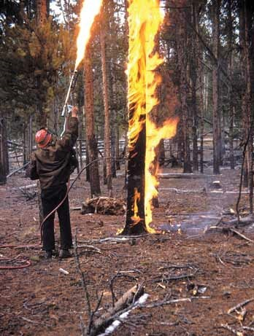
Invasive Plant Control

Slide 17
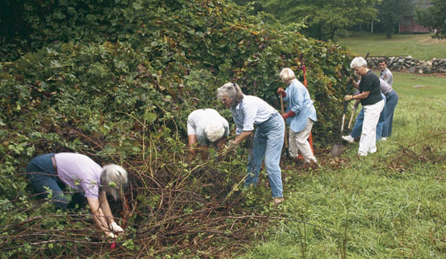
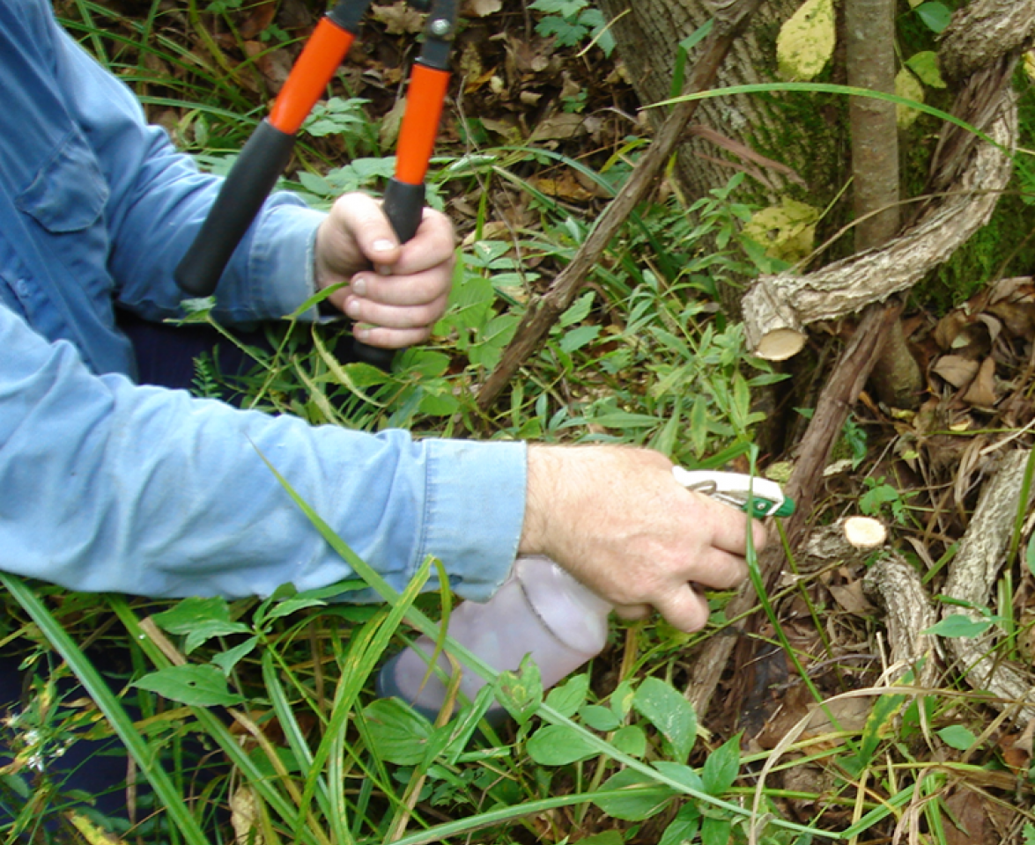
Invasive Plant Control

Slide 18
Massachusetts Criteria - Establishment
Establishment and maintenance plan
Seed mix not pre-treated with insecticide or fungicide
Amount of seed to be planted based on seed providers’ recommendation
Diversity of species
Diversity of bloom times
Seed mixes no more than 25% grasses and sedges
Trim zone plantings include significant % of flowering plants
Vegetation screen, if present, includes only native species
Specialist bee forage plants
Host plants for rare butterflies and moths
Fencing gaps to allow wildlife passage
Bee nesting habitat
Perennial water source
Educational signage
Habitat for rare wildlife species, bird boxes

Slide 19
Massachusetts Criteria - Maintenance
Mowing no more than once per year, before May 1 or after October 1 (AFTER SITE ESTABLISHMENT)
During establishment period (first 3-5 years), have botanist flag invasive plants for removal.
Limit vegetation clearing in trim zone.
Spot treatment of invasive species with herbicide or weed-whacker is acceptable where needed.
No insecticide or fungicide use.
Submit annual request for exclusion from spraying for mosquitoes.
Maintain log of annual mowing and any other vegetation management activities occurring on site.

Slide 20
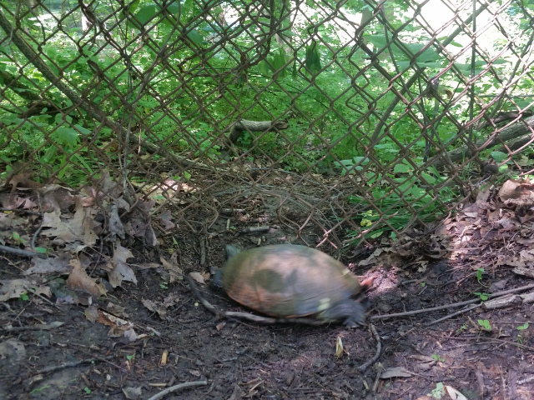
Wildlife Passage

Slide 21
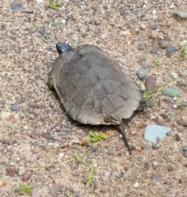
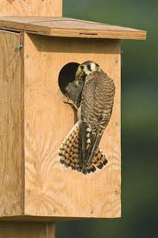
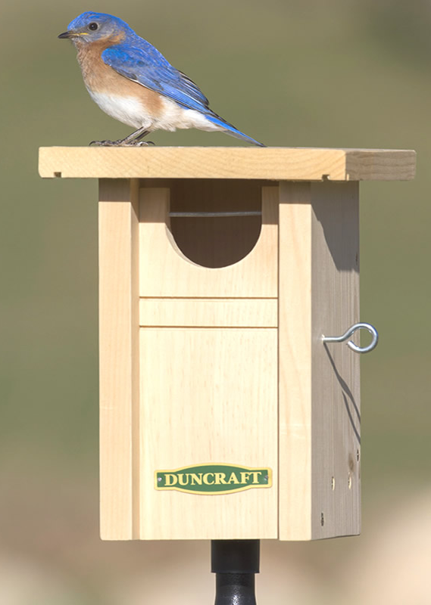
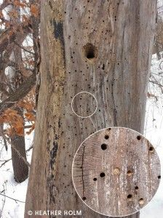
Wildlife Habitat

Slide 22
Certification Program Components
Certification Criteria (Certified, Silver, Gold, Platinum)
Certification Procedure and Fees
Best Management Practices Document
Recommended Plant Species List
Application Form
Annual Maintenance Log
Monitoring

Slide 23
Certification Process
Application, including Site Establishment & Maintenance Plan
Application fee
Review, comments, and revision of Establishment & Maintenance Plan
Letter of Certification issued
On-going maintenance according to the Plan
Submission of Annual Maintenance Log
Monitoring during fourth growing season
Payment of re-certification fee
Adjustment of maintenance activities, if needed
Monitoring every third growing season thereafter
Re-Certification

Slide 24
So Far in 2020…
7 certified projects, 2 solar development companies
Berkshire, Bristol, Franklin, Hampden, Worcester counties
1.0 – 6.7 MW DC capacity
April 2020 – Updated SMART Regulation
Solar incentive adder ($/kWh) for pollinator-friendly certification
“A Solar Tariff Generation Unit that obtains and maintains at least a silver certification from the University of Massachusetts Clean Energy Extension Pollinator-Friendly Certification Program, or other equivalent certification as determined by the Department, shall be eligible to receive an additional $0.0025/kWh Compensation Rate Adder.”
https://www.mass.gov/doc/225-cmr-2000-final-071020-clean/download

Slide 25
Expected Updates for 2021…
Continued flexibility and adjustments as we work out how to establish these sites
Remove rare or uncommon plant species from Recommended List
Review additional research on plants that support specialist bees or Lepidoptera for potential inclusion
Seed mix by seed count only
Provide recommendations on seeding rates (PLS per sq. ft)
Clarify language regarding criteria and BMPs
Provide information regarding geography of plant species by county
Provide signage with Letter of Certification

Slide 26
Thank You!
Questions?
Zara Dowling, UMass Clean Energy Extension
Email: zdowling@umass.edu
Phone: (413) 545-8516
Website: https://ag.umass.edu/clean-energy/services/pollinator-friendly-solar-pv-for-massachusetts

