Slide 1
Long Beach – the backstory Environmental Review Team
Completed ERT study of Pleasure Beach, Bridgeport in 1985
Contacted Bill McCann, Conservation Director for Stratford to request an ERT study of Long Beach
Together the two reports would provide a comprehensive study a single barrier beach
Coastal management staff recommended that Stratford discontinue the leasing of lands at Long Beach west for placement of cottages.
Stratford would discontinue the leases after the wooden bridge to Pleasure Beach burned – that eliminated emergency vehicle access to LBW.

Slide 2
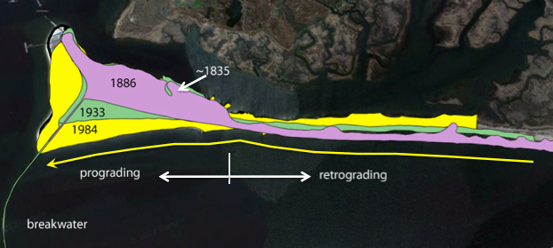
Long Beach – major beach types
Notes:
Long Beach is a classic and typical barrier beach that is gradually migrating landward in response to rising sea level. On the north side of Long Beach West an arrow points to the western edge of the retrograding beach circa 1835. The construction of the first breakwater occurred in 1871. The longshore current is from east to west as shown by the arrow – sand began to accumulate at the breakwater causing the beach to begin to prograde in a seaward direction. The breakwater was extended in 1907 allowing for additional progradation. It appears that the shorelineline at LBW and Pleasure have ceased growing seaward and sand that works around the point into the harbor is causing the west edge of Pleasure Beach to prograde.

Slide 3
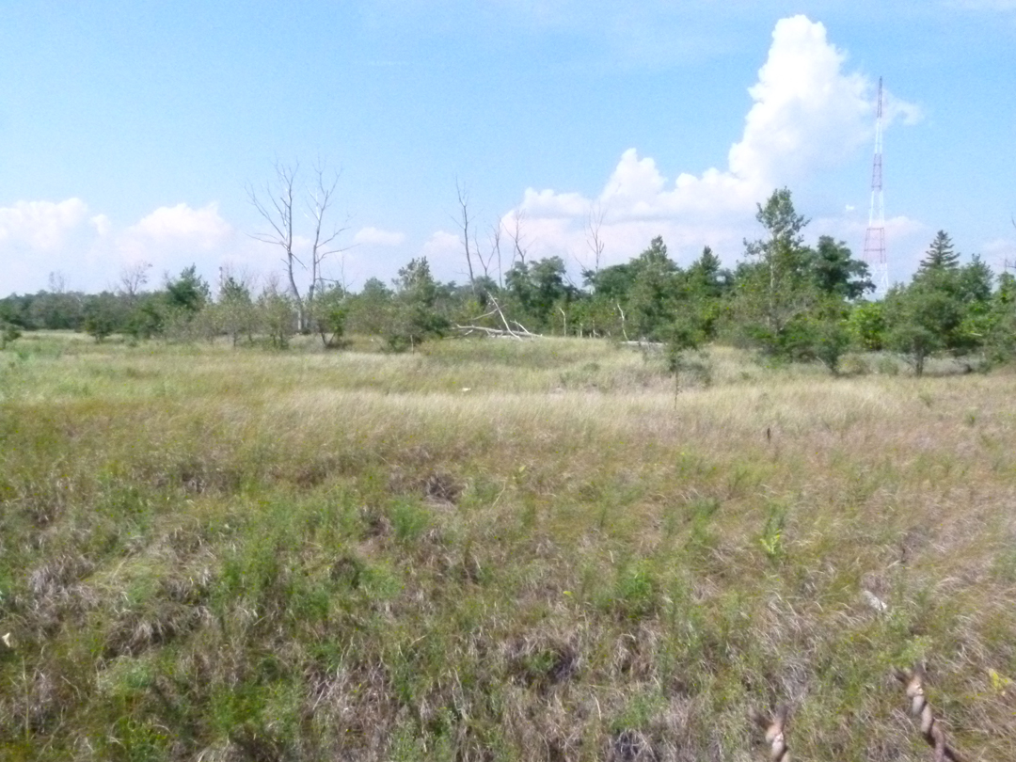
Beach Ridge Plain
Notes:
As beaches prograde, new primary dunes forms along the ocean shore – this creates an alternating series of dunes and swales. This is most evident at Pleasure Beach but there is a remnant interior dune at LBW. The most active sand deposition zone is at the primary dune – the foreslope and backslope being the areas that receives aeolian sand from the beach. There is little sand deposition on the interior ridge plain system and this substrate stability allows for species other than Ammophila to dominate. Ammophila actually requires active sand deposition to survive and be a dominant grass. The state listed plant species occur in this ridge plain complex.

Slide 4
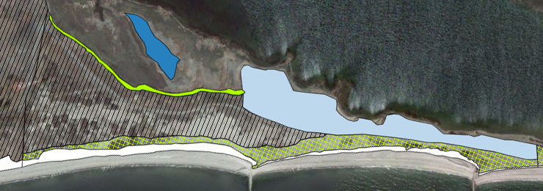
Long Beach West
berm
compact soil
relict inlet dune
Ridge plain
dune
eroded dune (2011 – Irene)

Slide 5
Landform Area

Slide 6
Long Beach Landforms
backbarrier flat
primary dune
eroded dune
Notes:
Long Beach is retrograding and dominated by a primary dune. In the mid-section are backbarrier flats – perhaps the remnant from a prior storm-overwash event.

Slide 7
Landform Recommendations
Landform recommendations:
No need to replant dunes – should rebuild [? Sandy has deposited more sand on the dunes – need to monitor to determine if Ammophila regrows – reassess the need for planting.]
Care needs to be exercised when placing string exclosure for nesting terns and plovers so as to not cause the public to destroy dune vegetation.
Review the potential harm that the existing groins may cause – during Irene they had the potential to create breaches/inlets
Compact soil area – monitor [Sandy deposit sand on the eastern ½ of this landform – this may help native plant recovery.]

Slide 8
Plant Communities
Primary dune
foreslope community – dominated by Ammophila breviligulata (beach grass), few associates, most active zone of aeolian sand deposition
backslope community – Ammophila dominant, increased species diversity, some Rosa rugosa shrub colonies – stable sands with limited aeolian sand deposition
Ridge plain (backbarrier flat has similar vegetation)
herbaceous species, more open ground, aeolian deposition minimal (most stable areas have lichens; reindeer moss at Pleasure Beach!)
Panicum virgatum grassland – north side of LBW – far west end
shrub thickets
Prunus maritima
Rosa rugosa
Rosa virginiana* - most extensive in the state

Slide 9
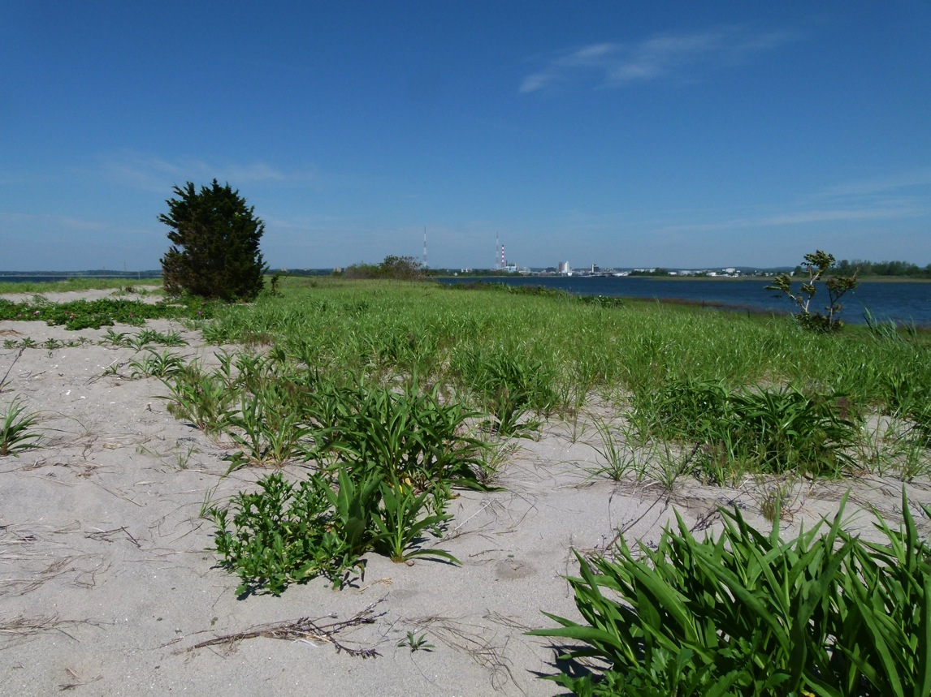
Backslope Dune

Slide 10
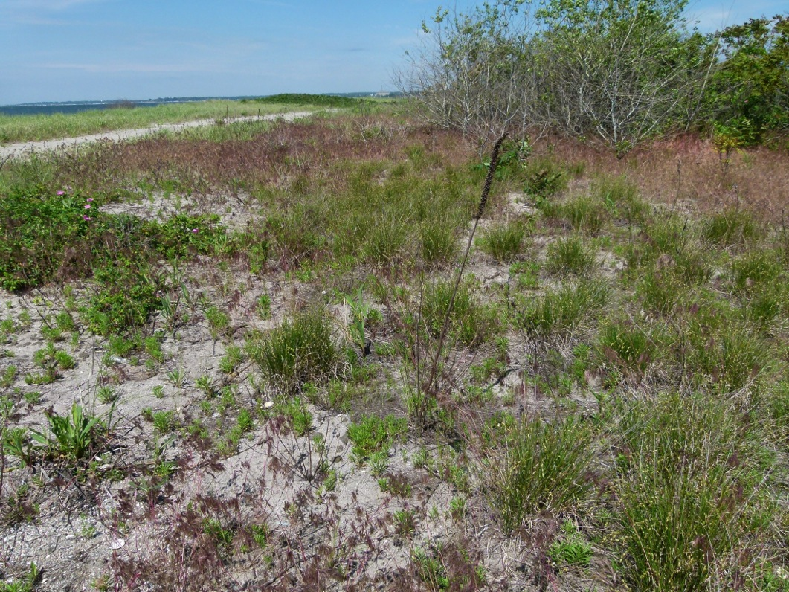
Backbarrier flats

Slide 11
Ridge Plain - Artemisia

Slide 12
Ridge Plain – state listed plants

Slide 13
Beach Ridge Plain
Rosa rugosa – several patches

Slide 14
Compact soil
Notes:
In September, the dominant plant was Crab-grass.

Slide 15
Vegetation Recommendations
Protect dune and ridge plain habitat through the removal of invasive species (specifics in next section).
Consider purchasing and planting native trees such as Prunus serotina and Amelanchier canadensis (replace the Locust with these trees) – protect from deer browsing. Establish a few Juniperus groves as owl habitat.
Monitor vegetation change at the compact landform site

Slide 16
State Listed Plants
Aristida tuberculosa – beach needlegrass
Pityopsis falcata – sickle leaved golden aster
Liatris borealis – New England blazing star
Panicum amarum – bitter panicgrass
All concentrated at the west end of LBW; Pityopsis has spread since 1987; Aristida covers the largest area; Liatris population – status unclear – flowering stalks are browsed by deer. Very large population of Panicum (~2000) in Pleasure Beach.

Slide 17
State listed Plant Recommendations
Apply deer off to Liatris plants before they flower
Monitor populations every 3 years
Important to control invasive species – shrubs, trees and grass listed in the next section.

Slide 18
Primary Invasive Plants

Slide 19
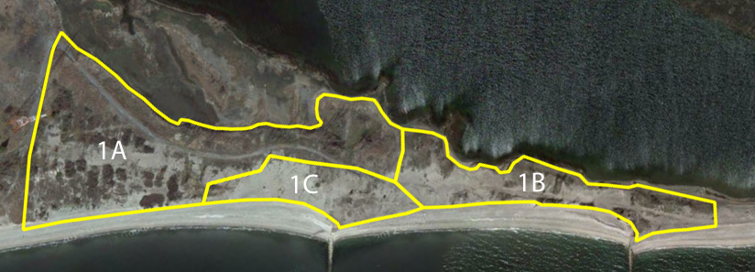
Zones

Slide 20
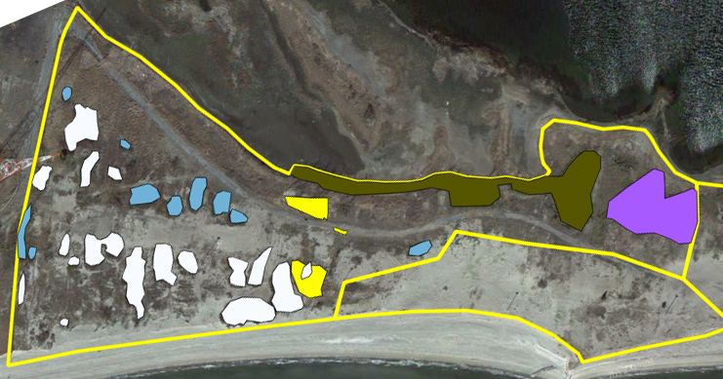
Zone 1a
Notes:
This is the primary control area – red is the area with Robinia trees; white are shrub islands, light blue are native beach plum, dark blue is an upland patch of Phragmites and yellow/green is the turf grass Zoysia. The basic control technique for shrubs and trees is to cut and paint with herbicide. The one exception is Quaking Aspen which is typically treated with a basal stem injection.

Slide 21
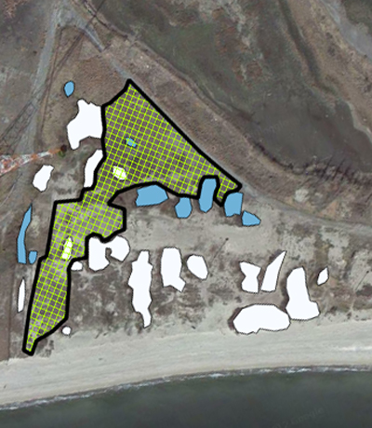
Zone 1A
The hatched area is a conservative approximation of the habitat area containing state listed plants.
Delineate the perimeter – stake/string to prevent access/trampling
Modify the perimeter to provide access to the few interior shrub islands

Slide 22
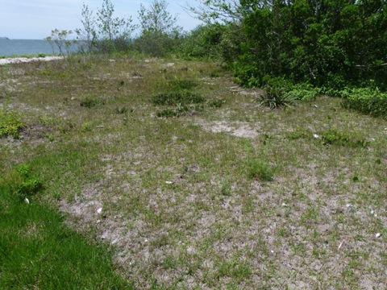
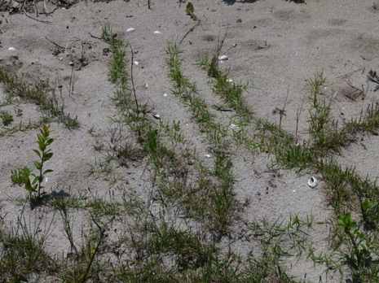
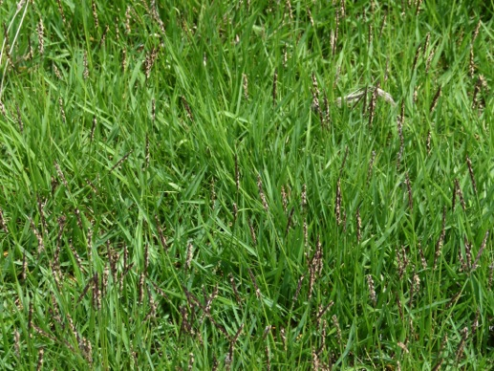
Zoysia
Characteristics:
2 lawn areas, and actively spreading
Area - 7041 SF
Recommended Control:
herbicide in late spring or early summer when growing well (after rain);
rake thatch and herbicide again (<2 weeks between spraying)
check for regrowth and treat as needed

Slide 23
Knapweed
Description:
Polygon area: 57588 SF, 1.3 acres
Invasive in sand dunes
Phytotoxic (catechin) – root exudate
Biennial (Life expectancy – 3 – 9 yrs)
Seeds viability – 5 to 8 years in soil.

Slide 24
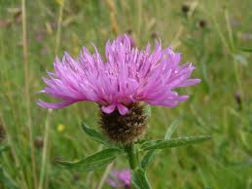
Knapweed Control
Control methods:
Hand pulling (wear gloves to avoid irritation) – preferably prior to seed set;
Use volunteers – help from OLISP
Flowering material should be bagged to prevent seed drop
Control outlying areas first (e.g., LBW)
LBW – outlier is 1st priority – most plant clusters except for easternmost area.
Work east from LBW – time and volunteers allowing

Slide 25
Recommendations
Get partners to work with Bridgeport to determine their interest towards invasive species control on Pleasure Beach
Mayor Fitch may be supportive of this
Pleasure Beach serves as a source for invasive species at LBW!!!
OLISP provides assistance to Bridgeport in drafting an application for restoration funds?
Ideally manage LBW/Pleasure Beach as a single ecosystem complex – the best example of backbarrier flats in all of Long Island Sound??
OLISP (?) assists Stratford with knapweed harvest – potentially great publicity and support from LISS.

Slide 26
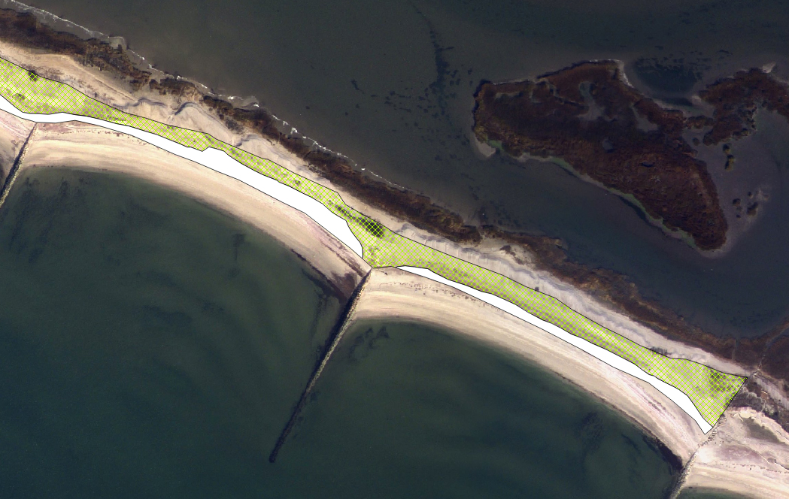
Nor’easter Sandy
Overwash fans
Migration direction

Slide 27
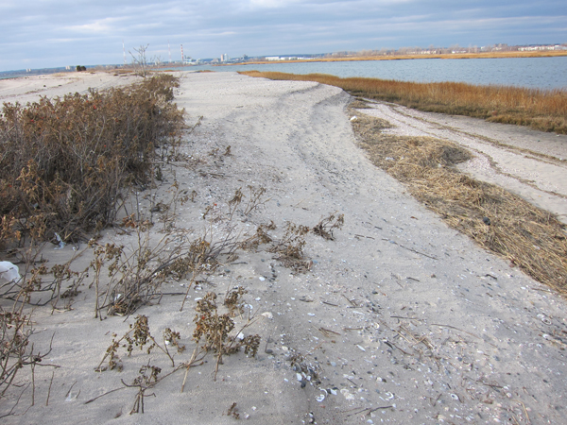
Post-Sandy

Slide 28
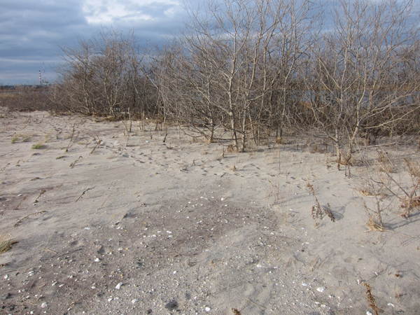
Populus – Celastrus - Ailanthus

Slide 29
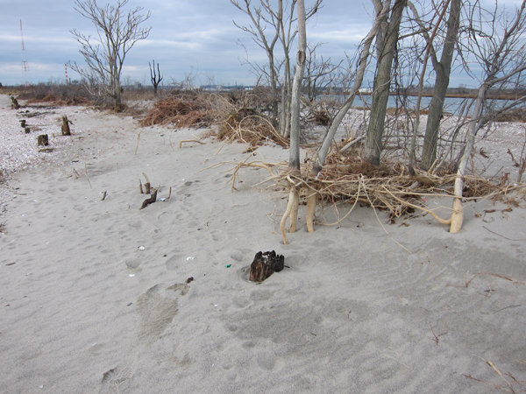
LBW – east end

Slide 30
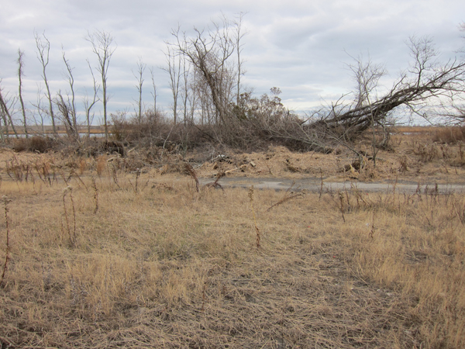
LBW - Berm

Slide 31
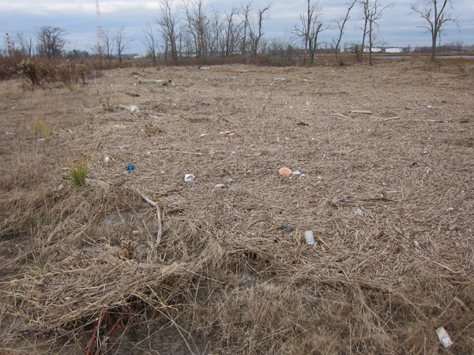
Flotsam
Notes:
New source of invasive species.

Slide 32
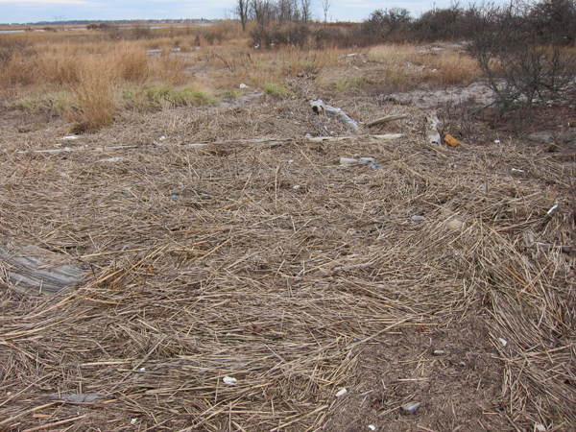
Rare plant habitat

