Slide 1

Quality of Massachusetts Waters:
Regulation, Improvement and Challenges
David Wong
SWCS SNEC Winter Conference
Amherst, MA
March 30, 2023

Slide 2
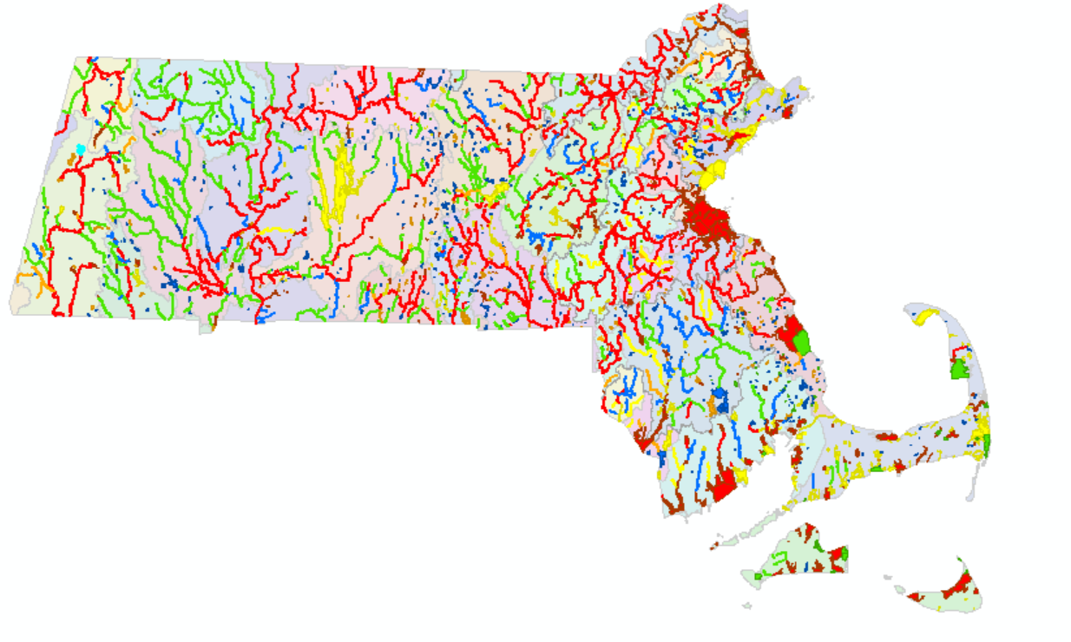
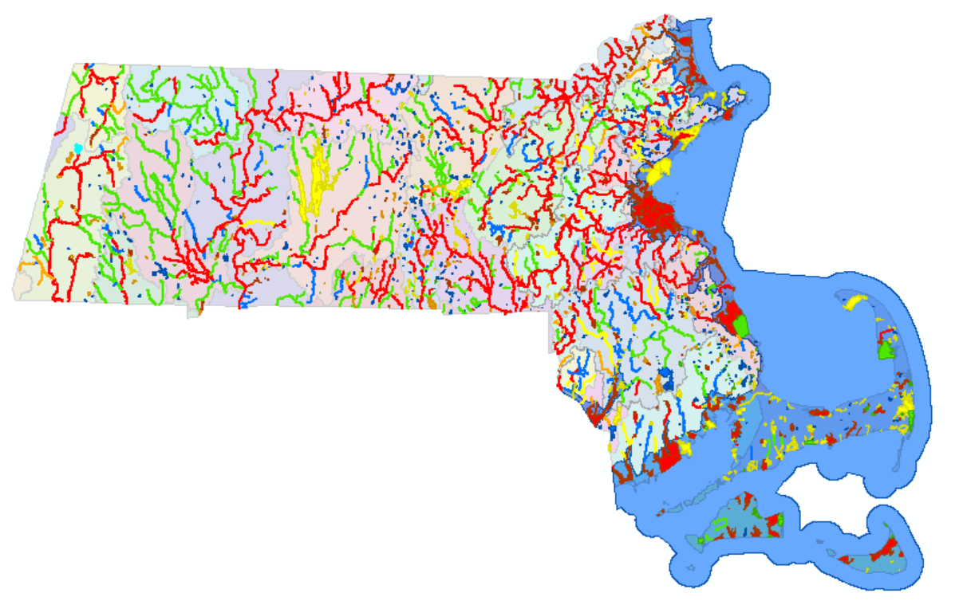
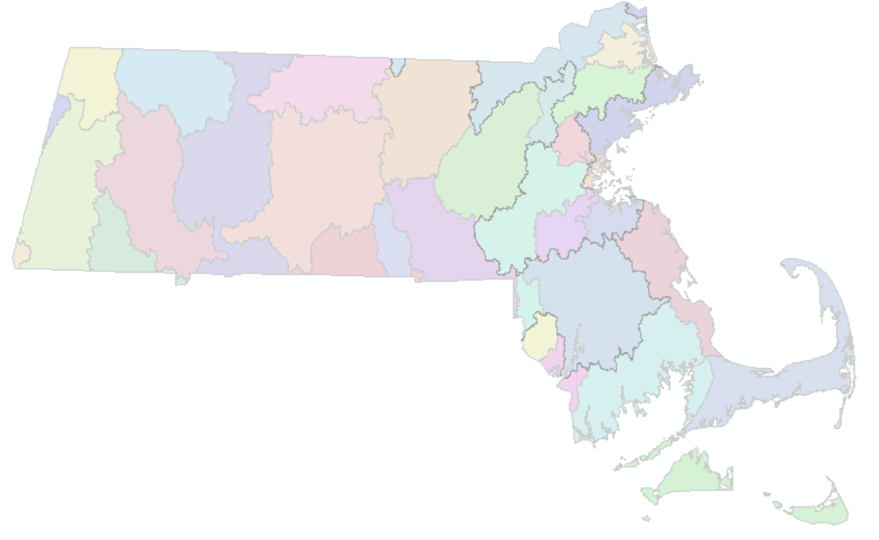
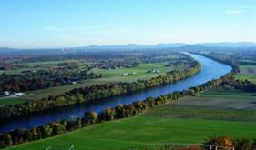
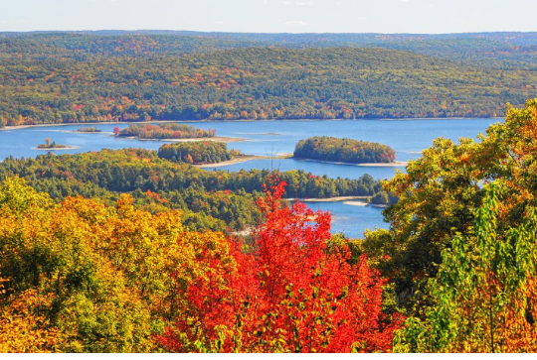
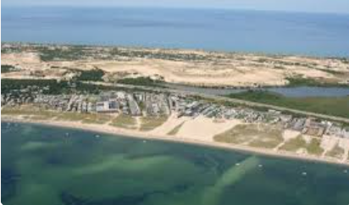
Massachusetts Surface Water
Excluding Drinking Water/Ground Water

Slide 3
Outline
MA Surface Water Regulation: Clean Water Act (CWA)
Improvement of Surface Water Quality
Challenges of MA Surface Water Quality
  Nutrient Enrichment (Eutrophication)
  Climate Change
  PFAS (Per- and Polyfluoroalkyl Substances)
  Plastics
  Road Salt

Slide 4
Monitoring
Assessment
303d List
305b Report
TMDLs
Permits and
Regulation
CWA 401 WQC
CWA 402 NPDES
CWA 106
Clean Water
State
Revolving
Fund
WQ
Standards
CWA 319
CWA 604b
Notes:
73 causes/87 sources: such as organic enrichment, or too high concentration of bacteria. 303 d impaired water list: Primary Recreational Use, Secondary Recreational Use, Aesthetics, Aquatic Life Use. These uses are not attainable and the water quality cannot meet the requirements of the water quality standards.

Slide 5
Clean Water Act (CWA) Section 401
Section 401 water quality certifications for activities that may affect water quality and require a federal license or permit
Under Section 401 of the CWA, a federal agency may not issue a permit or license to conduct any activity that may result in any discharge into waters of the United States unless a Section 401 water quality certification (WQC) is issued, or waived.
Some of the major federal licenses and permits subject to Section 401 include:
Clean Water Act Sections 402 and 404 permits issued by EPA or the Corps,
Federal Energy Regulatory Commission (FERC) licenses for hydropower facilities and natural gas pipelines, and
Rivers and Harbors Act Sections 9 and 10 permits
https://www.epa.gov/cwa-401/overview-cwa-section-401-certification

Slide 6
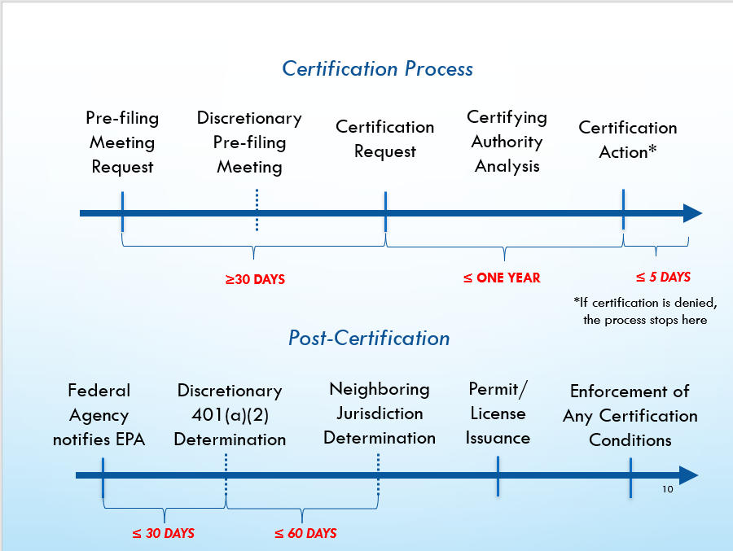
1. MA Surface Water Regulation: 401 Water Quality Cert.

Slide 7
314 CMR 9.00
401 Water Quality Certification for discharge of dredged or fill material, dredging, and dredged material disposal in waters of the United States within the Commonwealth
314 CMR 9.00 implements and supplements State Water Quality Standards 314 CMR 4.00

Slide 8
MassDEP 401 Water Quality Certification (WQC) Program
No fill or dredging shall be permitted unless appropriate and practicable steps have been taken which will first avoid, and if avoidance is not possible then minimize, or if neither avoidance or minimization are possible, then mitigate, potential adverse impacts to land under water or ocean, intertidal zone and special aquatic sites.
Notes:
This program is authorized under the Federal and State Clean Water Act: Projects should be avoid, minimize and mitigate any impacts to the water quality

Slide 9
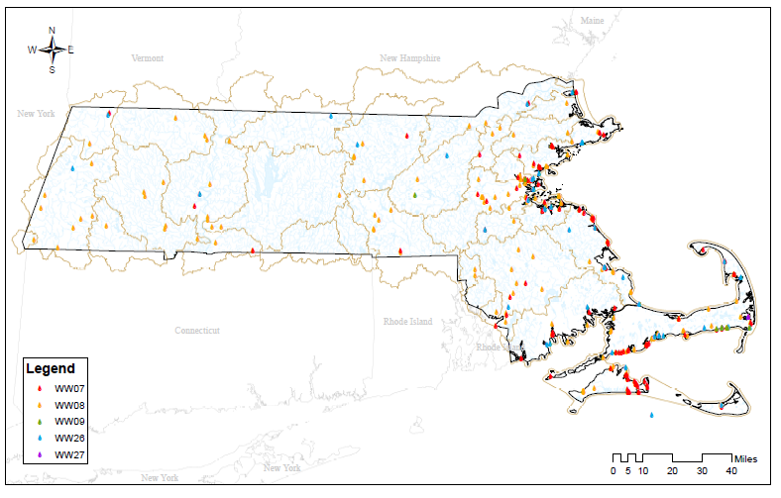
MA 401 Water Quality Certifications (WQCs)

Slide 10
Sampling and Analysis Requirements
(314 CMR 9.07(2))
The applicant shall submit the results of all relevant sampling with the application, unless an alternative schedule is specifically authorized by the Department in writing.
As part of sampling and analysis, the applicant shall perform a “due diligence” review to determine the potential for the sediment proposed to be dredged to have concentrations of oil or hazardous materials, as defined in 310 CMR 40.0000: Massachusetts Contingency Plan (MCP)

Slide 11
MAXIMUM ALLOWABLE CONTAMINANT LEVELS FOR REUSE AT LINED LANDFILLS
CONTAMINANT | Reuse Levels (mg/kg, dry weight) | RCS-1 (mg/kg, dry weight)
Total Arsenic | 40 | 20
Total Cadmium | 80 | 70
Total Chromium | 1,000 | 100
Total Lead | 2,000 | 200
Total Mercury | 10 | 20
Total Petroleum Hydrocarbons (TPH) | 5,000
Total PCBs | < 2 | 1
Total PAHs | 100
Total VOCs | 10
Listed or Characteristic Hazardous Waste (TCLPs) | *
*TCLP testing should be performed for metals or organic compounds when the total concentrations in the sediments are above the theoretical levels at which the TCLP criteria may be met or exceeded. For the above metals such levels (mg/kg) are: As > 100, Cd > 20, Cr > 100, Pb > 100, Hg > 4

Slide 12
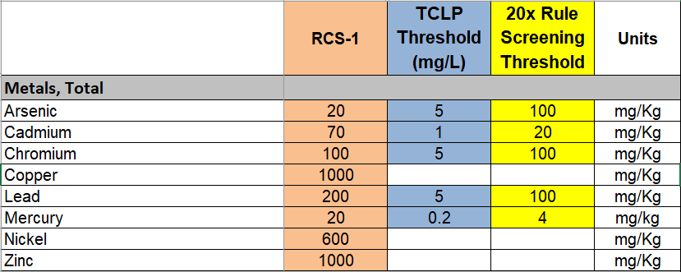
TCLP
Toxicity Characteristics Leaching Procedure

Slide 13
Sampling and Analysis Requirements
(314 CMR 9.07(2))
No chemical testing shall be required if the sediment to be dredged contains less than 10% by weight of particles passing the No. 200 U.S. Standard Series Testing Sieve (nominal opening 0.0029 inches), and if the required “due diligence” review demonstrates, to the Department’s satisfaction, that the area is unlikely to contain anthropogenic concentrations of oil or hazardous materials (314 CMR 9.07(2)(a)).
In all other instances, chemical and physical testing shall be conducted and the information provided in writing to the Department.

Slide 14
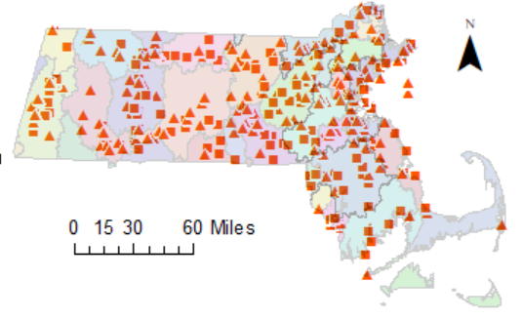
CWA 402 NPDES Surface Water Discharge Permits
Notes:
The upgrade of wastewater treatment facilities is critical in the 1990s and early 2000s.
The implementation of the surface water discharge (SWD) permit program (in coordination with EPA Region 1’s National Pollutant Discharge Elimination System (NPDES) Program) and the residuals program for the Bureau of Water Resources.
As one system, the NPDES surface water discharege permit and wastewater plant upgrade contributed significantly to the improvement of nutrient removal in MA waters which will be covered in a minute.

Slide 15
2. MA Water Quality Improvement

Slide 16
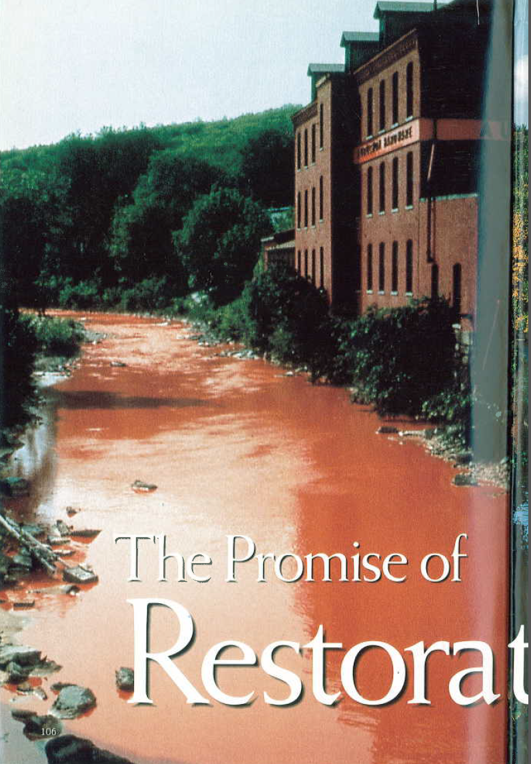
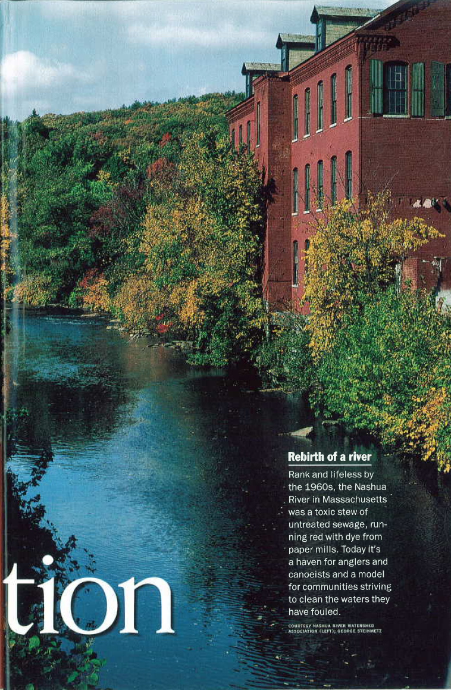
The Nashua River
Rebirth of a river
Rank and lifeless by the 1960s, the Nashua River in MA was a toxic stew of untreated sewage, running red with dye from paper mills. Today it’s a haven for anglers and canoeists and a model for communities striving to clean the waters they have fouled (National Geographic 1993 by George Steinmetz)
1960s
1990s
Notes:
Mostly due to primary treatment, physical treatment/screen

Slide 17
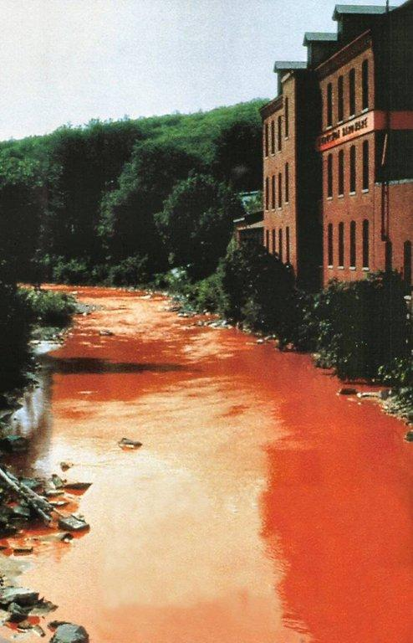
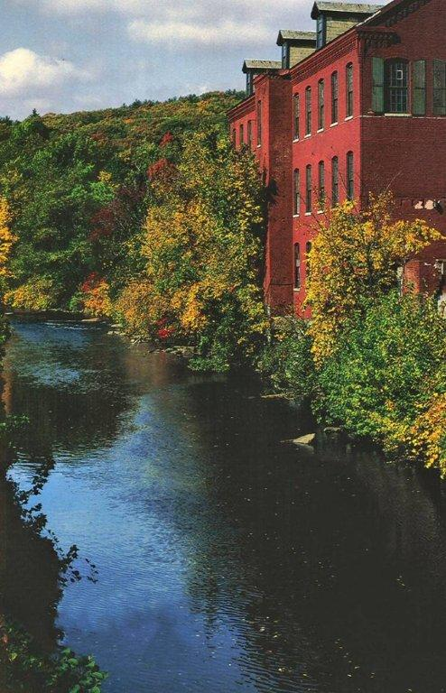
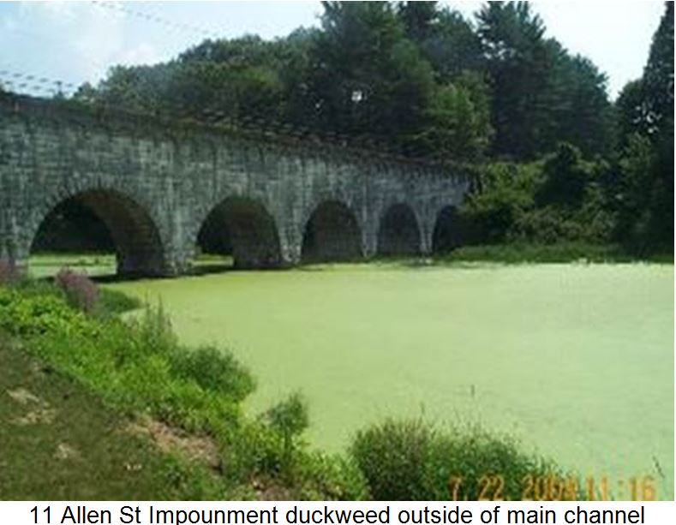
The Nashua River The Assabet River
1960s
1990s
Late 1990s to early 2000s
Photo by NRWA
Photo by George Steinmetz
Photo by Therese Beaudoin
Notes:
Rebirth of the Nashua River is absolutely a great success story to tell everybody because it represents thousands of rives in New England and the whole county. Absolutely the water in the 1990s are much more clear than the 60s/70s. But is that clean? Look at the Assbet River in the late 90s and early 2000. Summer time it is fully covered by duckweeds and filamentous algae. What happened since then? My talk today is going to focus on these rivers in Massachusetts from the late 1998 to 2013

Slide 18
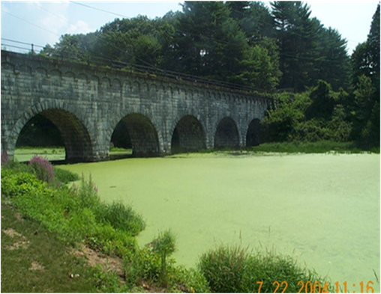
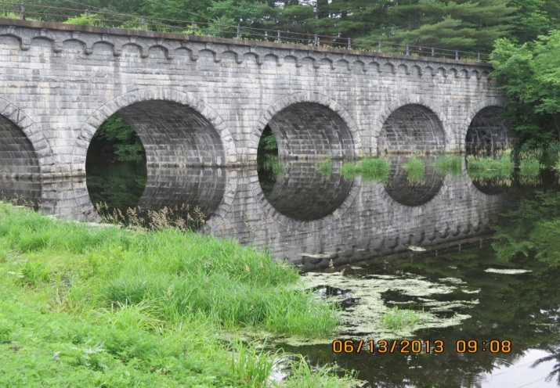
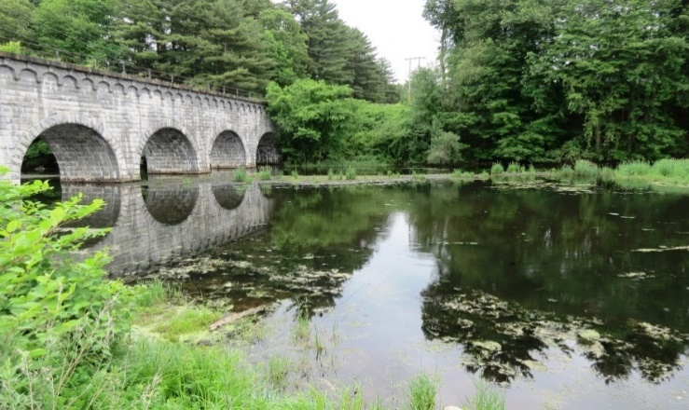
Aquatic Plants in Assabet River
2004
2013
2014

Slide 19
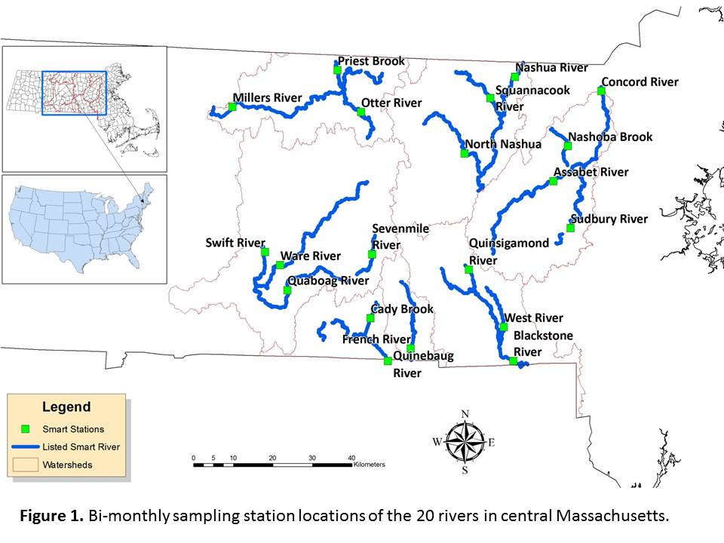
1999 to 2013

Slide 20
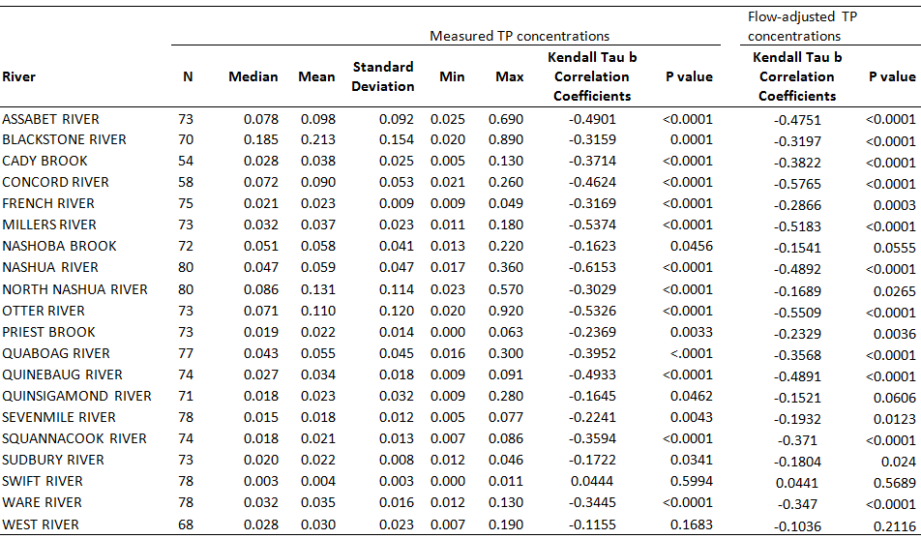
20-River Summary statistics and trend analysis (1999-2013):
Total Phosphorus concentrations and sampling years
Notes:
59% P removal from 0.045 mg/l to 0.019 mg/l

Slide 21
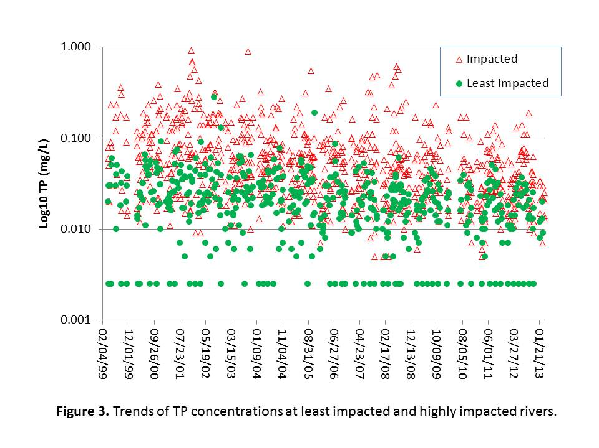

Slide 23
Declining Phosphorus Trends in Massachusetts Watersheds
62%
69%
68%
36%
78%
78%
42%

Slide 24
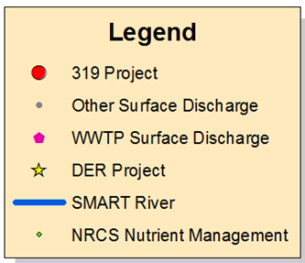
Protection/Restoration Activities
Notes:
What happened? The answer is: Environmental Protection!
Strategic Monitoring and Assessment for River basin Teams (SMART) program staff

Slide 25
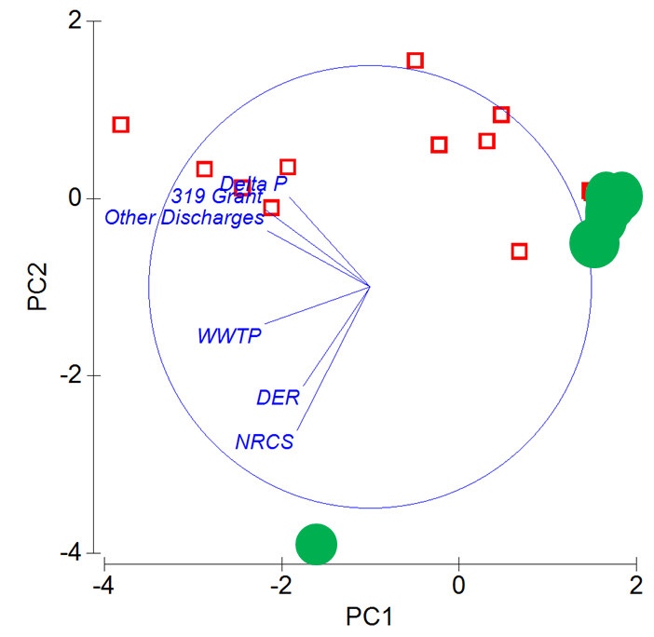
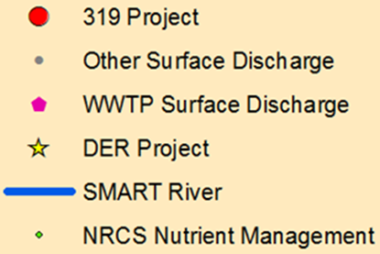
Highly impacted rivers
Least impacted rivers
Principal Components (PC) 1 and 2 explain 54.9% and 18.8% of the variation, respectively.

Slide 27
MA Water Quality Challenges
Nutrient enrichment (Eutrophication)
Climate Change
PFAS (Per- and Polyfluoroalkyl Substances)
Plastics in water
Road Salt

Slide 28
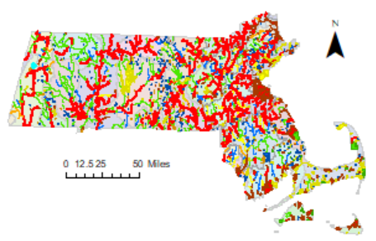
Freshwaters: Nutrient enrichment (mainly Phosphorus) directly or indirectly linked to approximately 48% of water quality impairments
Notes:
It is one of the 73 causes that a waterbody can be added to the 303d impaired waterbody list.

Slide 29
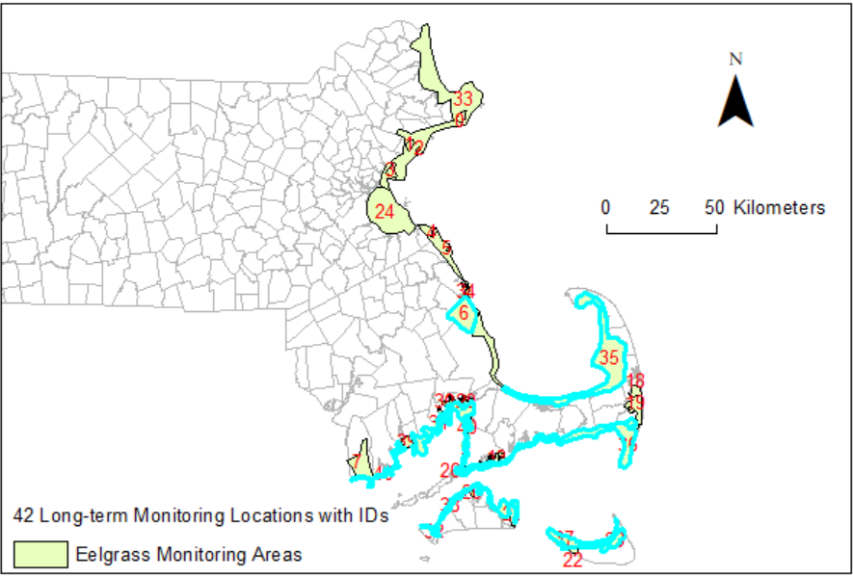
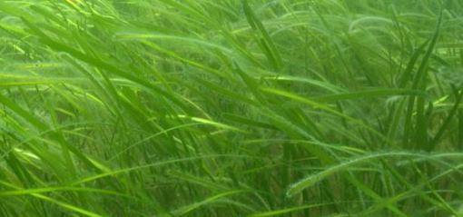
Coastal Waters
Notes:
Coastal Waters: I don’t have direct water quality data to share with you, but eelgrass is the best ecological coastal water quality index:
Eelgrass continues to decline: The acreage of 10 areas (out of 42 in total) declined significantly (Kendall’s Trend Analysis, P < 0.05) and the rate of eelgrass beds disappearance for these 10 areas was - 2.70 %/Year.
As a whole, 49.5% of eelgrass beds in coastal Massachusetts have gone which corresponding to a rate of decline of -2.35%/Year.
In the Cape, a lot of septic systems failed. Therefore, nitrogen loading could be a big problem.

Slide 30

Secchi (water clarity)
Shoreline isolation
Sediment TOC%
Sediment particle size class
Salinity
Depth
Total Nitrogen Loads
Naomi E. Detenbeck and Steven Rego 2015
Notes:
However, I don’t have any data to prove that the significant decline in the Southeast IS directly caused by Nitrogen Load. A Cornell University graduate student is working on what’s going on with eelgrass decline here in MA coastal area. Hope we can get a good answer from that.

Slide 31
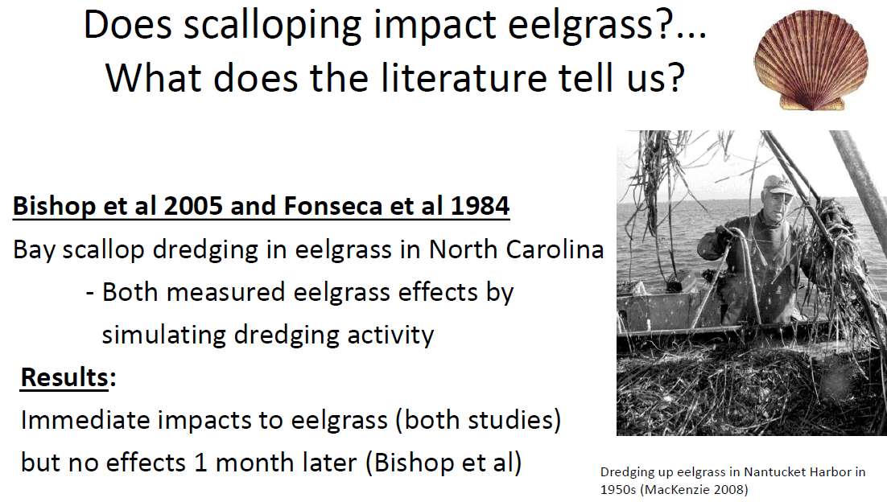
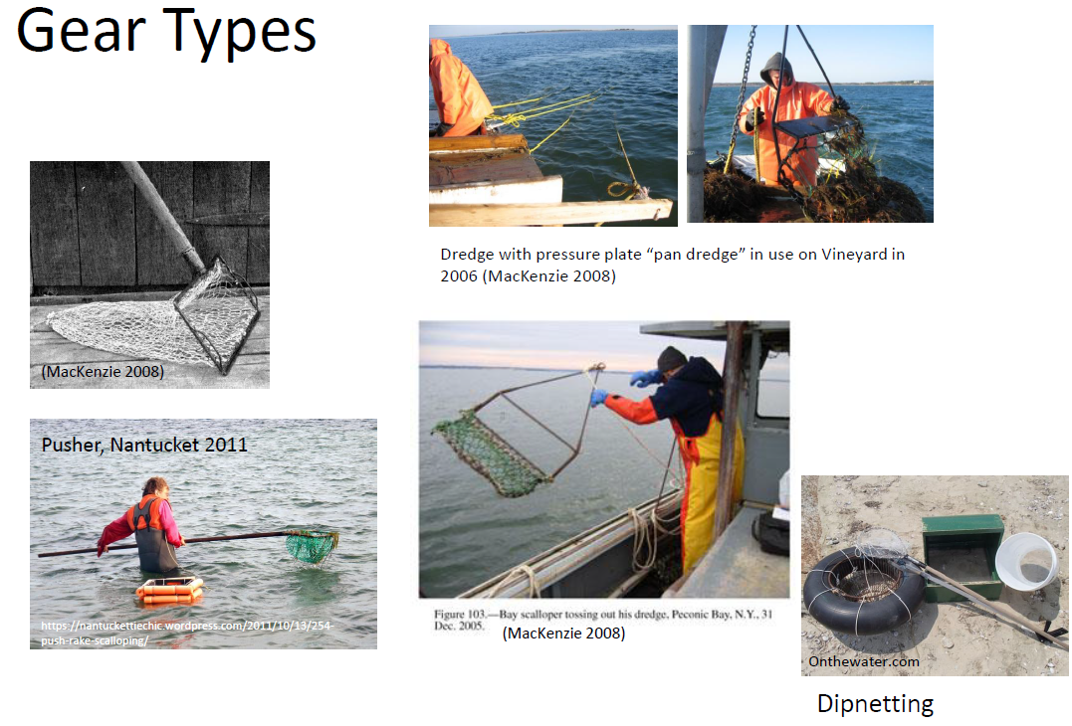
Fishing and Shellfishing Activities
Notes:
500-1000 scallop/clam dredging boats in the Southeast MA

Slide 32

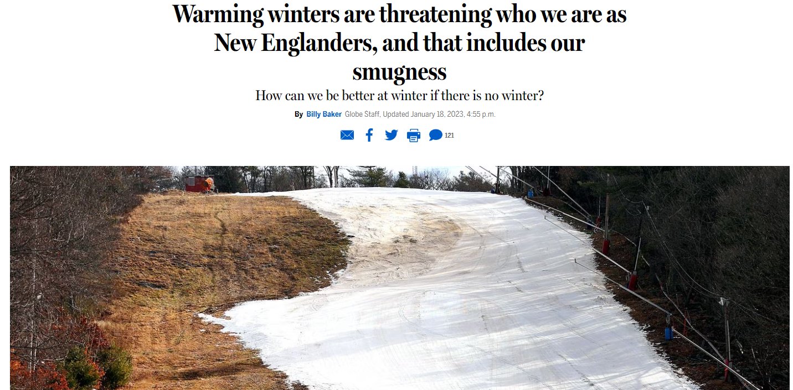
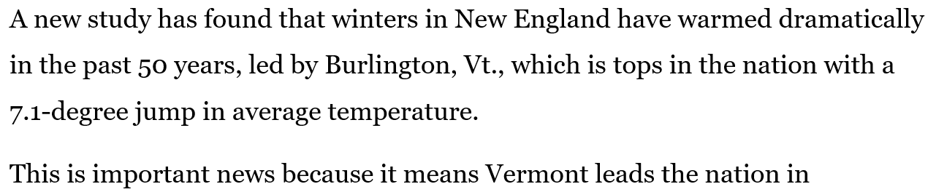
Notes:
Boston Globe, January 18, 2023. The goal from IPCC to Year 2100 is keep the warmer rate below 1.5oC, i.e., 2.7oF. It is now almost 3 times of that goal ALREADY!

Slide 33
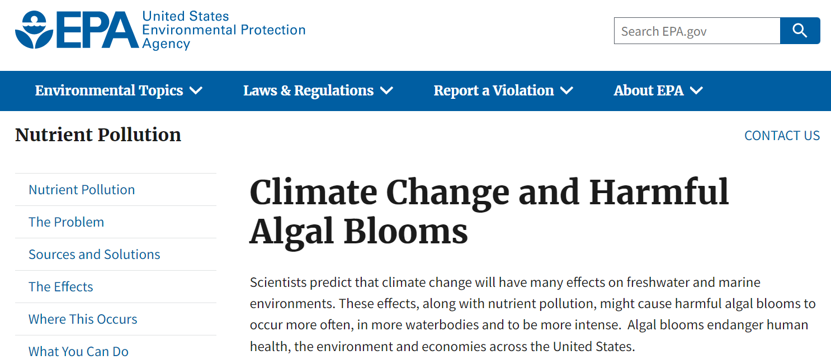
Toxic blue-green algae prefer warmer water.
Warmer temperatures prevent water from mixing, allowing algae to grow thicker and faster.
Algal blooms absorb sunlight, making water even warmer and promoting more blooms.

Slide 34
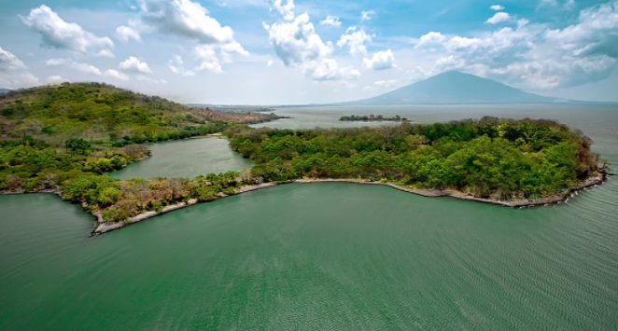
Climate Change
Fish Kill
Eutrophication
Algal Bloom
Nutrient Enrichment (P or/and N)
Hypoxia
cnntravel
Notes:
Air Temperatures: 0.25oC per decade/Ocean Surface Temperatures: 0.12oC per decade/Lake Surface Temperatures: 0.34oC per decade/ Hartmann et al. 2013; O’Reilly et al. 2015

Slide 35
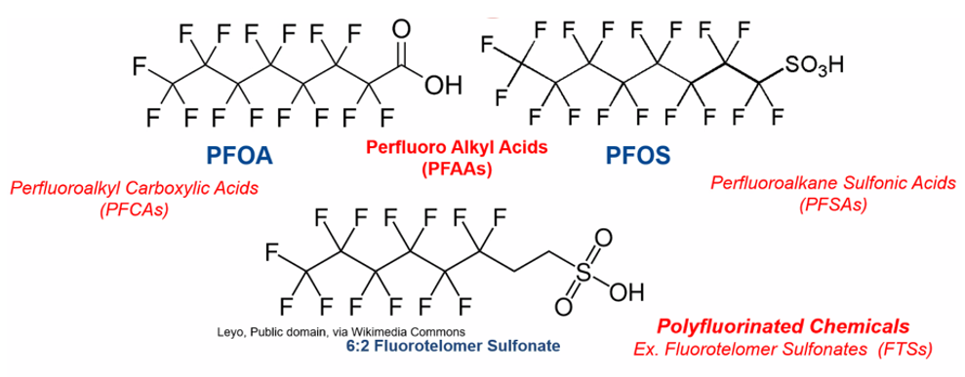
Per- and polyfluoroalkyl Substances (PFAS)
Jim Occhialini 2023
Notes:
Jim mentioned that somebody told him that there are about 12,000 PFAS chemicals in the world.

Slide 36
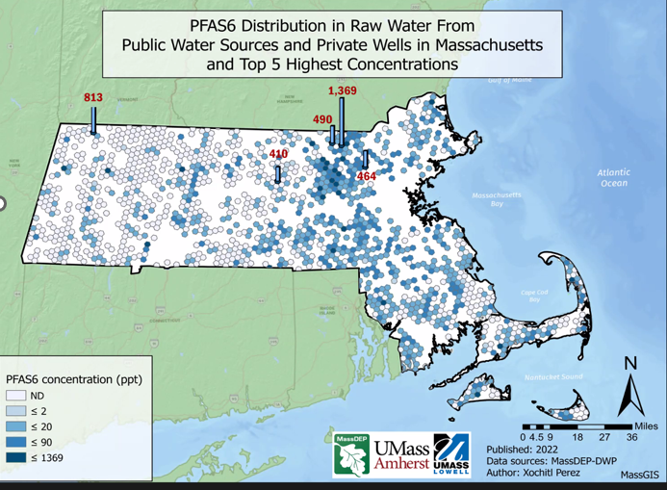

Slide 37
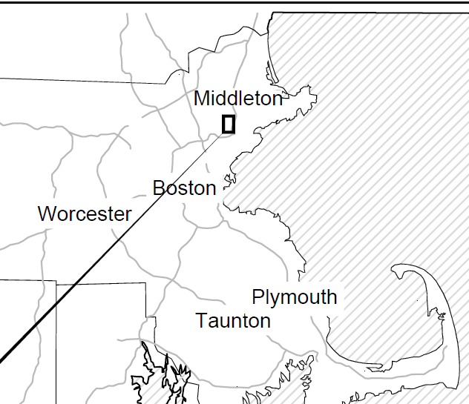
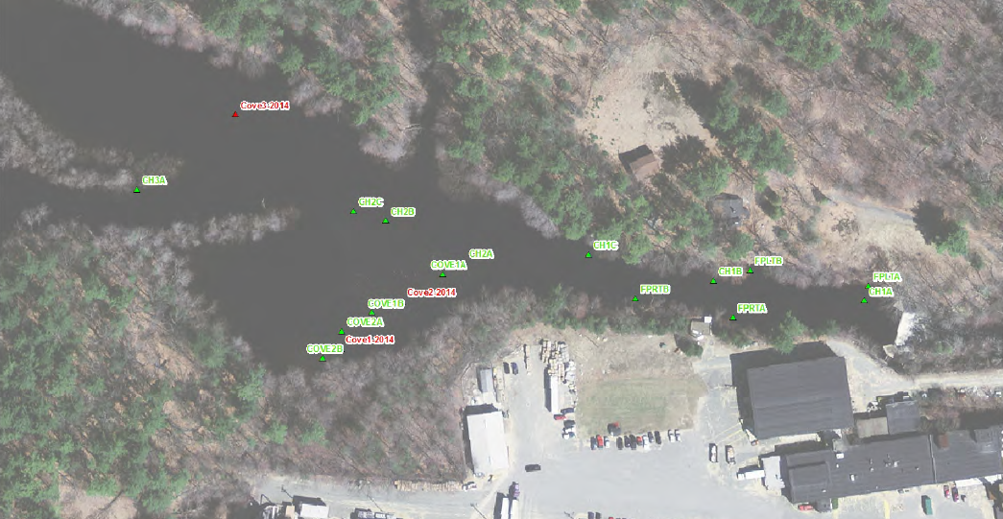
401 WQC: Dam Removal
South Middleton Dam

Slide 38
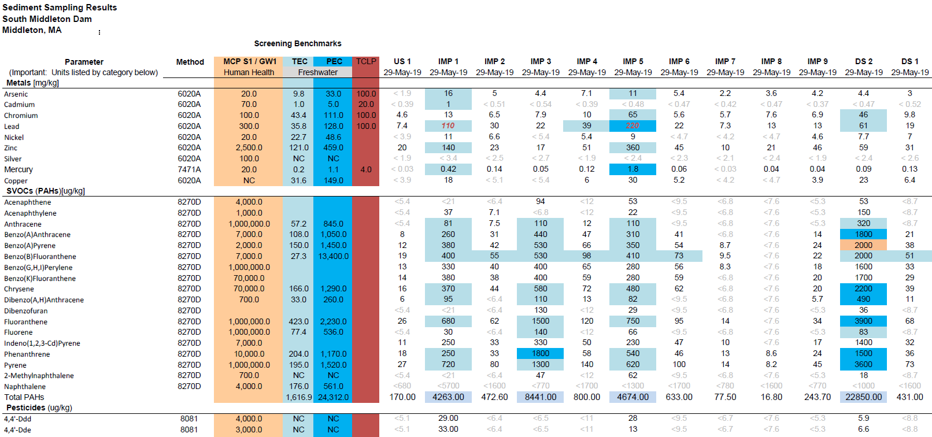
South Middleton Dam
2021: The Salem-Beverly Water Supply provided comments that potential PFAS may be generated by sediment released downstream

Slide 39
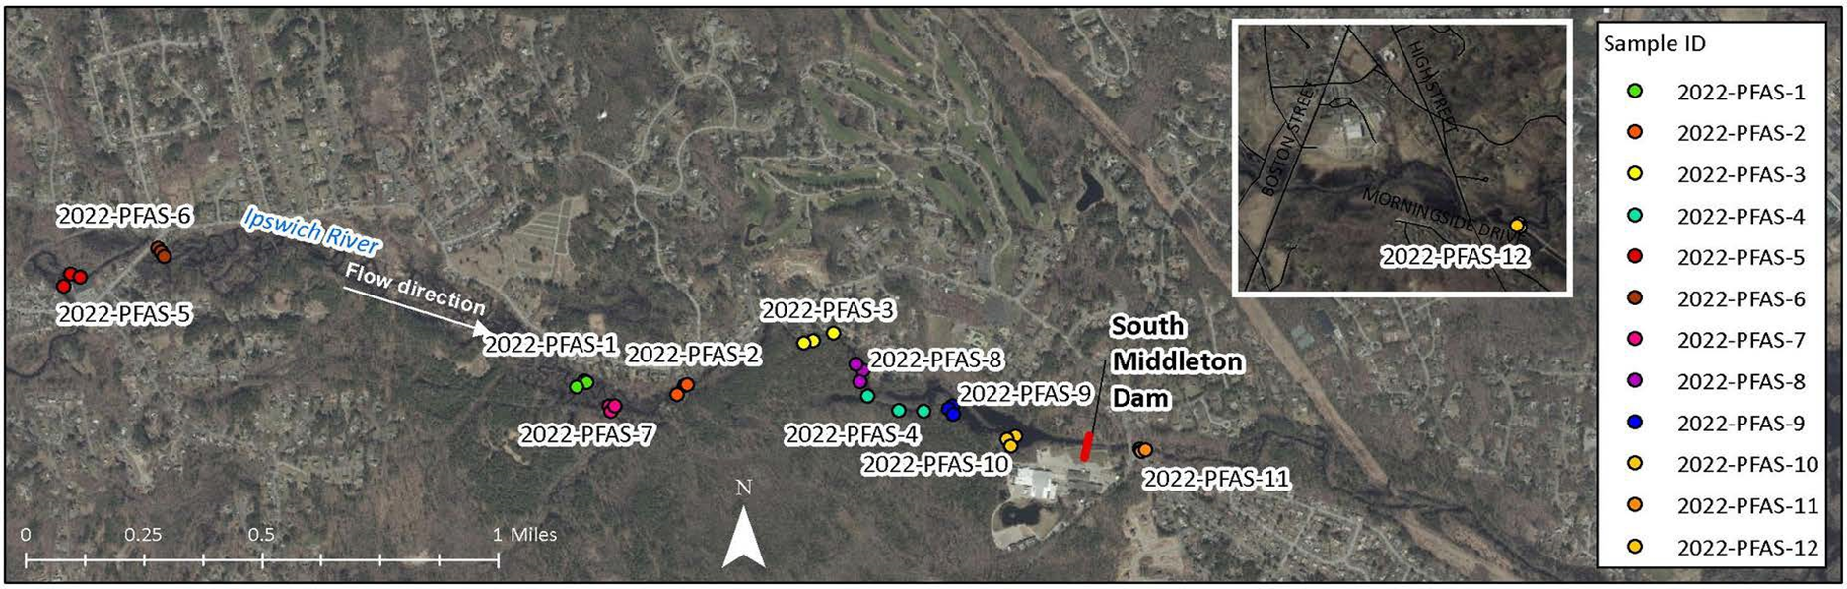
PFAS Sampling and Analysis
Units | Analyte |  | MA Contingency Plan Method 1 S-1/GW-1 standards
ug/kg (ppb) | PFHpA |  | 0.5
ug/kg (ppb) | PFOA |  | 0.72
ug/kg (ppb) | PFNA |  | 0.32
ug/kg (ppb) | PFDA |  | 0.3
ug/kg (ppb) | PFHxS |  | 0.3
ug/kg (ppb) | PFOS |  | 2
Notes:
MCP PFAS standards: December 27, 2019. On March 14, 2023, , the EPA announced a proposed MCLs for two of the most prevalent PFAS compounds, PFOS and PFOA. In addition, EPA is proposing to address four other PFAS (GenX, PFBS, PFNA, and PFHxS) as a single standards using a Hazard Index of 1 (risk assessment-related endpoint

Slide 41
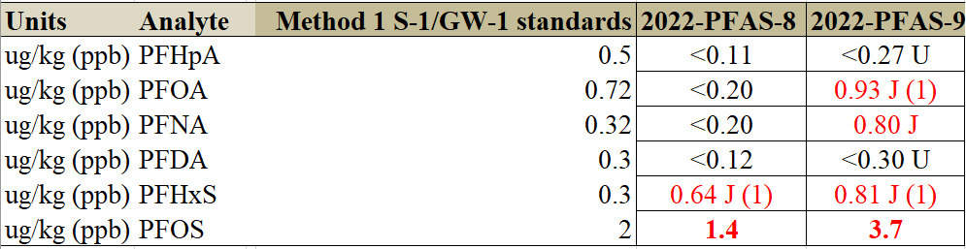

Slide 42
Plastics in Marine and
Freshwaters

Slide 43
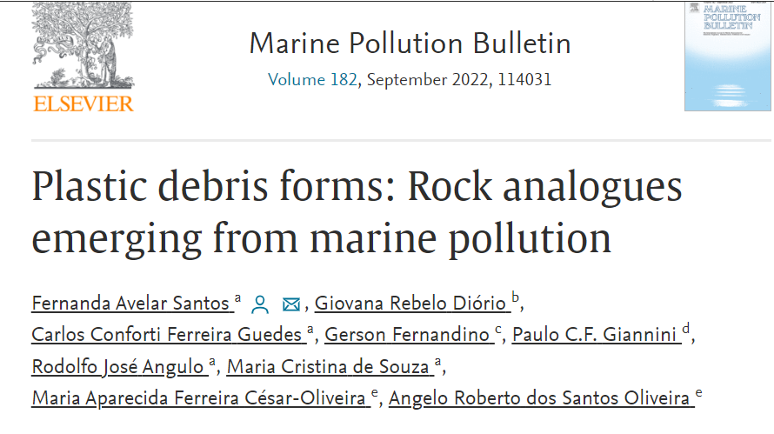
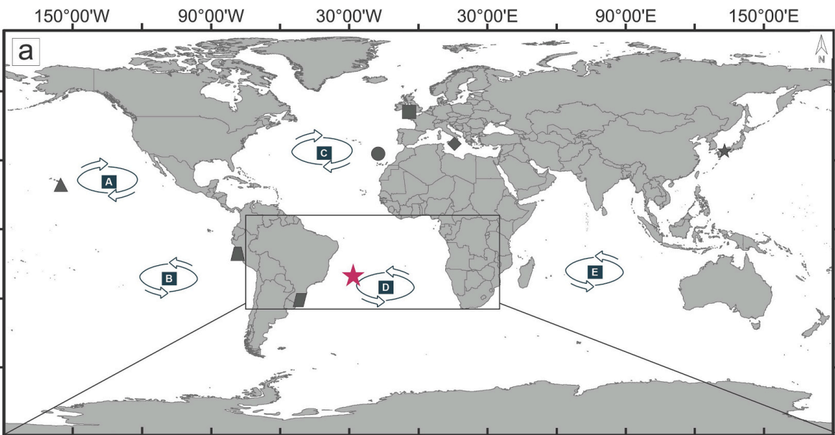
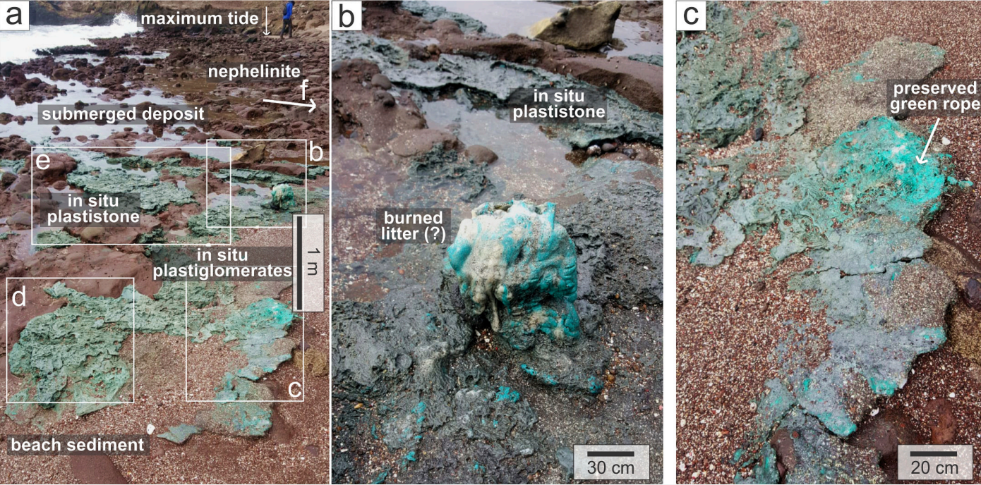
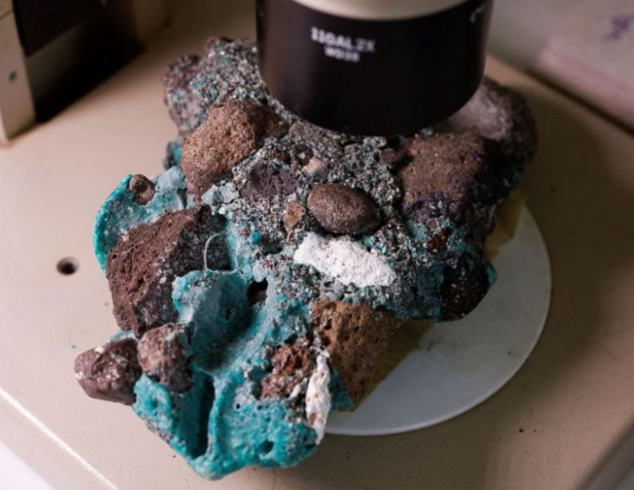
Plastistone
a novel plastic debris form
Notes:
Over 600 mile offshore of Brazil: major component is fish net.

Slide 44
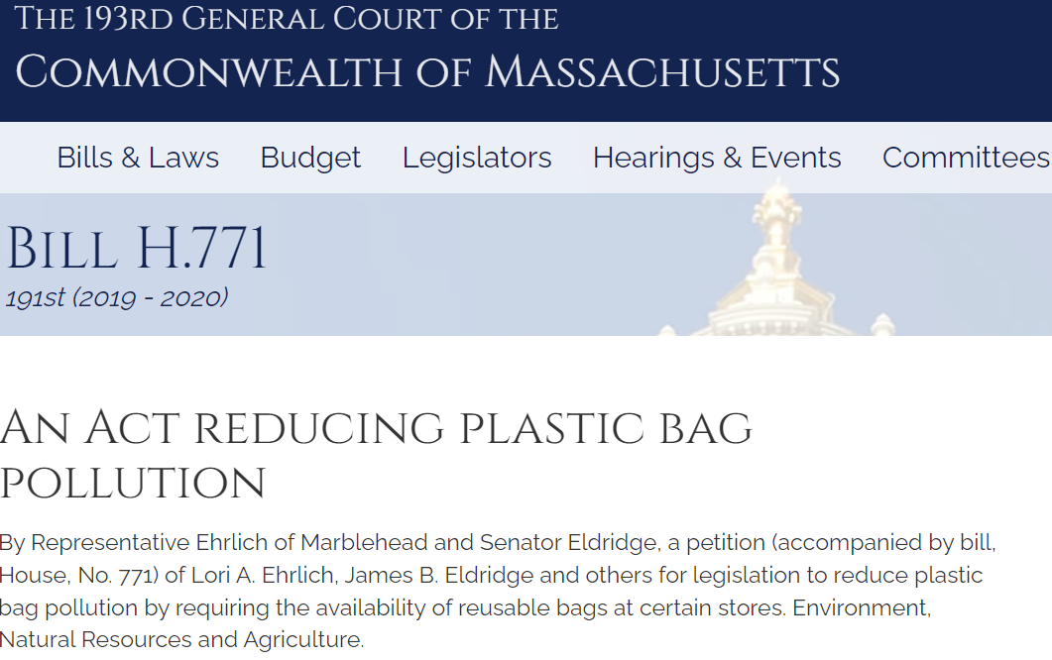
Microplastics
Notes:
One of the challenges is how to quantify microplastics in water, set up water quality standards for microplastics. I.e., there is no criteria/standard for plastics yet.

Slide 45
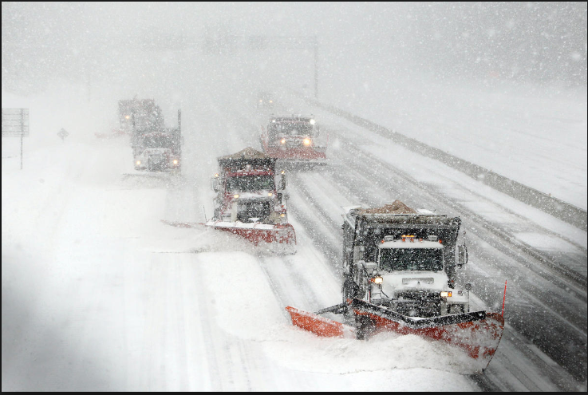
Road Salt
2003
2005
2009
2001
2004
2008
2010
2006
2007
2002
The Boston Globe 2015
(modified from MassDOT 2012)
Notes:
Storm JUNO: 35, 000 tons of salt in Boston (1/28/2015)
WSI: an indicator based on four weather-related factors including Minimum Daily Temperature, Maximum Daily Temperature, Snowfall, and the number of days with frost potential (i.e., minimum daily temperature below 32oF). Snowfall amounts are weighed more heavily than other weather factors and account for 35% of the WSI value.
Sodium (Na+): sodium in drinking water is a concern for individuals restricted to low-sodium diets due to high blood pressure. EPA Drinking Water Advisory: 20 mg/L for low sodium diet

Slide 46
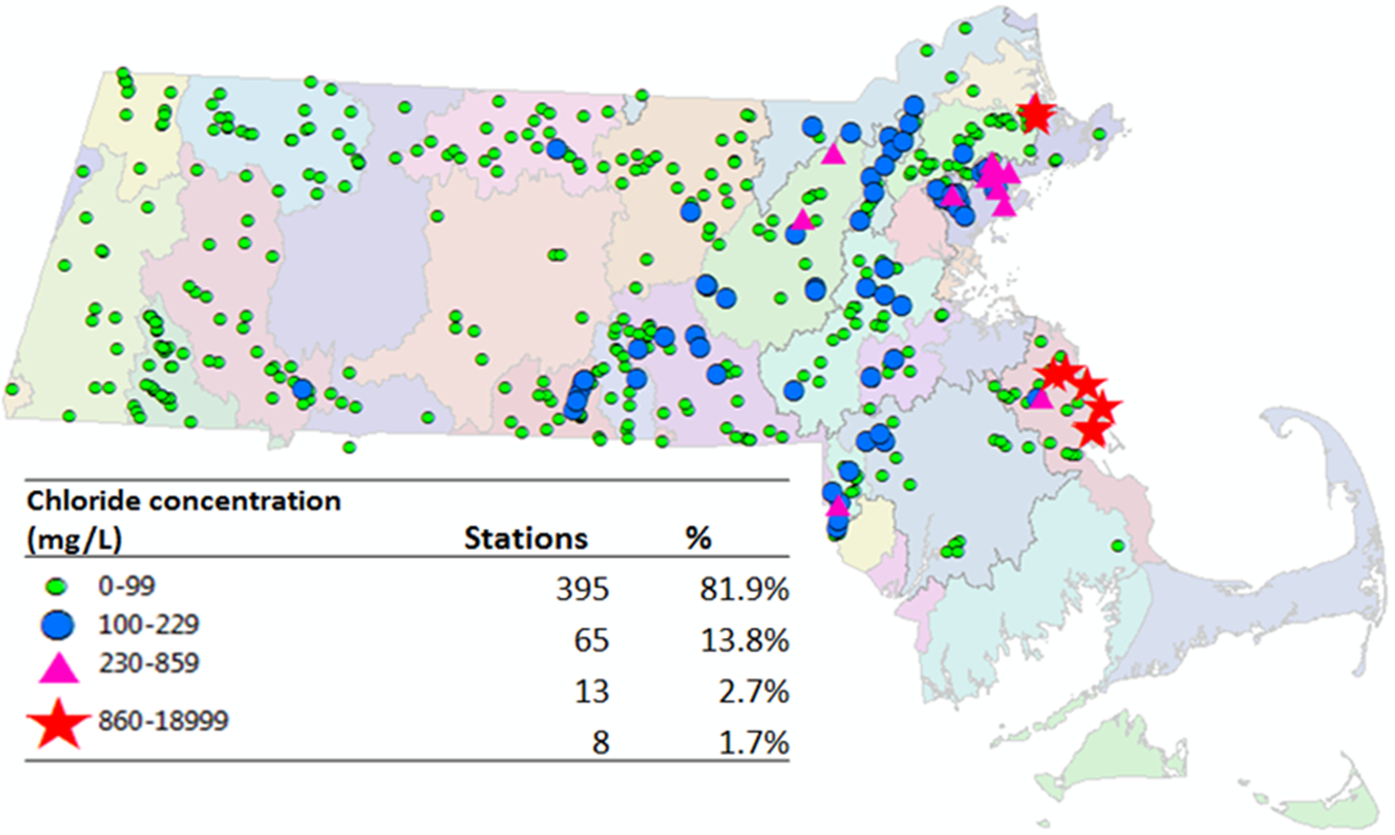
Chloride levels in MA surface waters
Wong et al. 2017
Notes:
toxic to aquatic life and impacts vegetation and wildlife. There is no natural process by which chlorides are broken down, metabolized, taken up, or removed from the environment

Slide 47
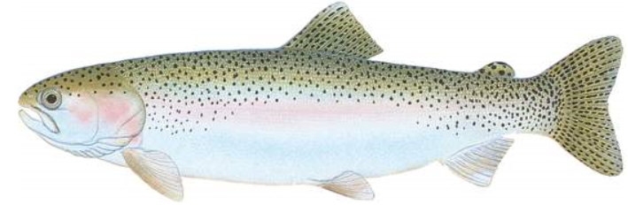
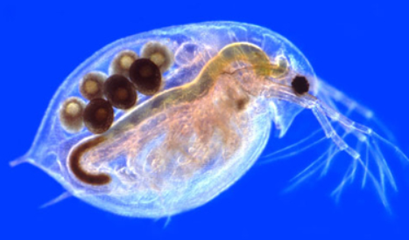
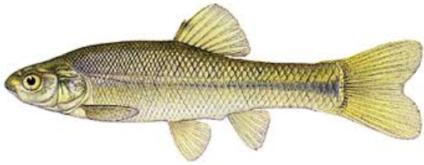

EPA Chloride Criteria
Aquatic Life: The acute (1-hour average) standard is 860 mg/L; the chronic (four-day average) standard is 230 mg/l: These criteria should not be exceeded more than once every three years
David Wong and http://www.lake-link.com/fish/id.cfm/25/

Slide 48





River Meadow Brook
Site 4: Forest 32%
4
3
Site 3: Forest 36%
Increasing urbanization
2
Site 2: Forest 54%
1
Site 1: Forest 67%
Notes:
Experimental Hypothesis: Road salt applications significantly affect the concentrations of chloride in River Meadow Brook

Slide 49

Chloride Concentrations in River Meadow Brook
Notes:
The Winter Peak is the runoff directly to the stream during or just after a snow event. Why the high concentration is from late July to Early Nov? It is because road soil can stay in the soil for decades. Late July to Early Nov, it is usually the dry period of time in Massachusetts. Water level in the stream is low, you still have the legacy salt in the soil entering to the system.

Slide 50
Average Chloride Concentrations in River Meadow Brook
River Meadow Brook
Notes:
The higher % the natural area, the lower the concentration of chloride. Therefore, likely MassPike contribute partial of the chloride problem here.

Slide 51

MassDEP Snow Disposal Guidance
Notes:
This guide will help communities and businesses dispose of plowed snow without harming the environment.
Finding a place to dispose of collected snow poses a challenge to municipalities and businesses as they clear roads, parking lots, bridges, and sidewalks. Public safety is of the utmost importance. However, care must be taken to ensure that collected snow, which may be contaminated with road salt, sand, litter, and automotive pollutants such as oil, is disposed of in a manner that will minimize threats to nearby sensitive resource areas.
In order to avoid potential contamination to wetlands, water supplies, and waterbodies, MassDEP recommends that municipalities and businesses identify and map appropriate upland snow disposal locations. To assist municipalities and businesses in this planning effort, and to avoid use of snow disposal at sites which compromise wetlands resources or public water supplies, MassDEP has developed this snow disposal mapping tool:

Slide 52


Questions?
david.w.wong@mass.gov
Thanks to Warren Kimball, Therese Beaudoin

